Slide 1
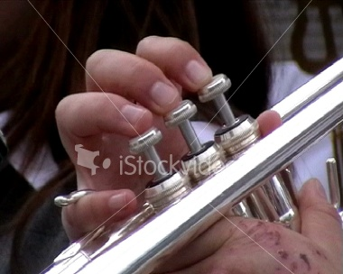
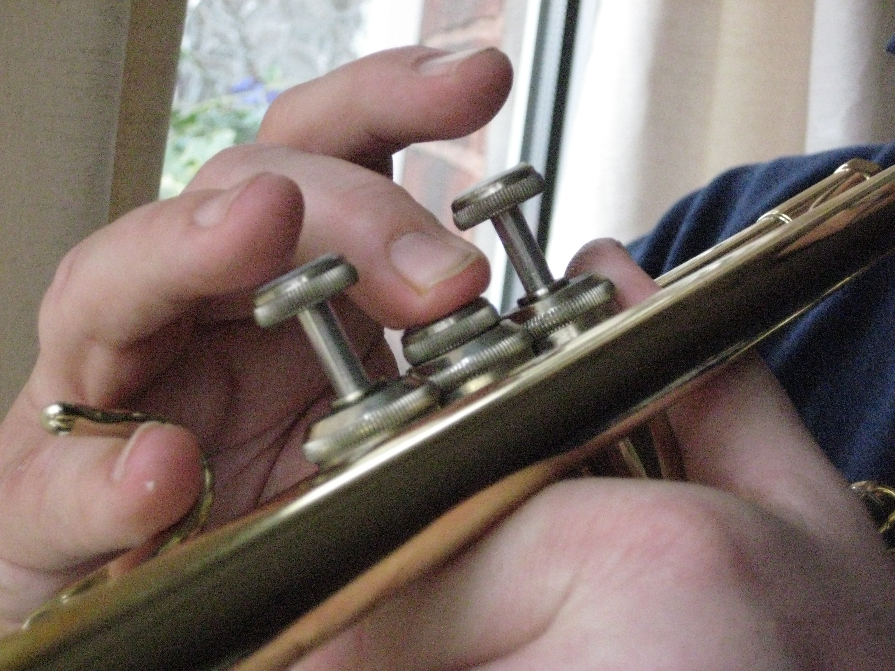
Middle It
In This piece we use 2 notes.
One is played open the other uses the 2nd (or middle) valve
open
2

Slide 2
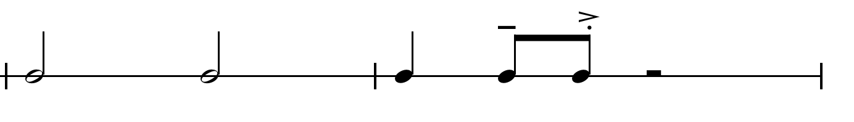
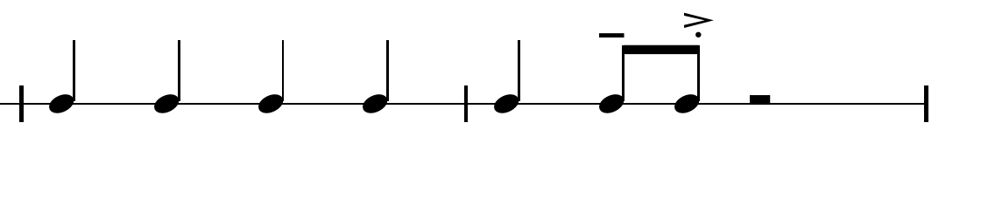
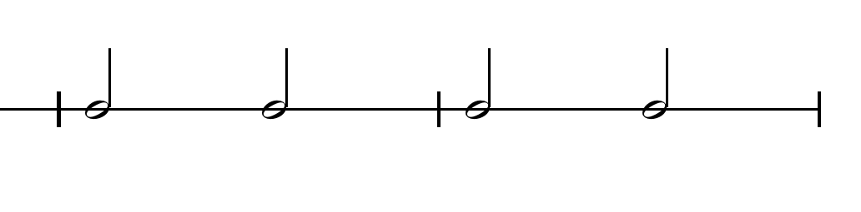

lets learn the RHYTHM there are 3 patterns

Slide 3

for animated version of previous slide click here

Slide 4
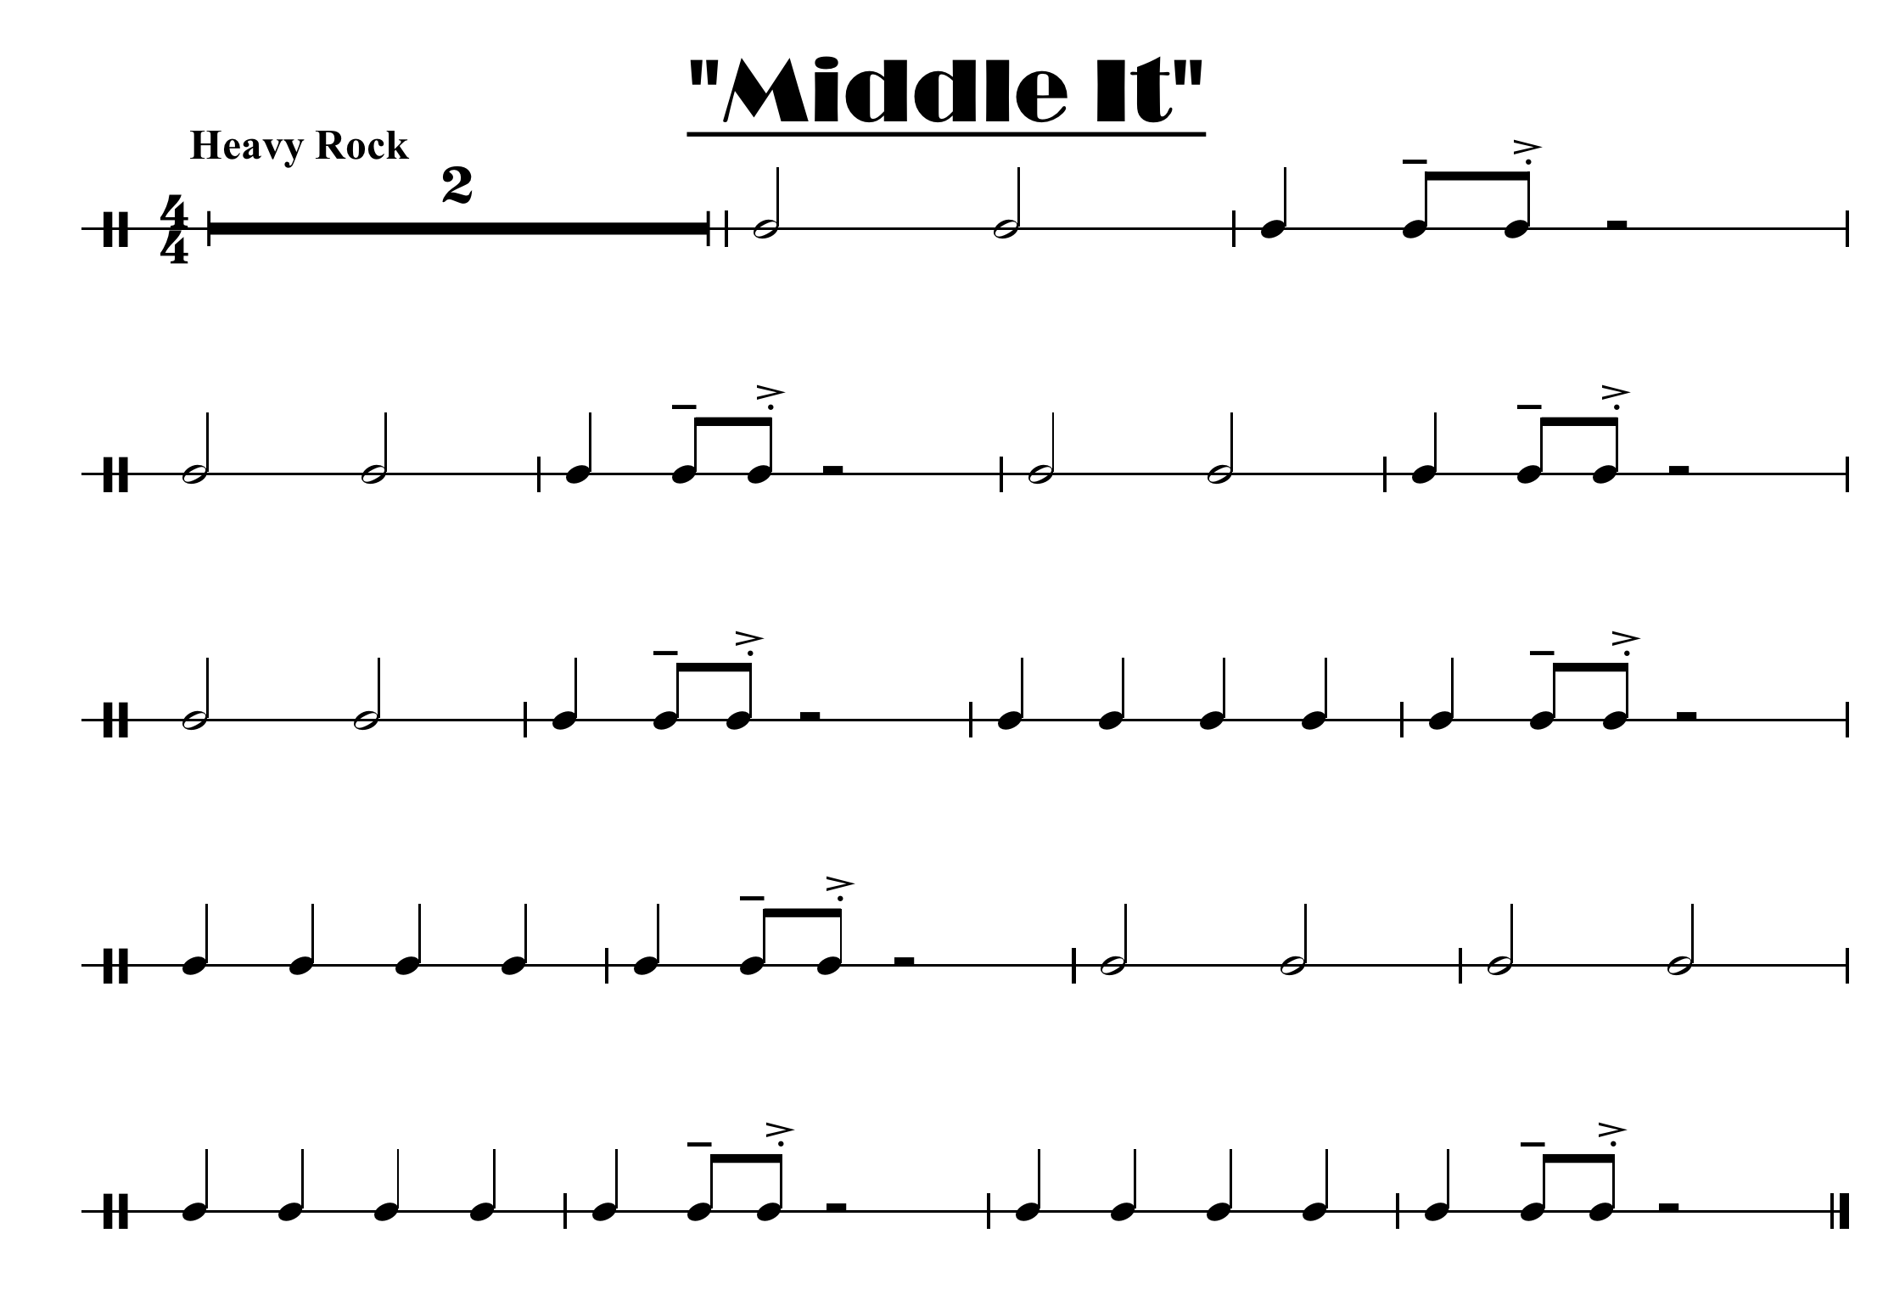
here is just the rhythm of the whole piece

Slide 5
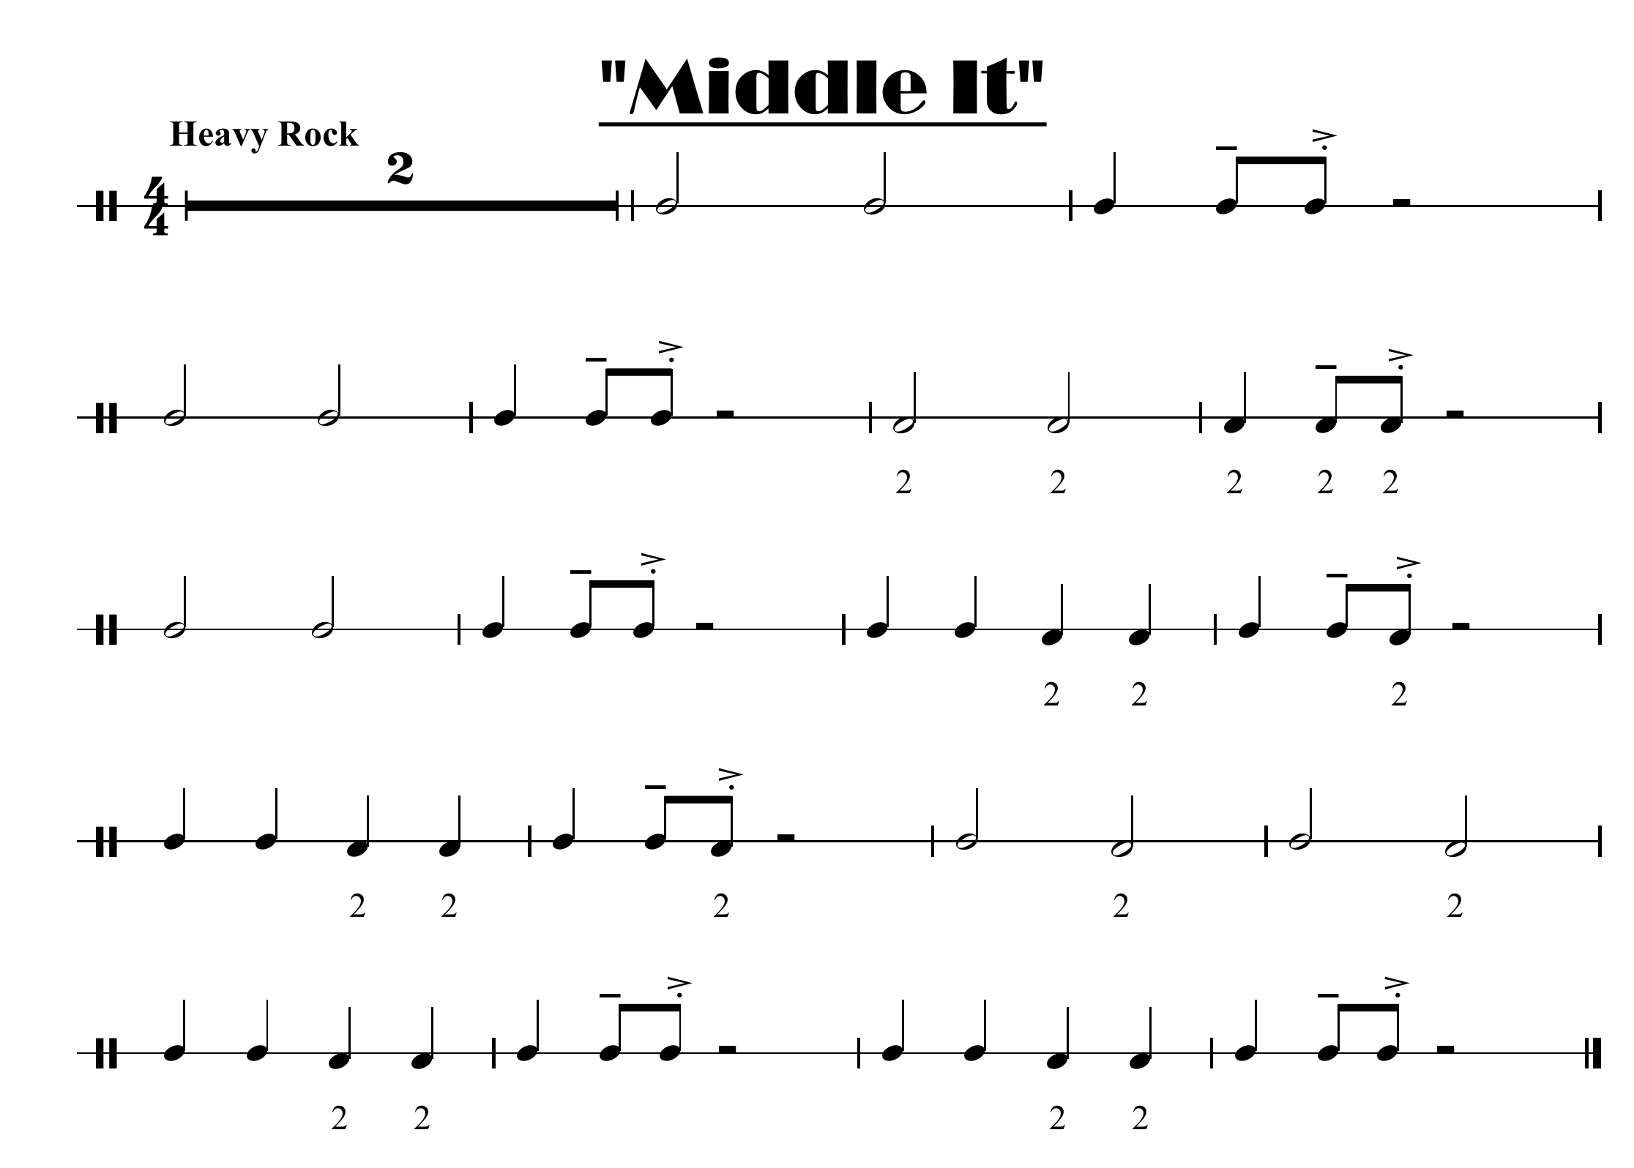
here is the same music with a 2 under where the middle valve goes down

Slide 6
