Slide 1
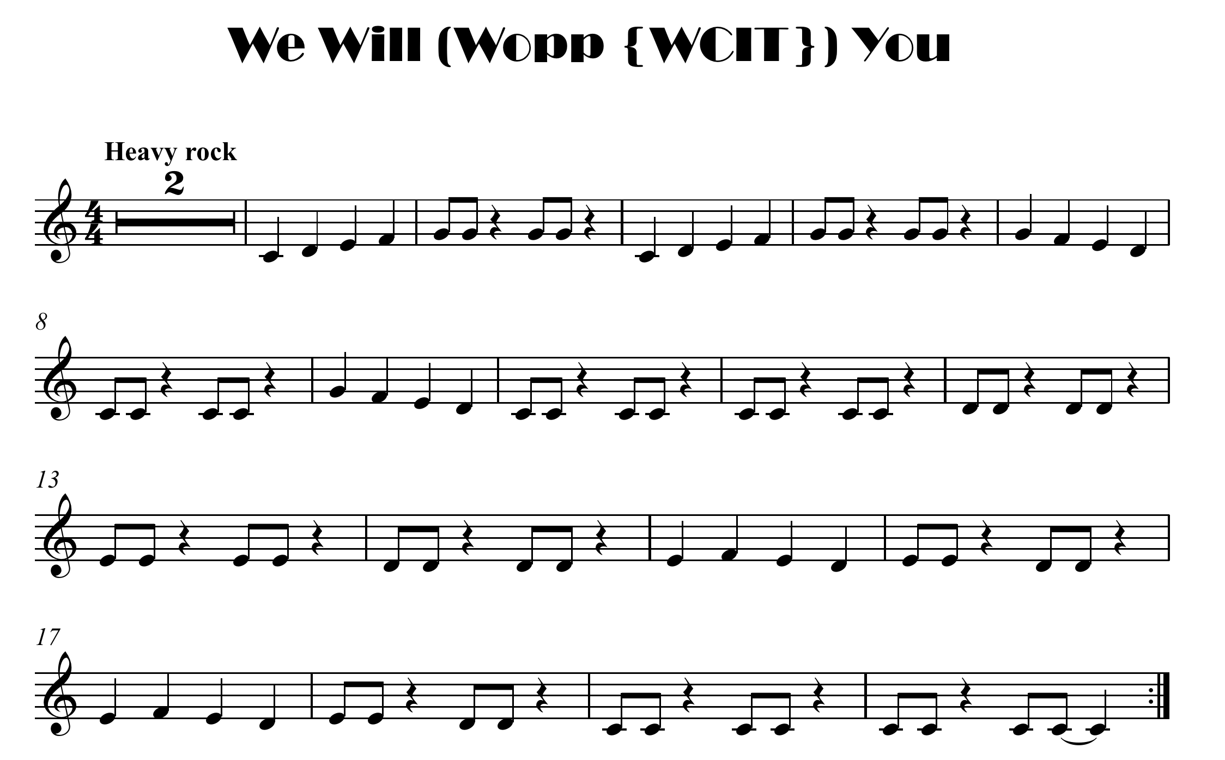


click here for note names

Slide 2
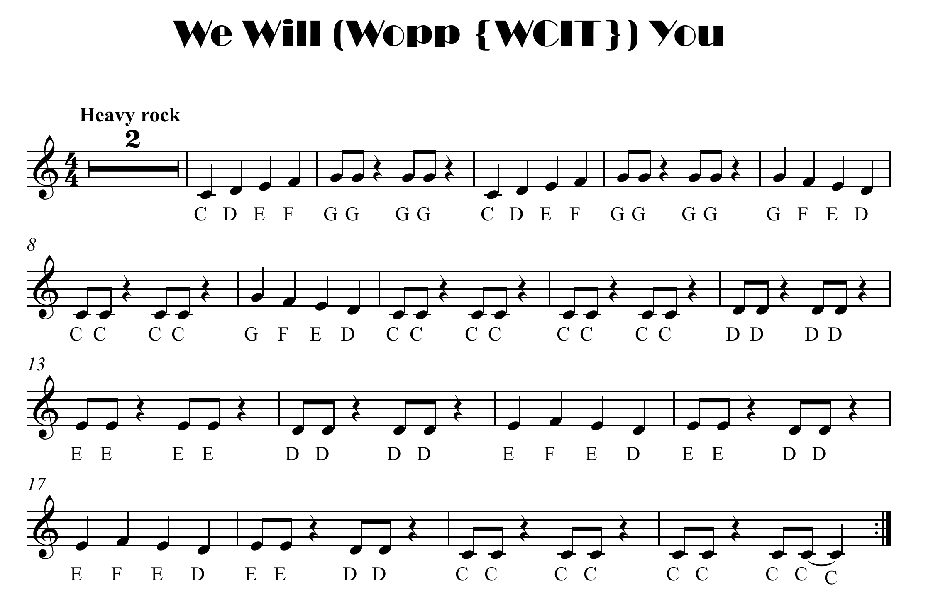

Slide 3

click here for note names

Slide 5
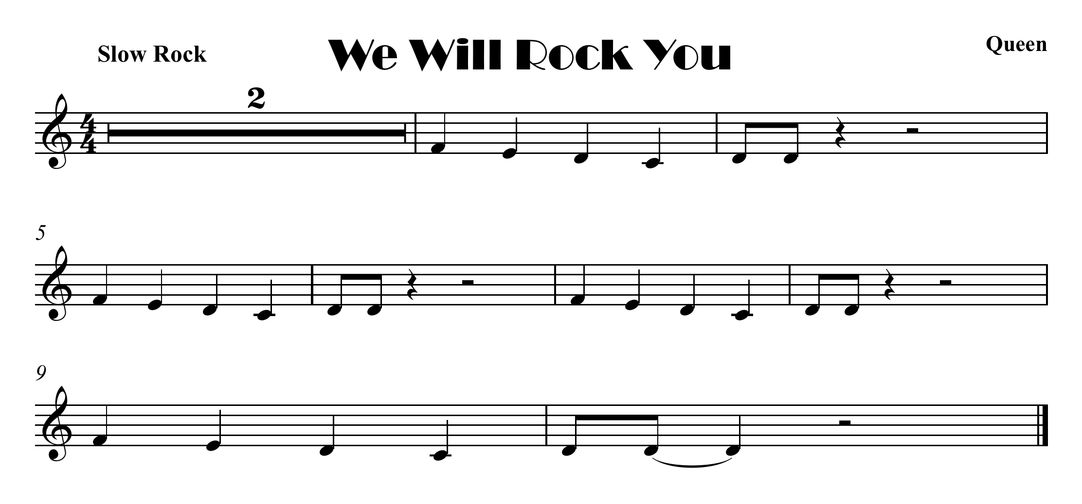
click here for note names

Slide 6
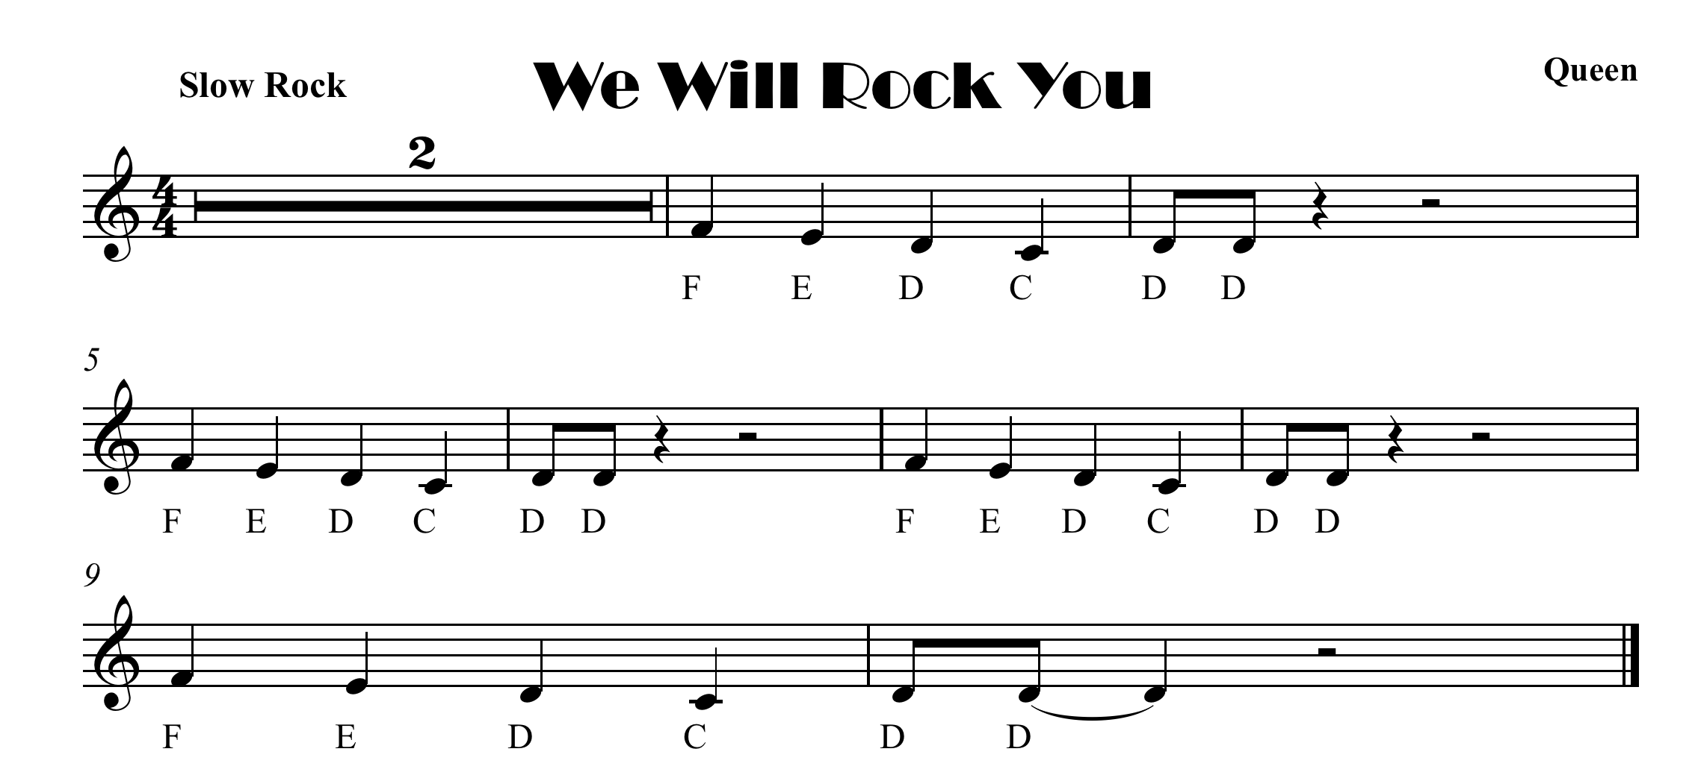

Slide 7
click here for note names

