Slide 1
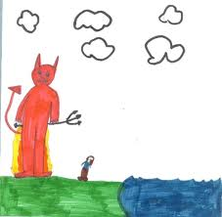
Between The Devil and The Deep Blue C

Slide 2
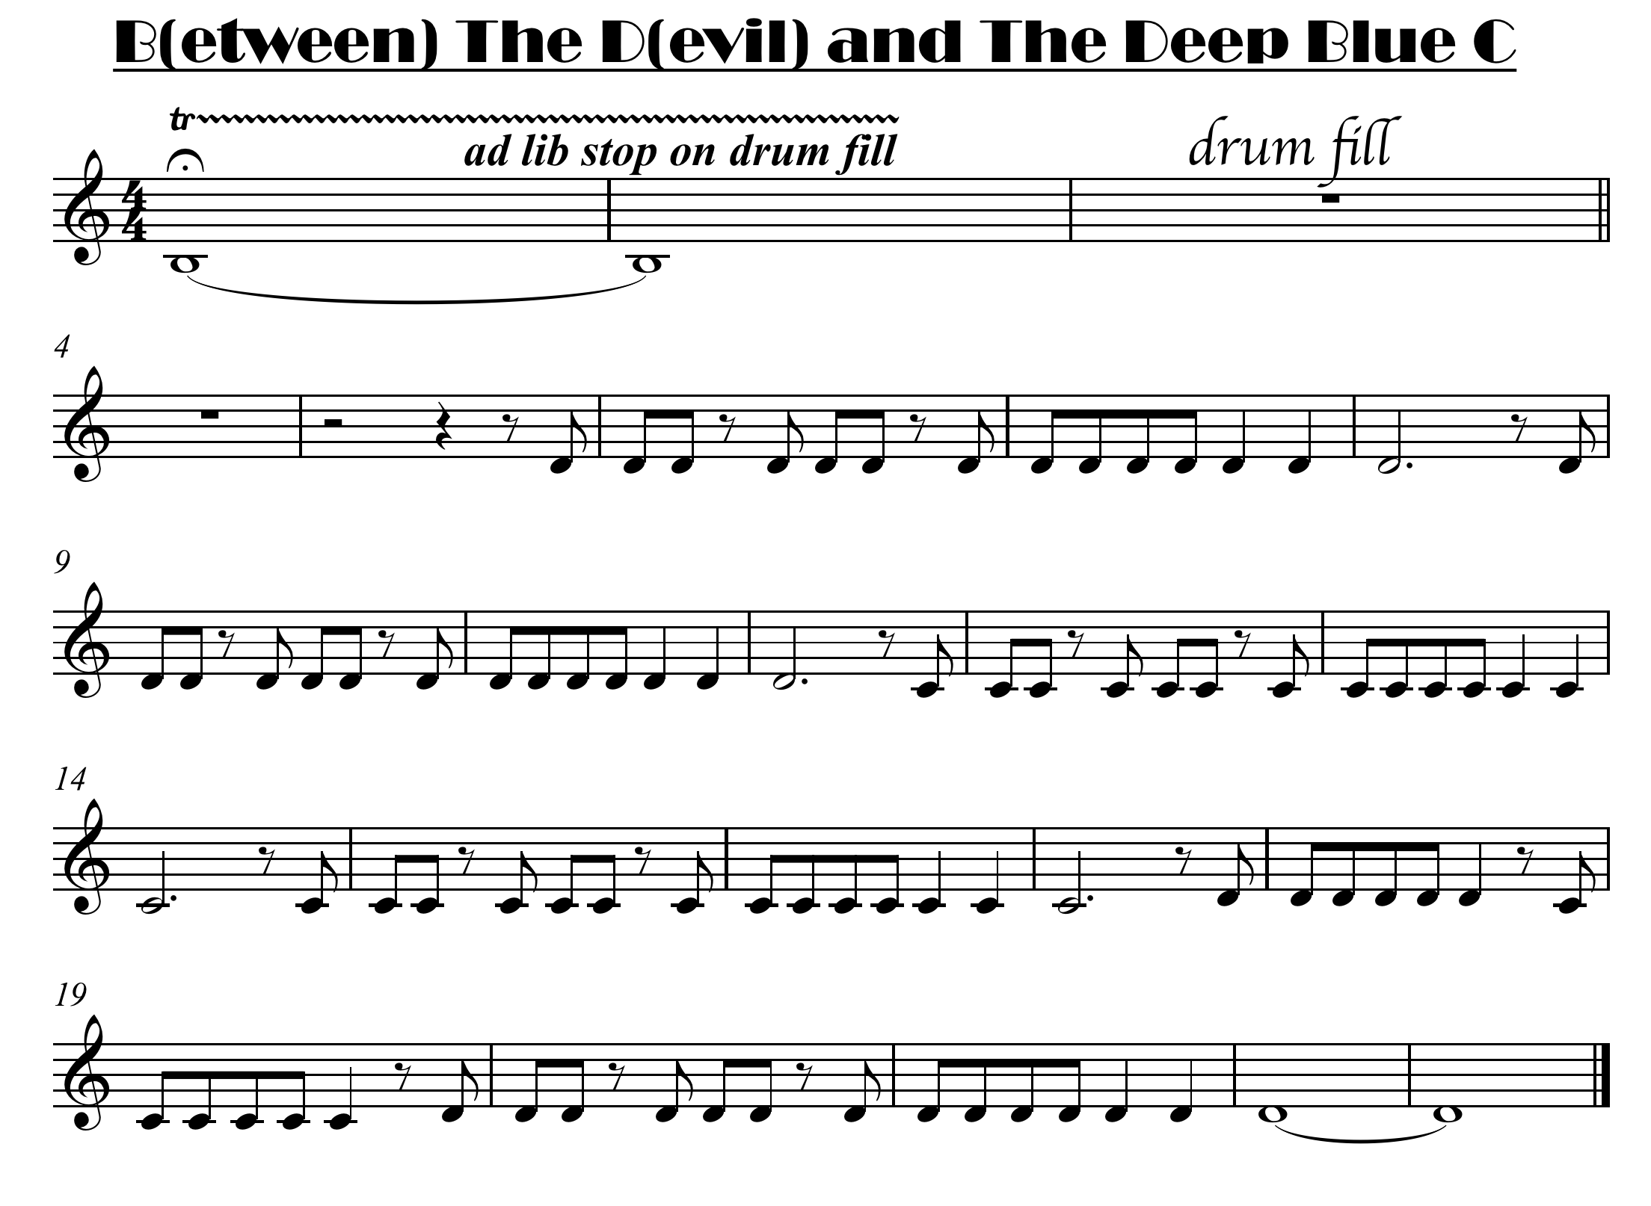


click for note names

Slide 3
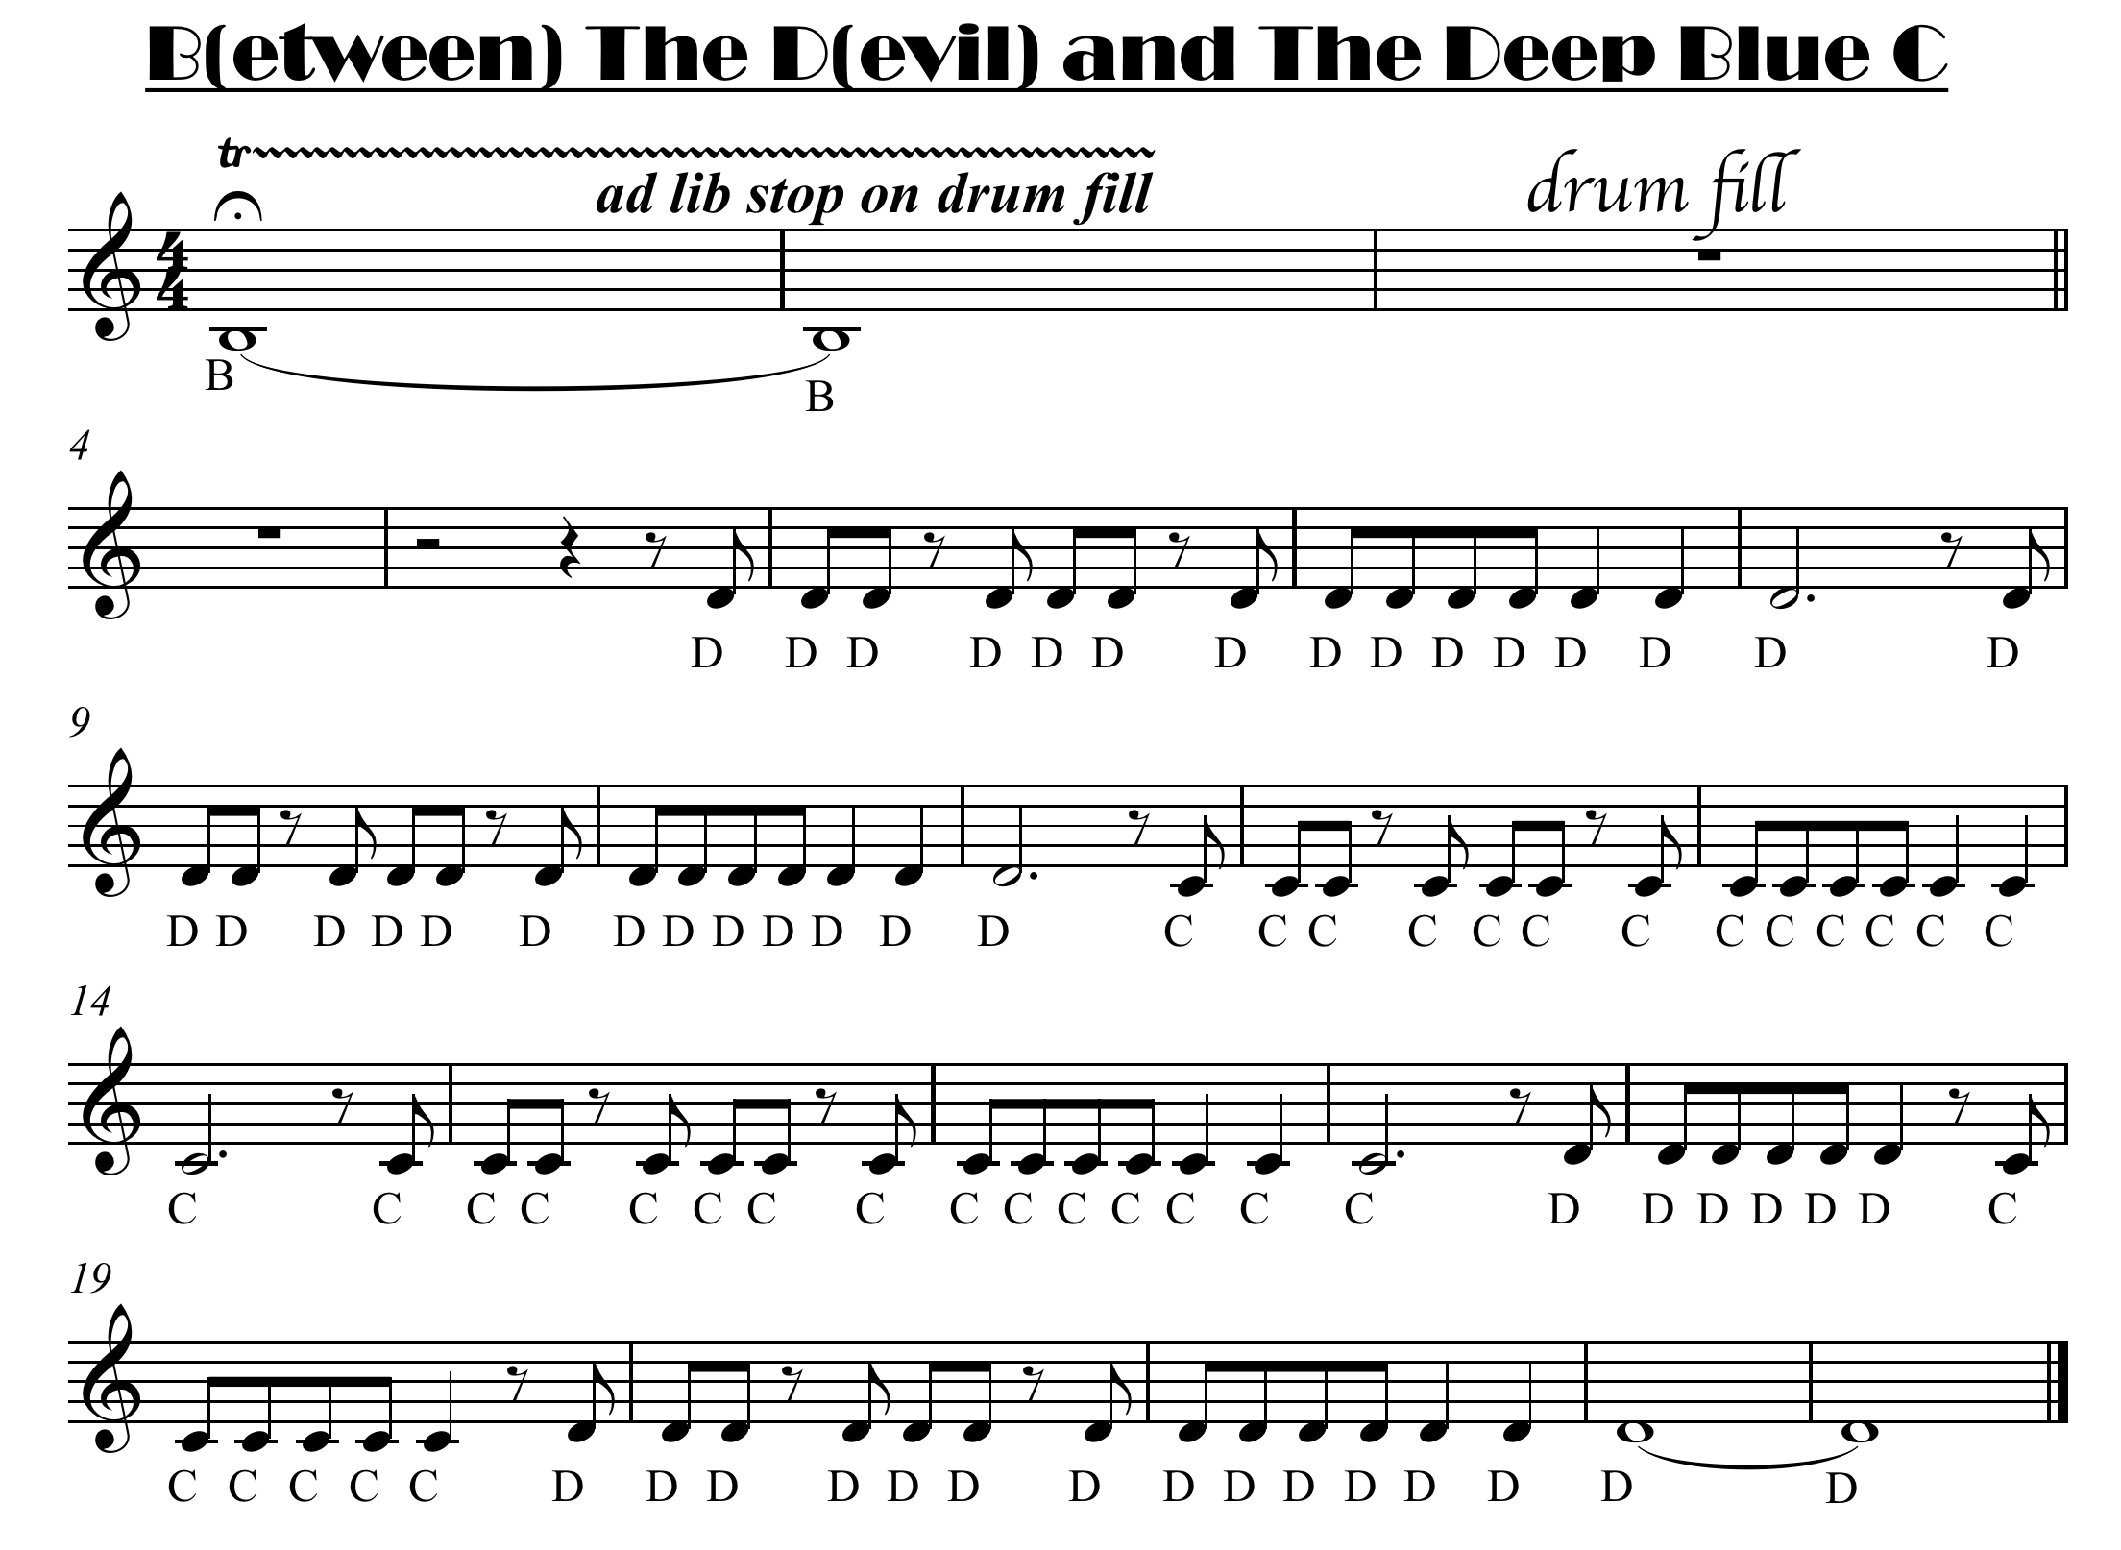

Slide 4

click for note names

