Slide 1
Susato and his book of Dances published in 1551 was the first ever book of music for people to play

Slide 2
The type of event and the players past and present

Slide 3
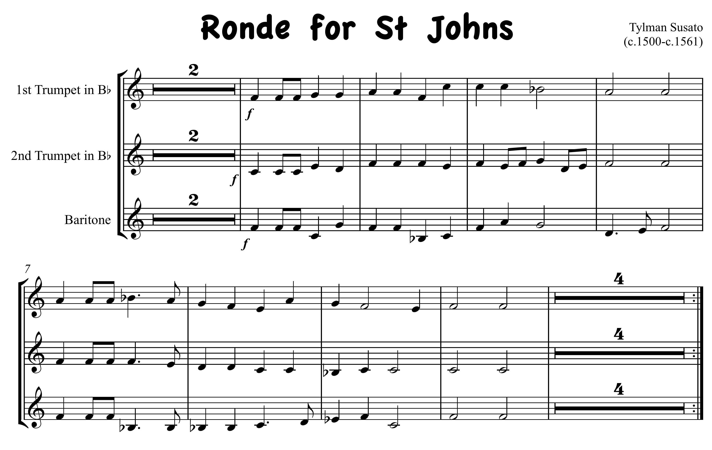


Slide 4
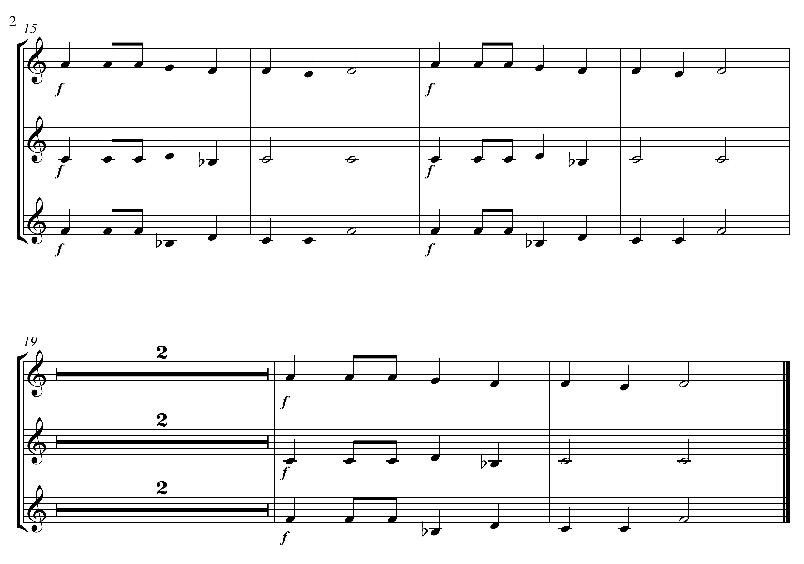

Slide 5
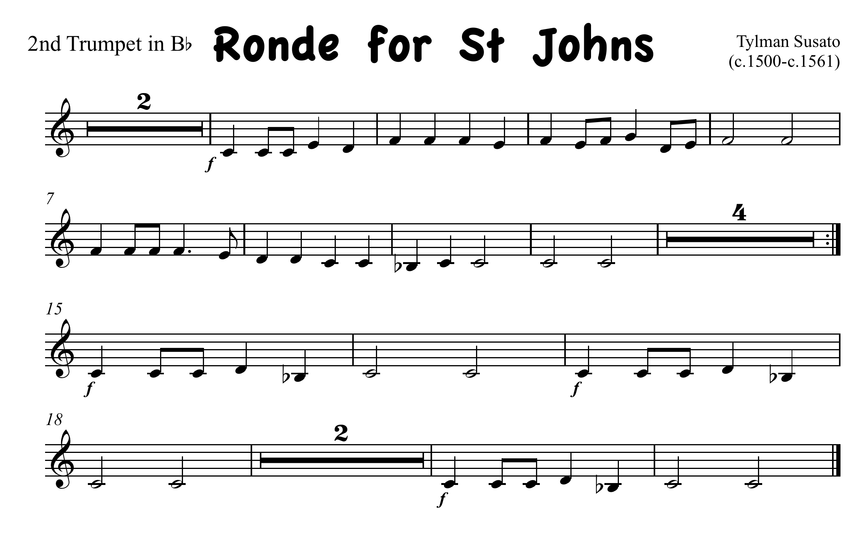
click here for note names

Slide 6
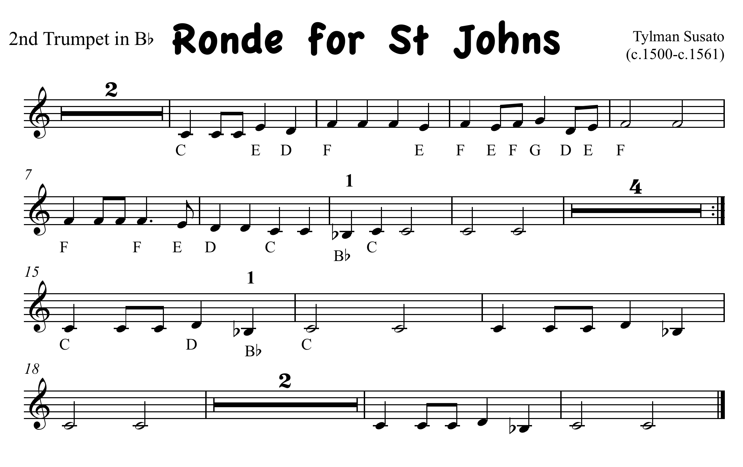

Slide 7
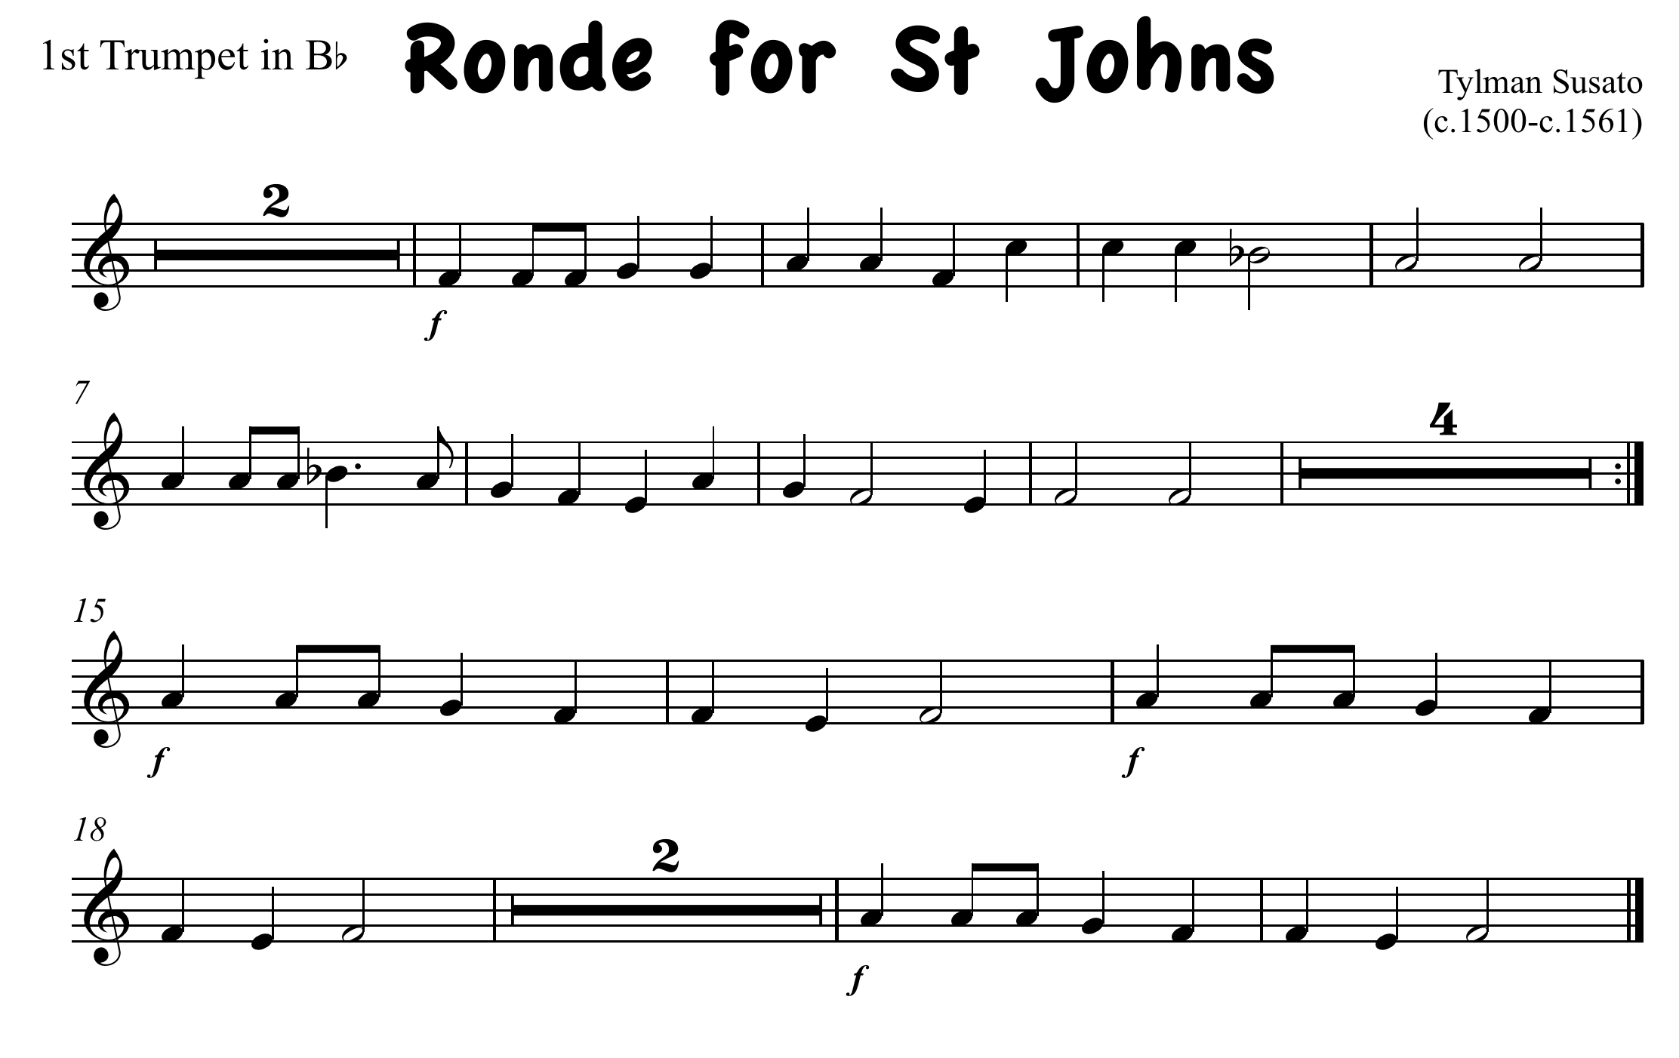
click here for note names

Slide 8
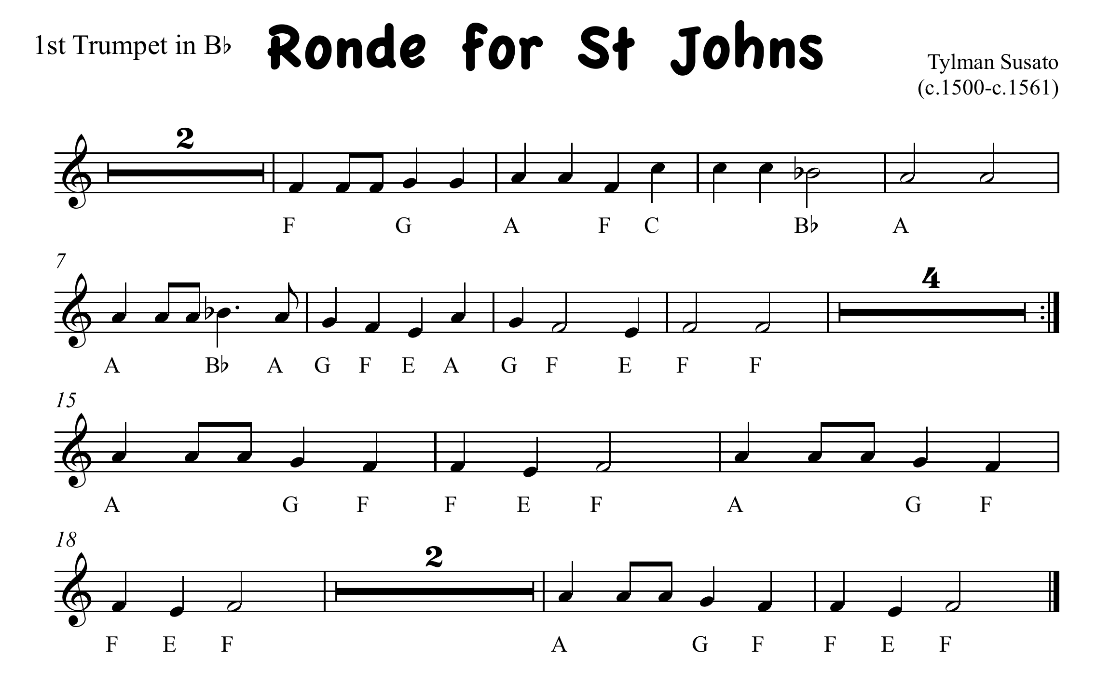

Slide 9
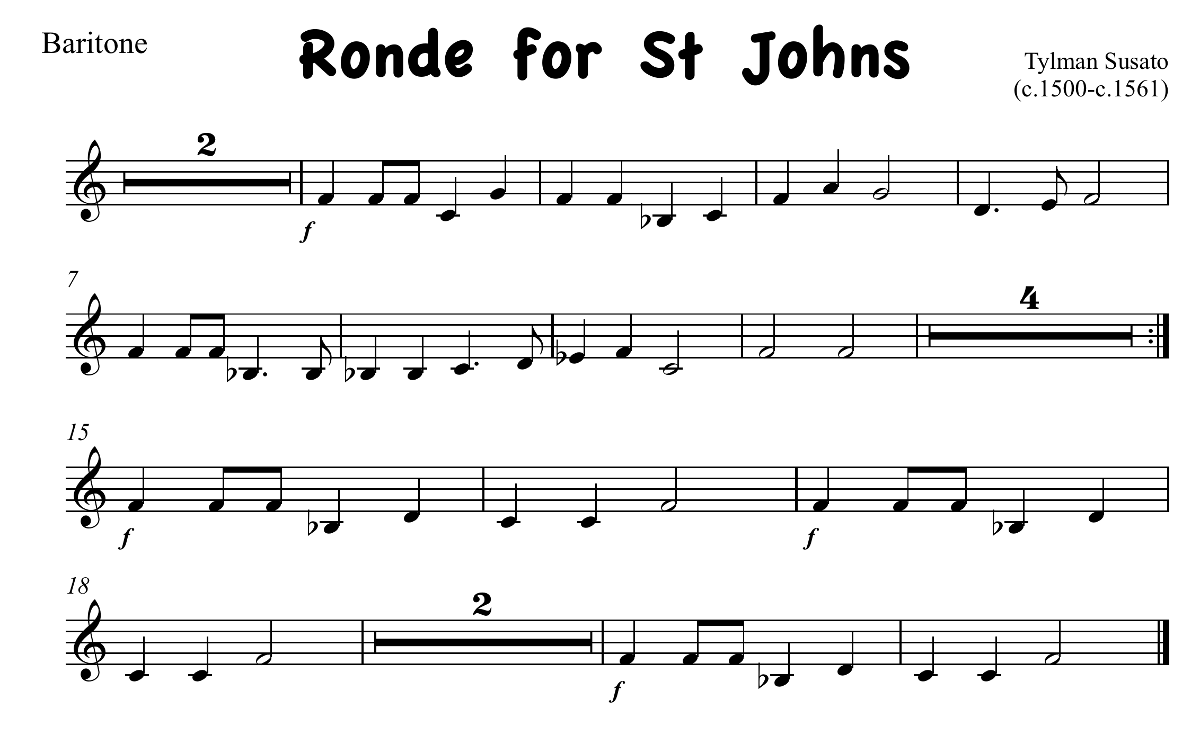
click here for note names

Slide 10
