Slide 1
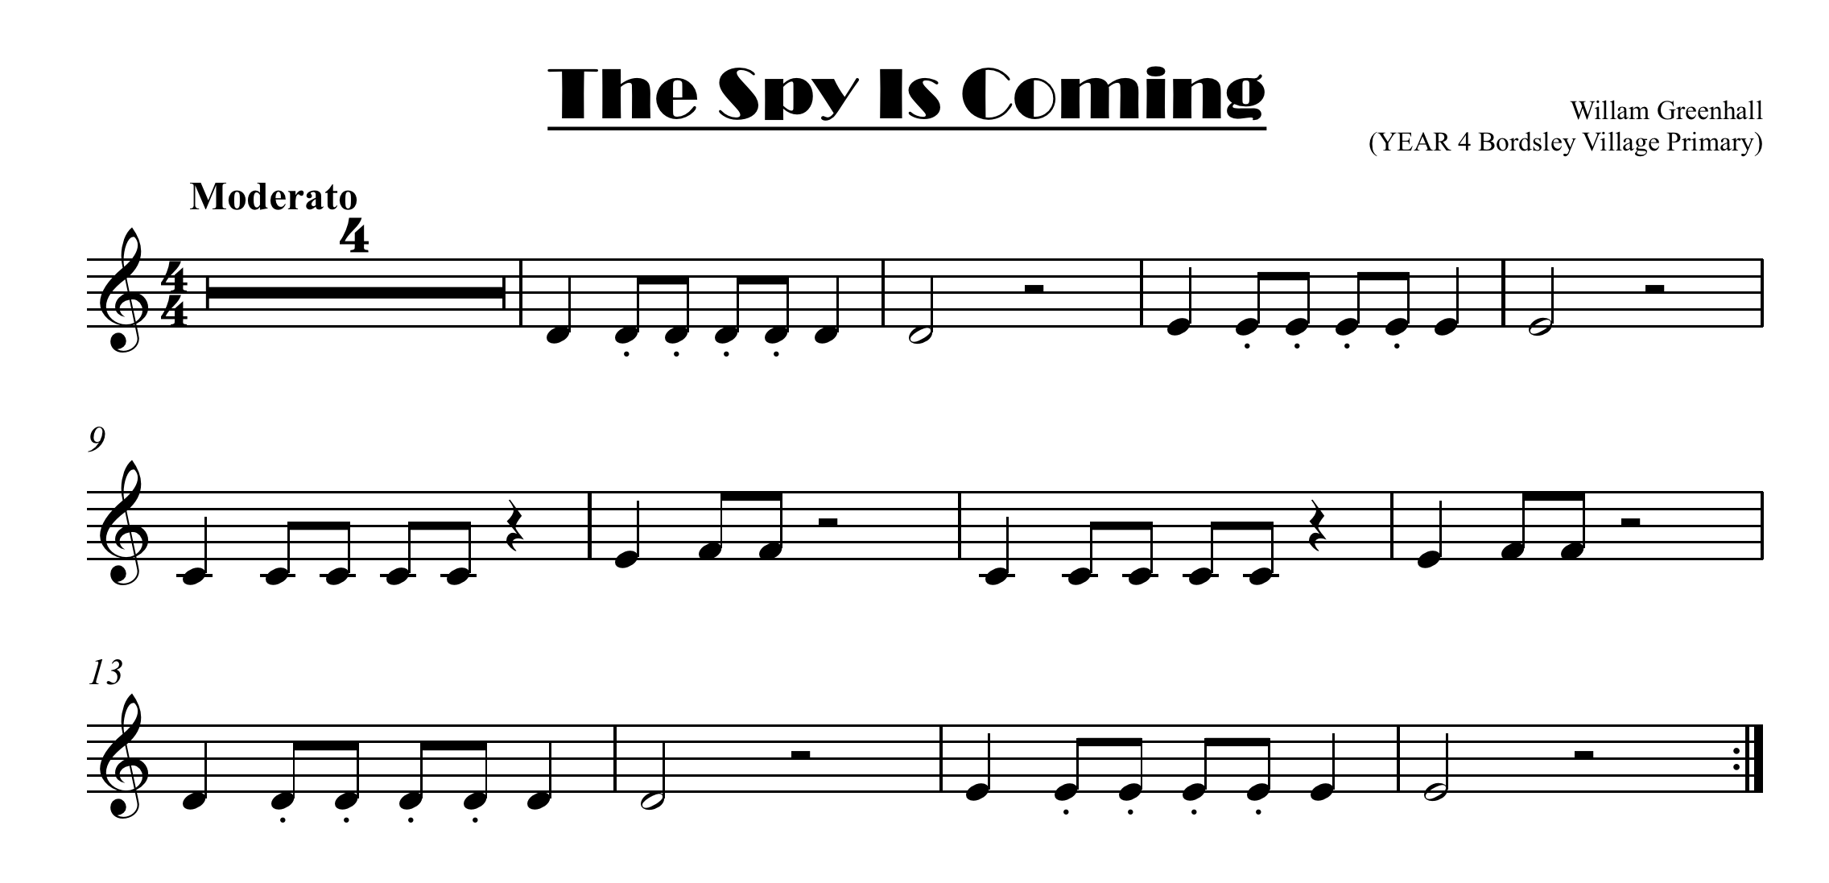


click here for note names

Slide 2
