Slide 1
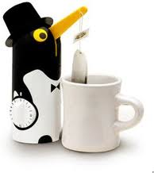

The Penguin Song
go to next slide press start slide show then right arrow twice to start

Slide 2




Have you ever had
A penguin round for tea
Take a look at me
A penguin you will see
Penguins Attention!!
Penguins begin
1 Right Hand
2 Right Hand Left Hand
3 Right Hand Left Hand Right Foot
4 Right Hand Left Hand Right Foot Left Foot
5 Right Hand Left Hand Right Foot Left Foot
Stick out yer bum!!
6 Right Hand Left Hand Right Foot Left Foot
Stick out yer bum!! Turn Around
Have you ever had
A penguin round for tea
Take a look at me
A penguin you will see
Penguins Attention!!
Penguins STOP!!!!

