Slide 1
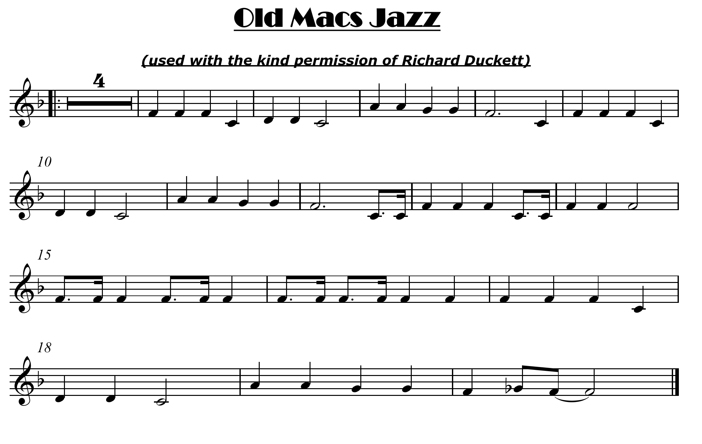

Listen and play the jazz rhythms “By Ear”
click here for note names

Slide 2


