Slide 1
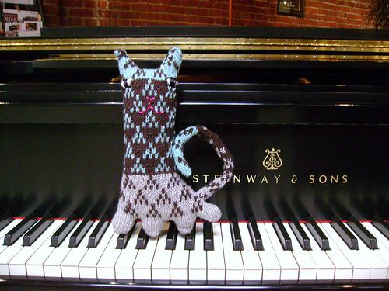
The Odd Socks Sonata

Slide 2
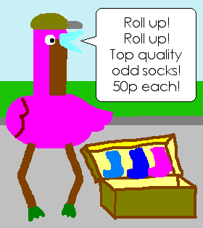

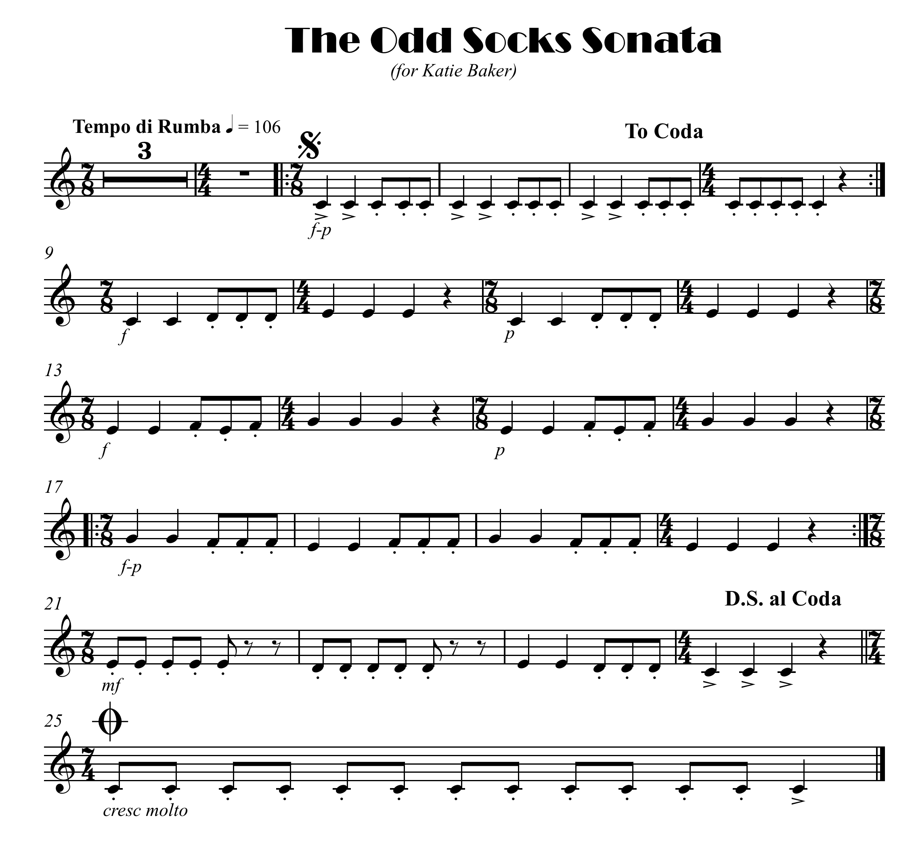

click here for note names

Slide 3
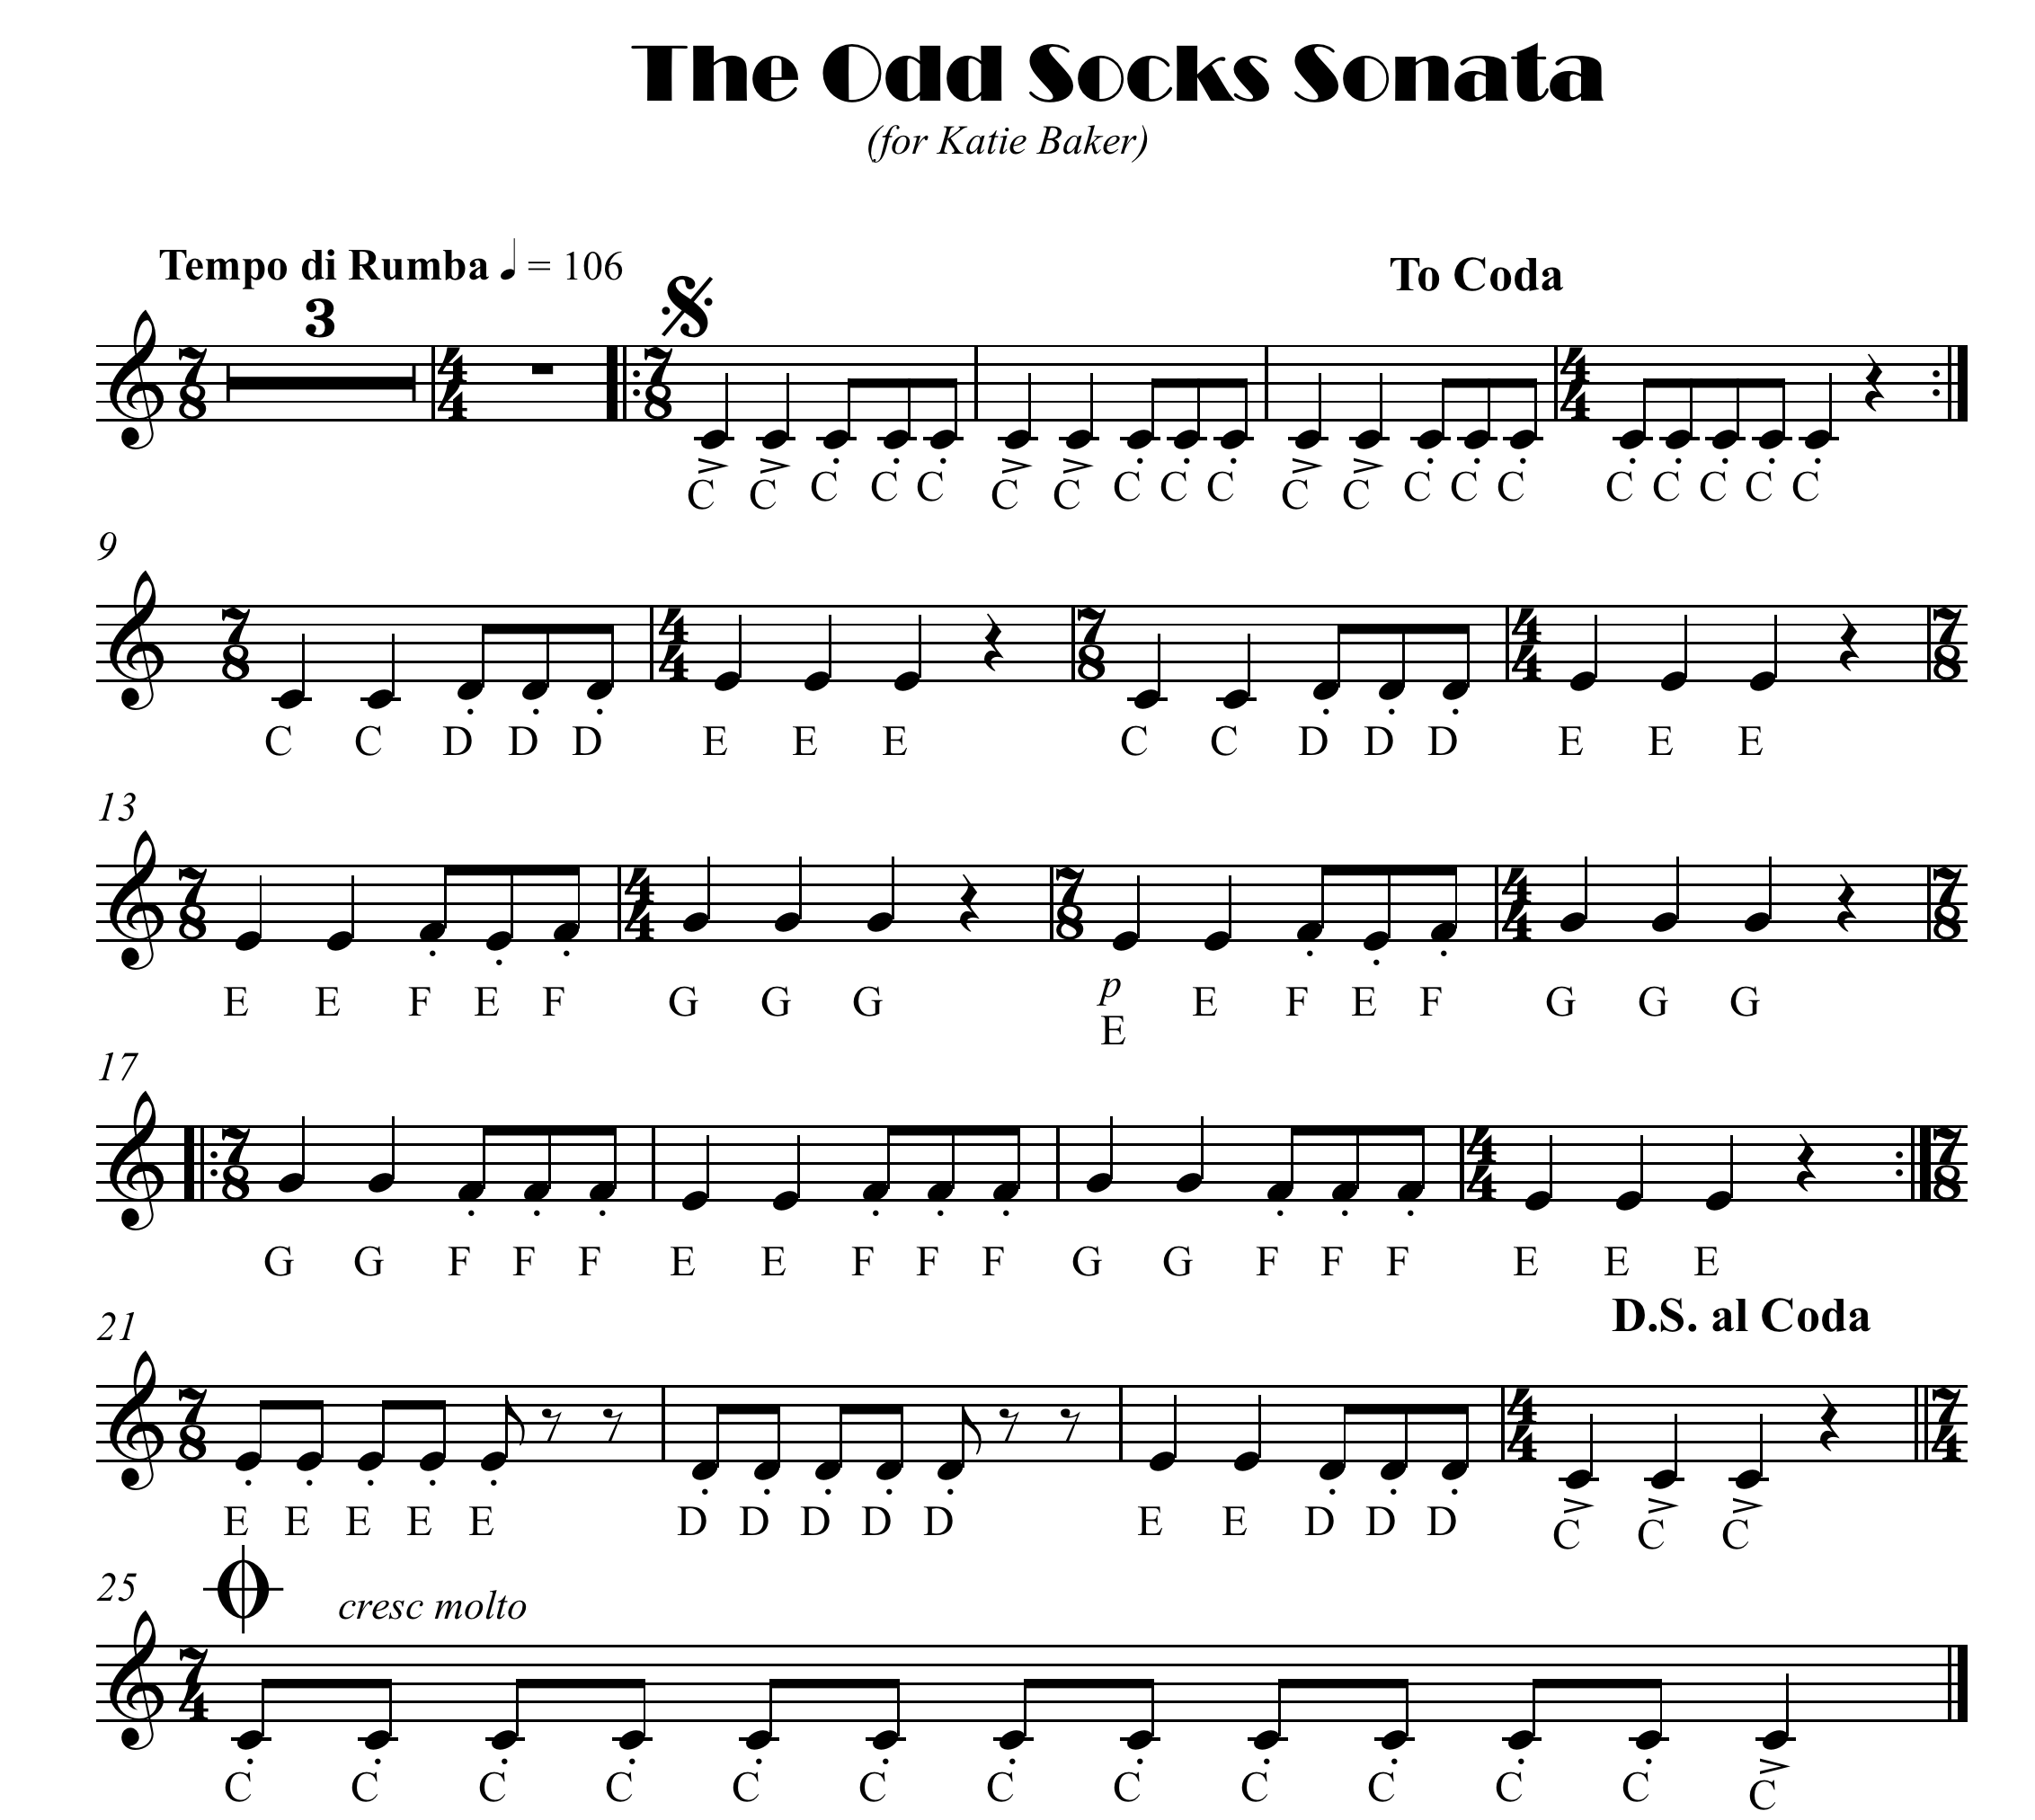

Slide 4

click here for note names

Slide 6

click here for note names

