Slide 1
Term 1 2nd Half Term (Web Version)
In this half term we will start to use the valves and learn about *****
Can you guess the word?
Have a look at the next few slides.

Slide 2
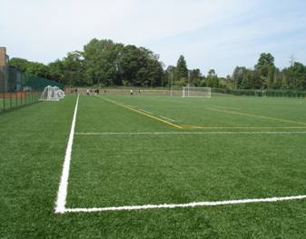
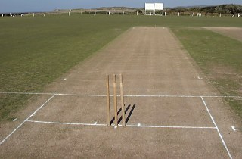
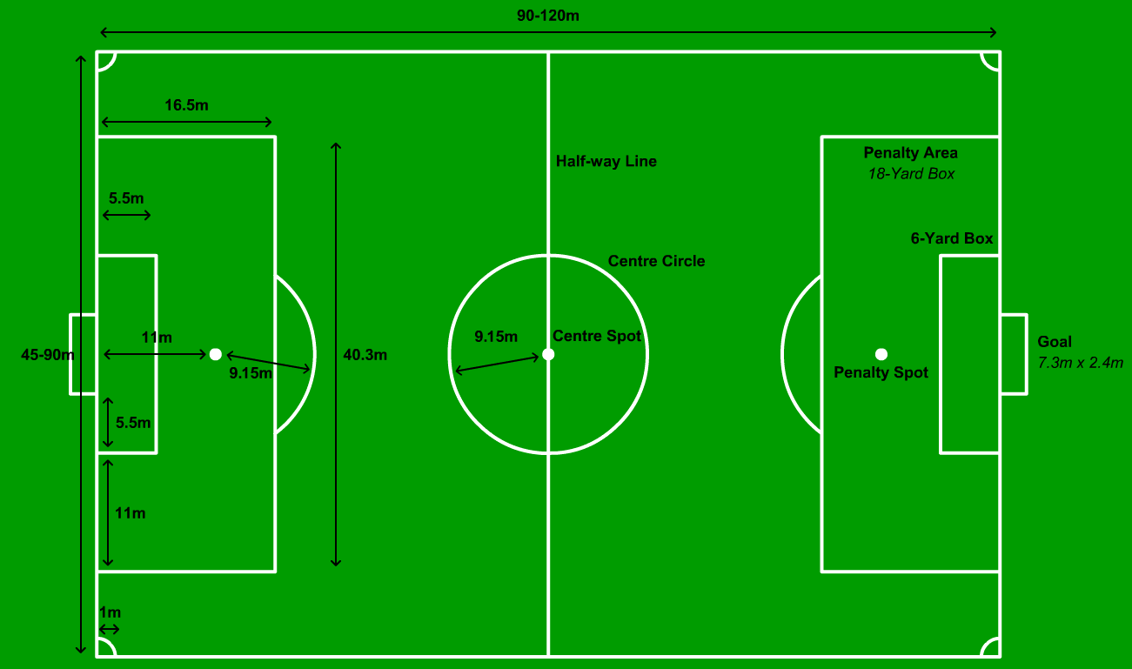
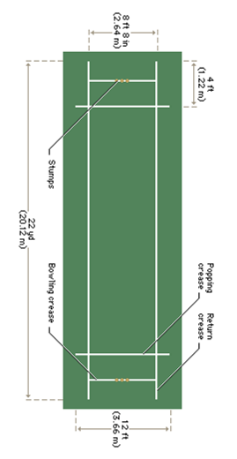
What Word are we looking for???

Slide 3
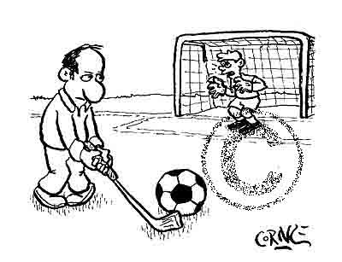

Did
You
Get
It
PITCH

Slide 4


Think of These Sounds
Is It A High Pitch Sound
Is It A Low Pitch Sound

Slide 5

Here's another
Is It A High Pitch Sound
Is It A Low Pitch Sound

Slide 6
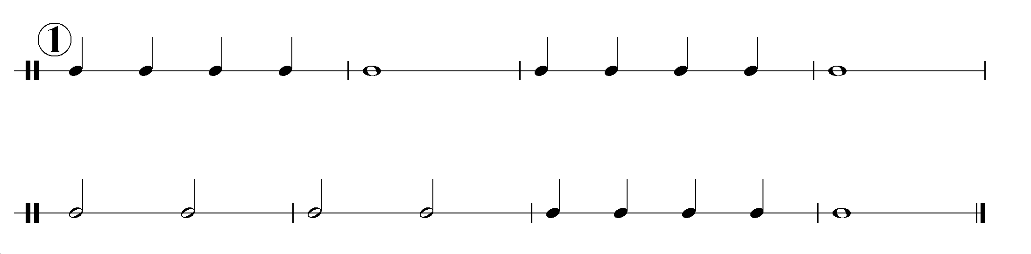
Can you play this longer rhythm?
Sing the Beat Values to help

Slide 7
Pitch
There are 2 ways to change the pitch of the note on a brass instrument
1.By using the valves

Slide 8
2. By changing the pressure of the lips

Slide 9
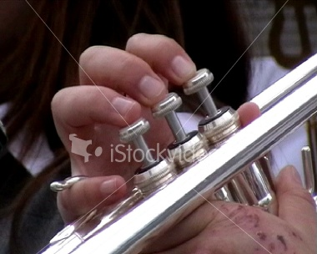

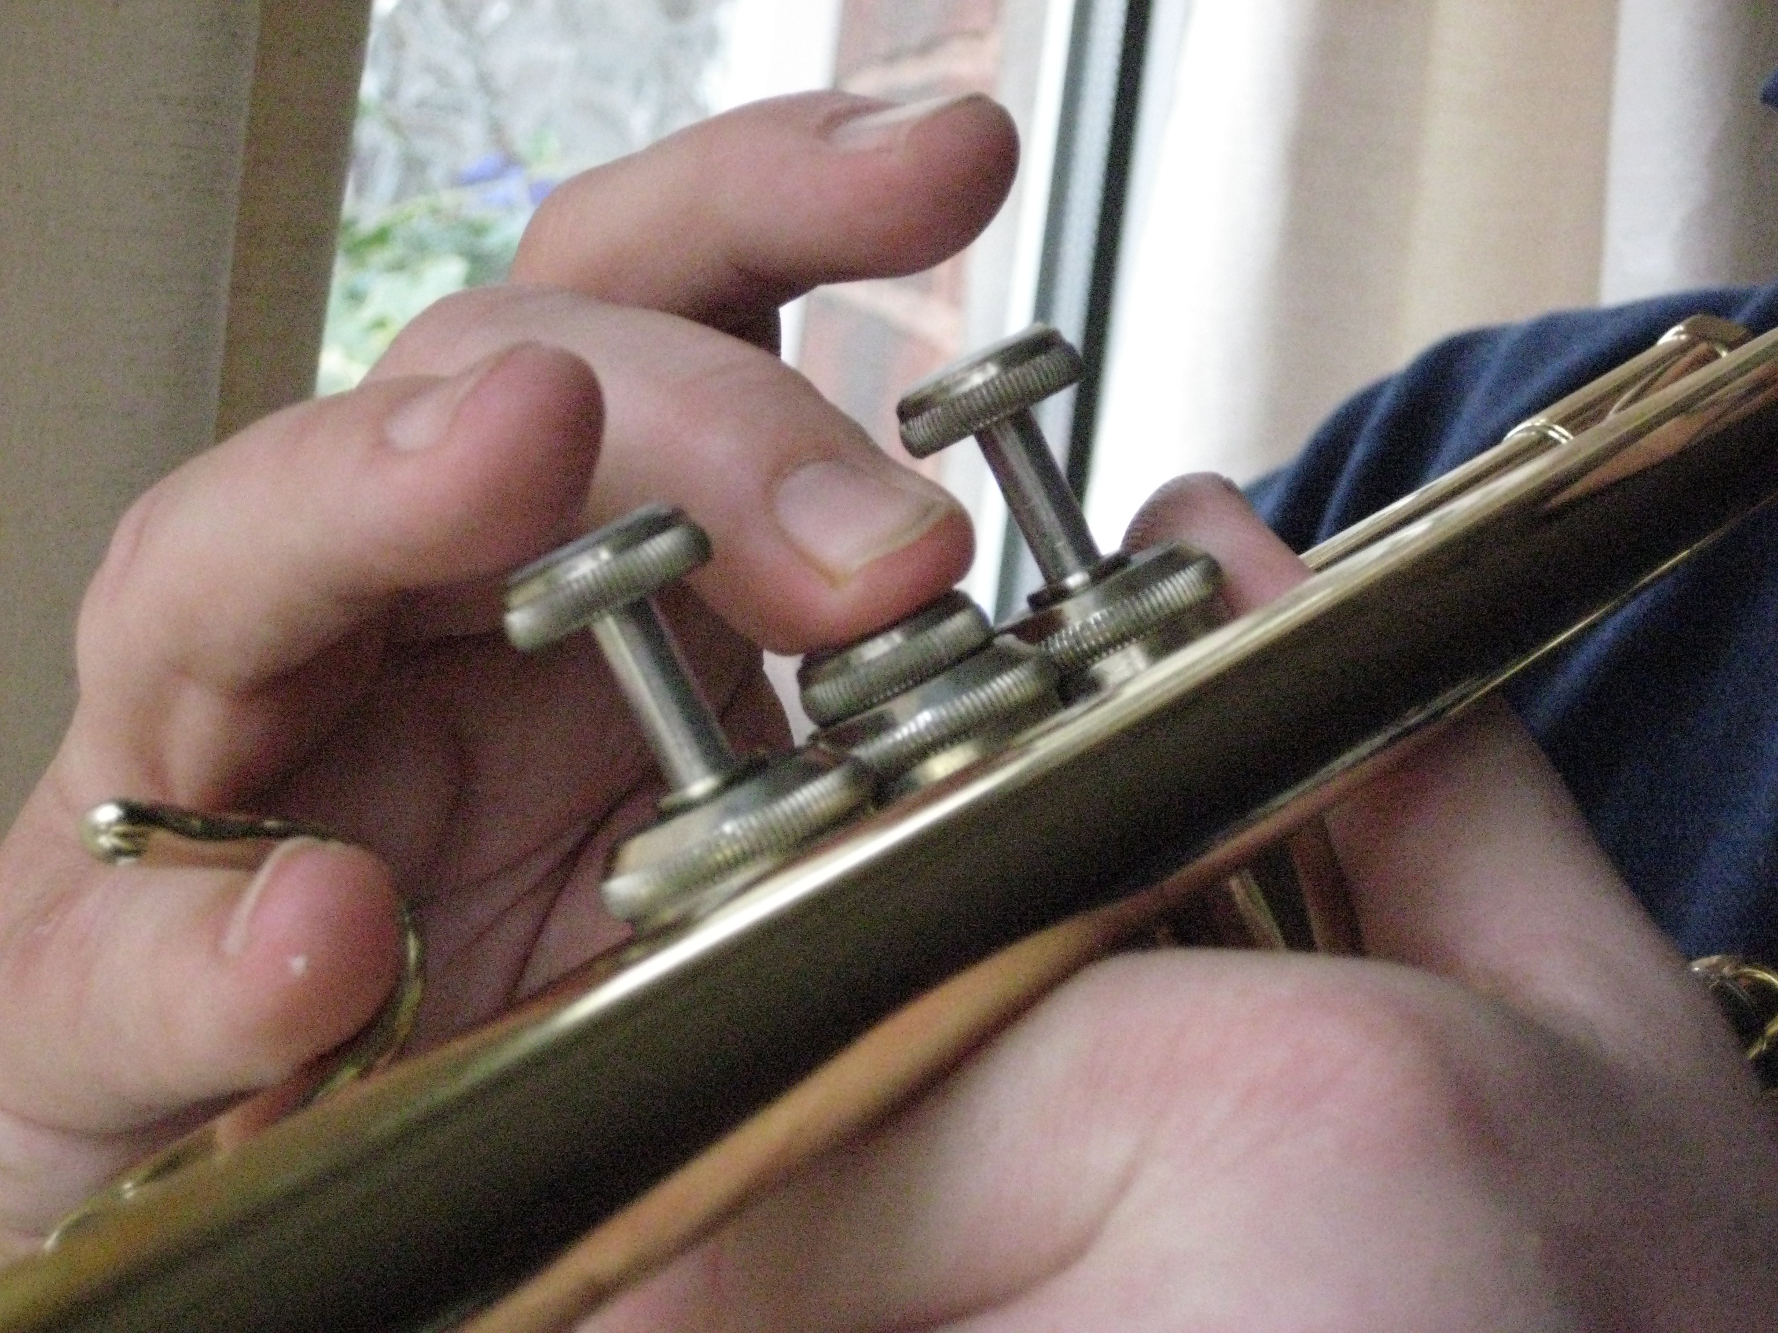
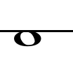
open
2

Slide 10
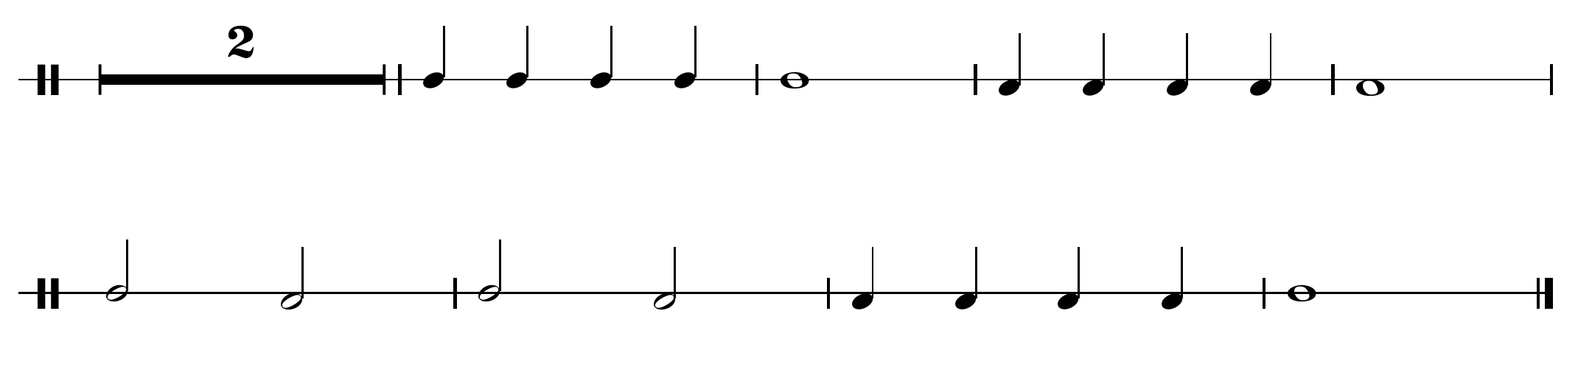
Play this using a “Pitch” change
2nd Valve
you are going to use a lower note

Slide 11
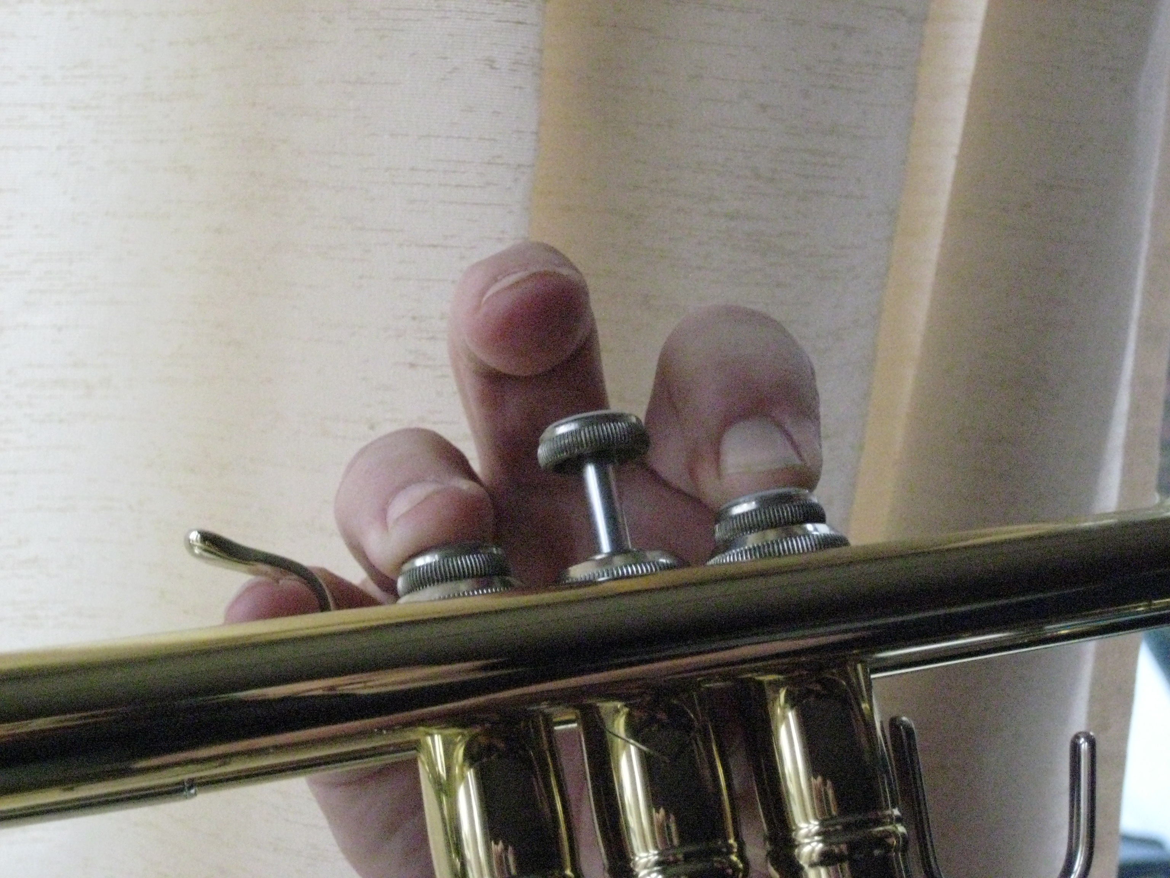
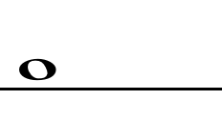
1 and 3

Slide 12
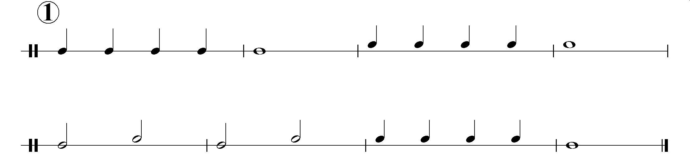
Play this using a “Pitch” change
1st and 3rd valves
You going to use a higher note?

Slide 13
In Music:-
Pitch takes the form of notes which are then named after the first 7 letters of the alphabet
A
B
C
D
E
F
G

Slide 14
Starting with “A” the pitch gets higher
G
F
E
D
C
B
A

Slide 15
Starting with “G” the pitch gets lower
G
F
E
D
C
B
A

Slide 16

The letter names form a sort of Pitch Ladder
G
F
E
D
C
B
A

Slide 17
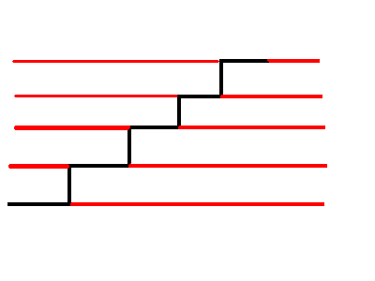
Put The Ladder over 5 lines and you have the stave or staff which is used to write music on

Slide 18
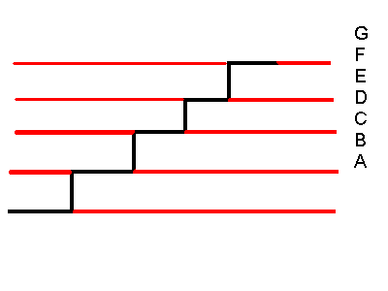
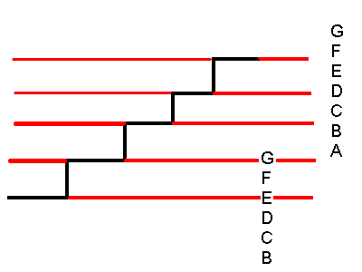
The 7 Letters are then placed like this:-
There is one more sign needed to complete this

Slide 19
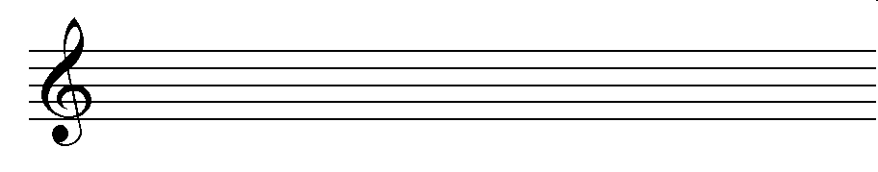
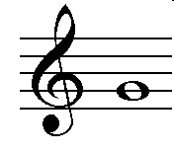
The lines or stave now has a sign called a “clef” placed at the beginning
The clef starts from the 2nd line
This tells you where the note “G” is
This clef is known as The Treble Clef or
The “G” Clef

Slide 20
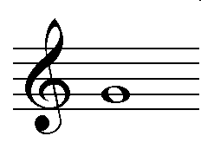
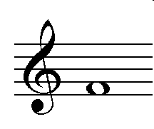
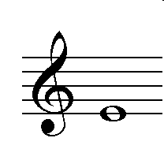
Can you work out these notes?
G
F
E

Slide 21
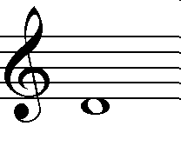
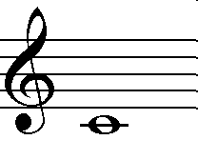
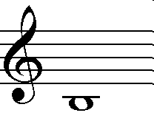
Here are 3 more
D
C
B

Slide 22
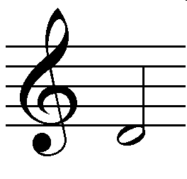
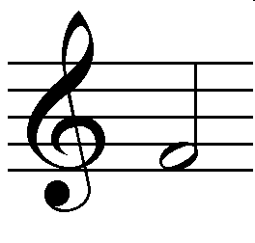
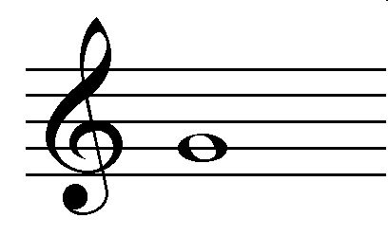
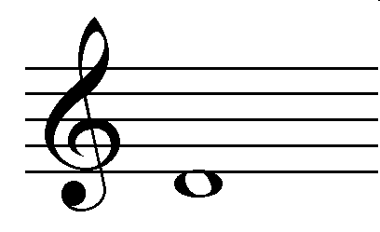
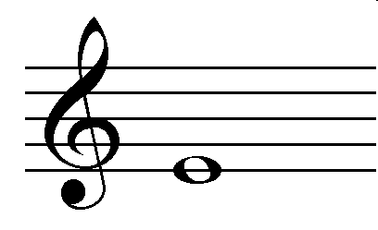
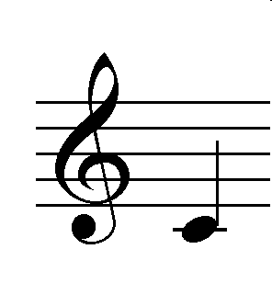
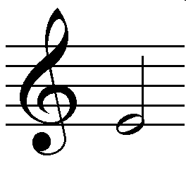
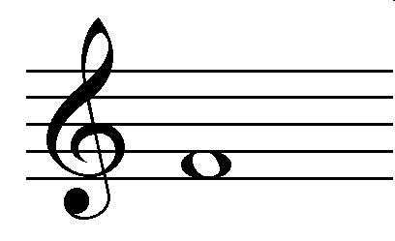
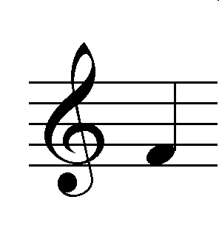

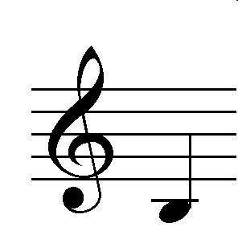
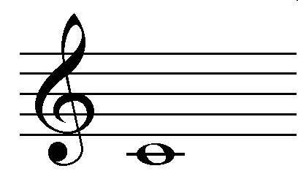
How quick can you name the notes
Can you tell the rhythm (note length in beats)

Slide 23
Have another go!!
Can you tell the rhythm (note length in beats)

Slide 24
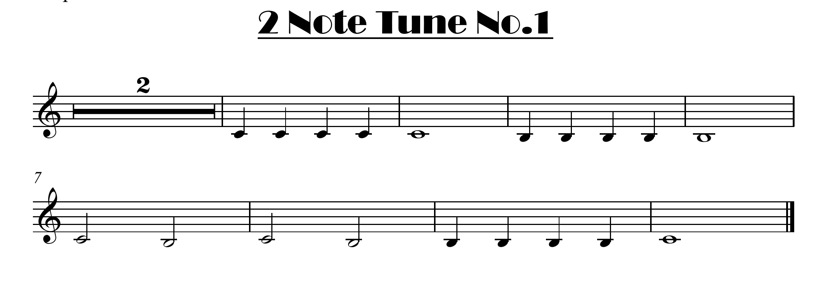
Here is the 2 note tune with the full notation
click for note names

Slide 25
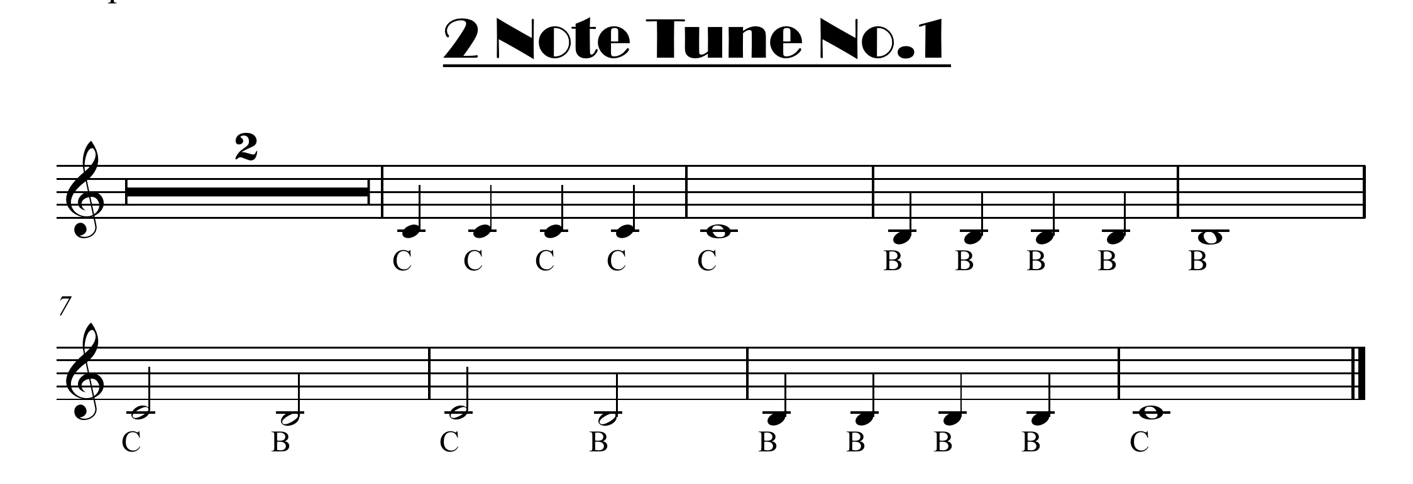
C is Open B is 2

Slide 26
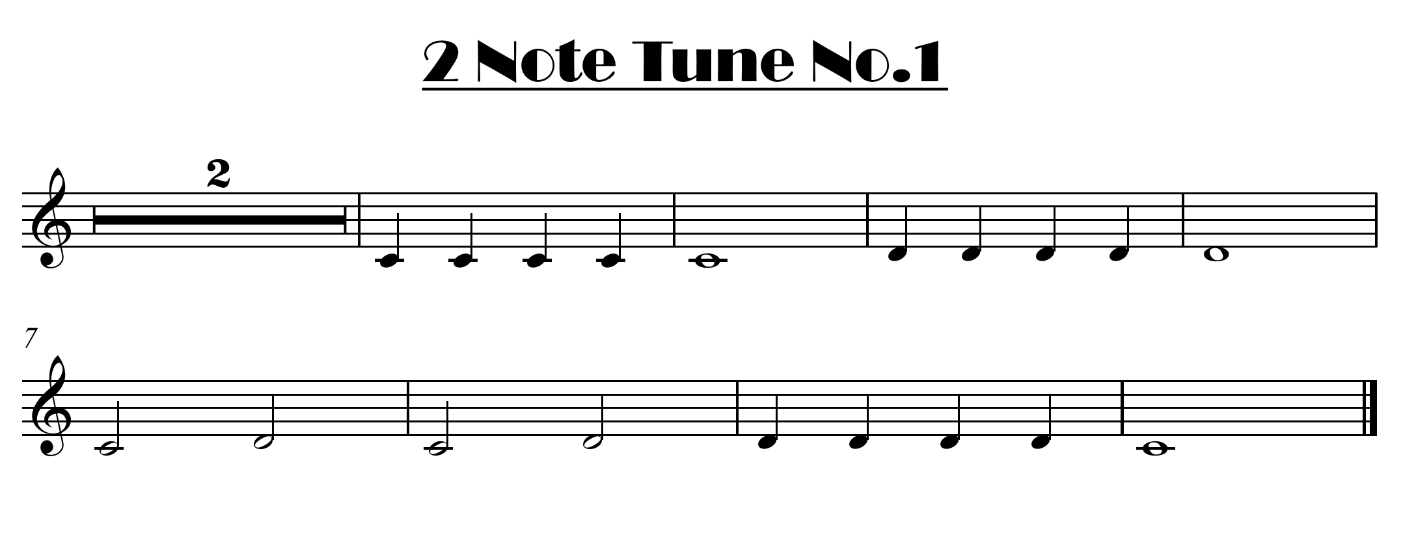
here is the other version
click for note names

Slide 27
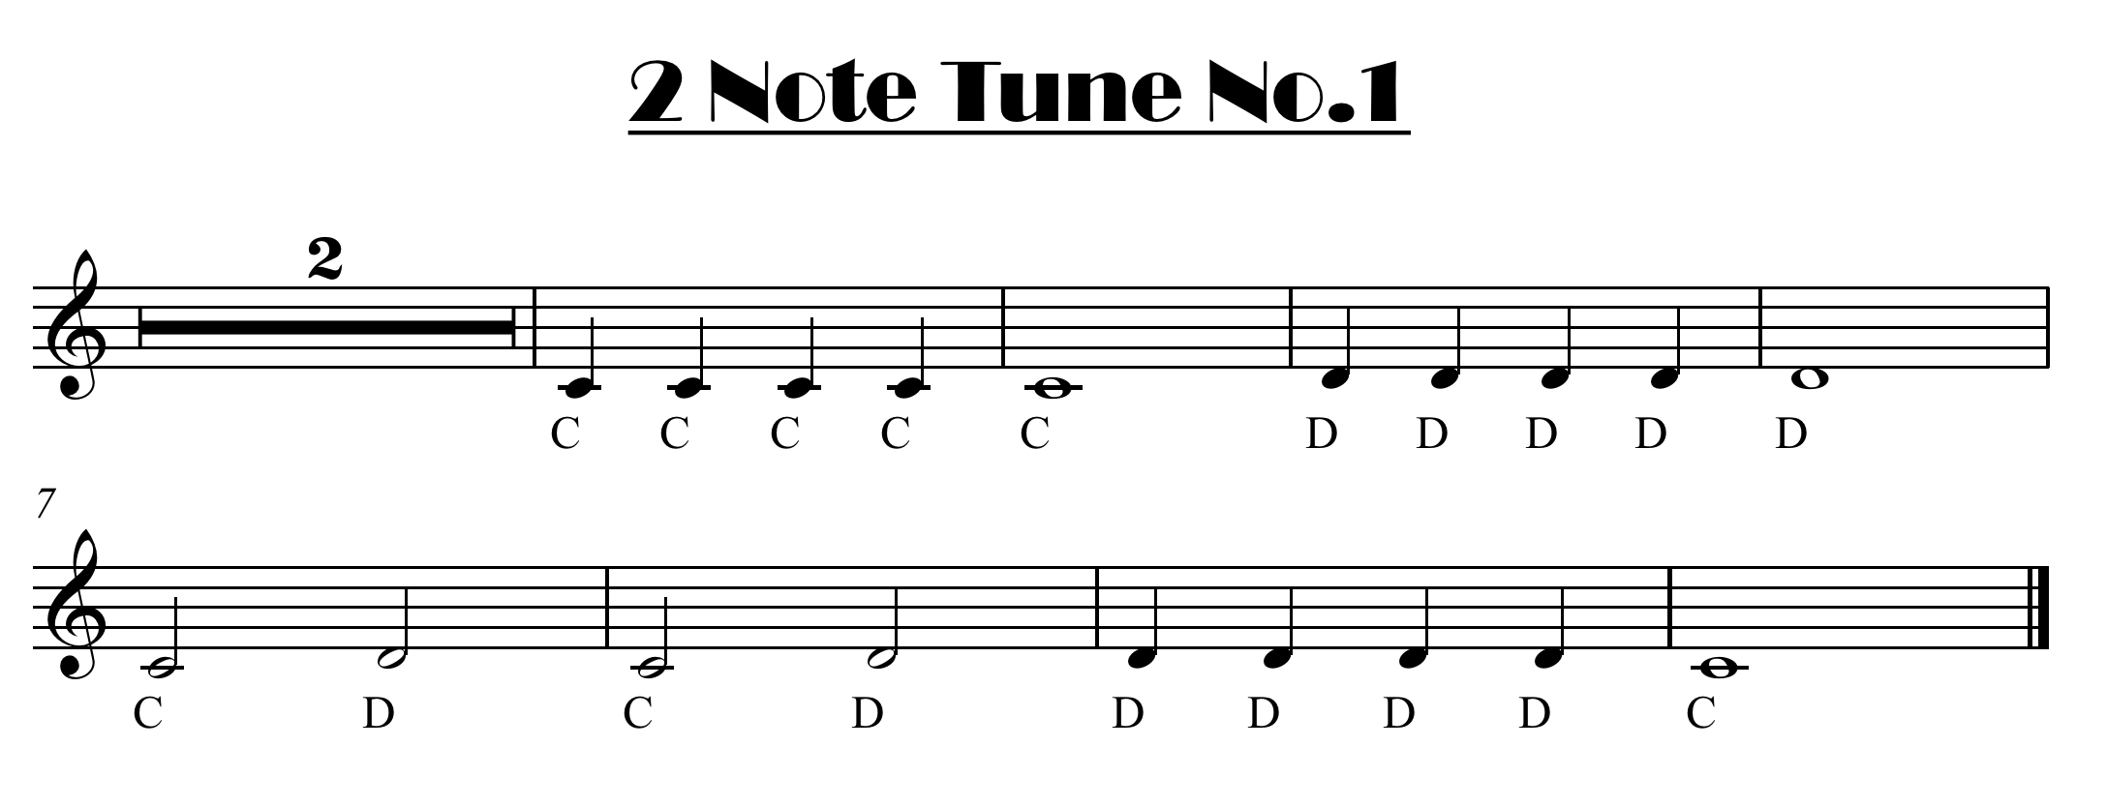
C is Open D is 1 and 3

Slide 28
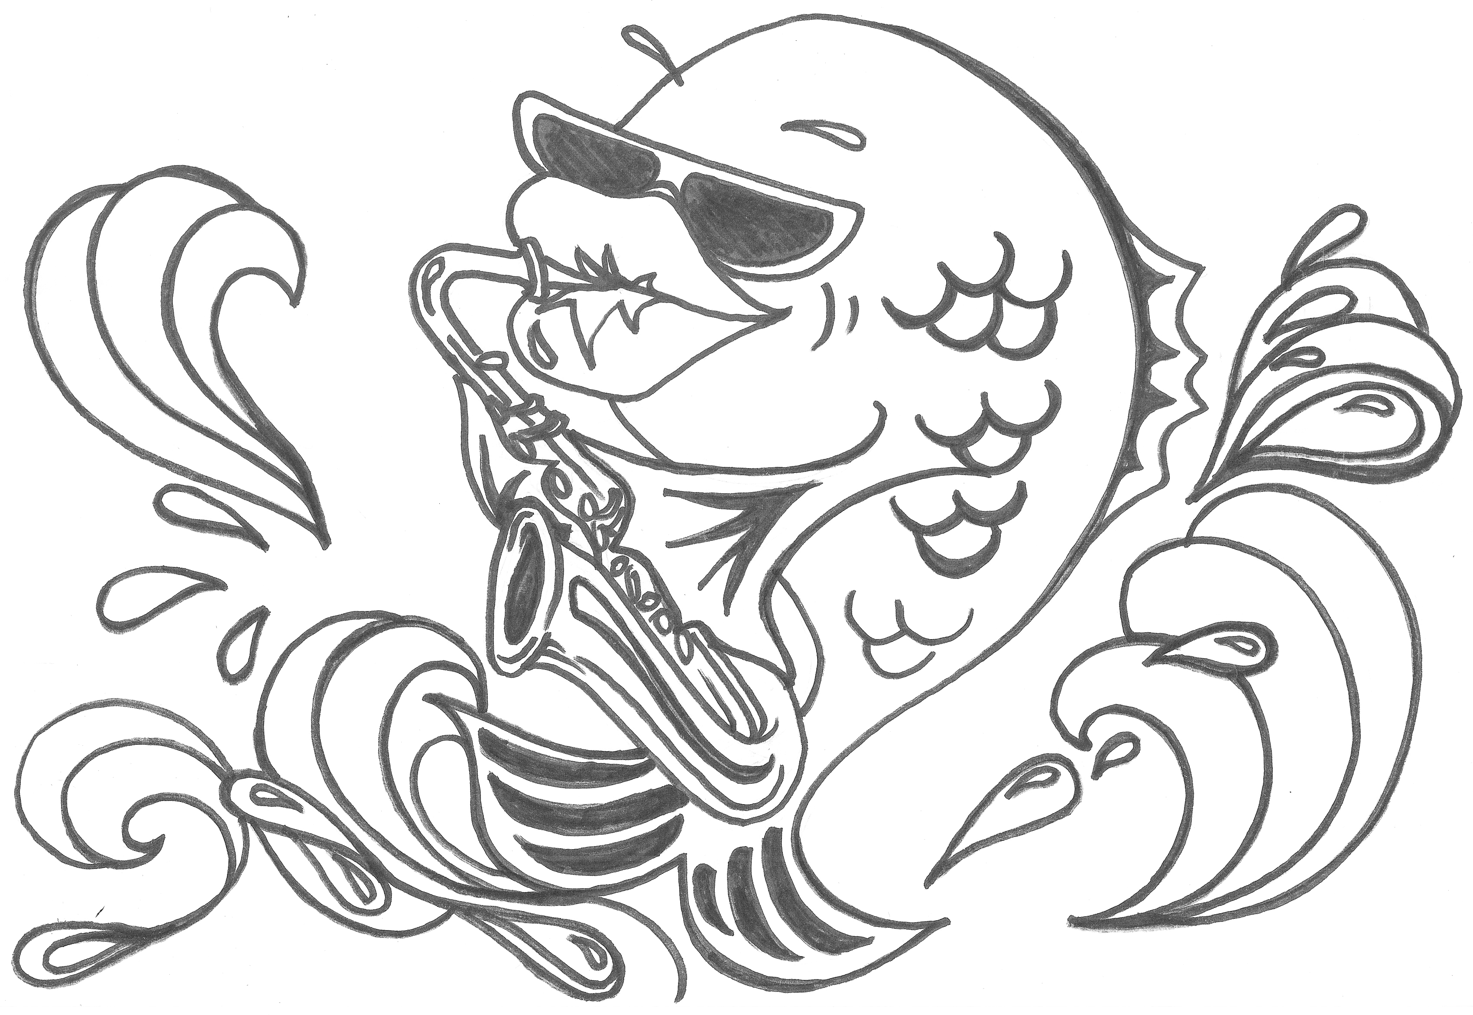
C Bass Blues (artwork by Julie Burton)

Slide 29
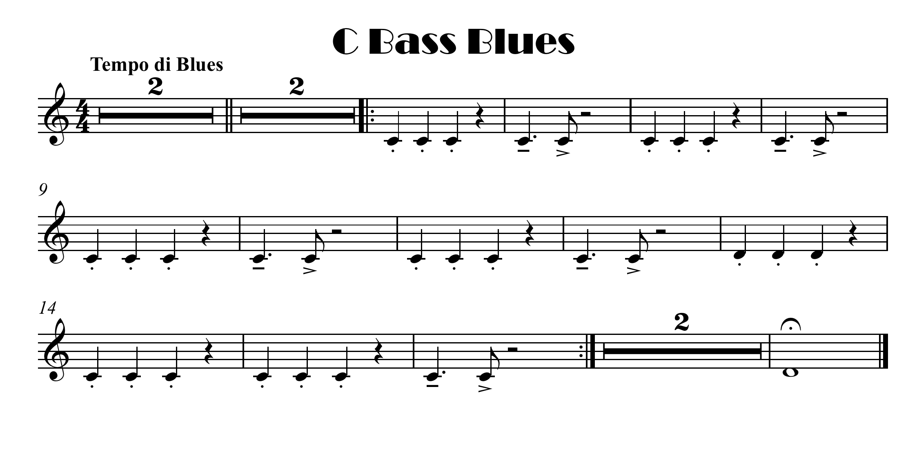
click for note names

Slide 30


Slide 31



Down
with
the
Valves
1 and 3
2
open

Slide 32
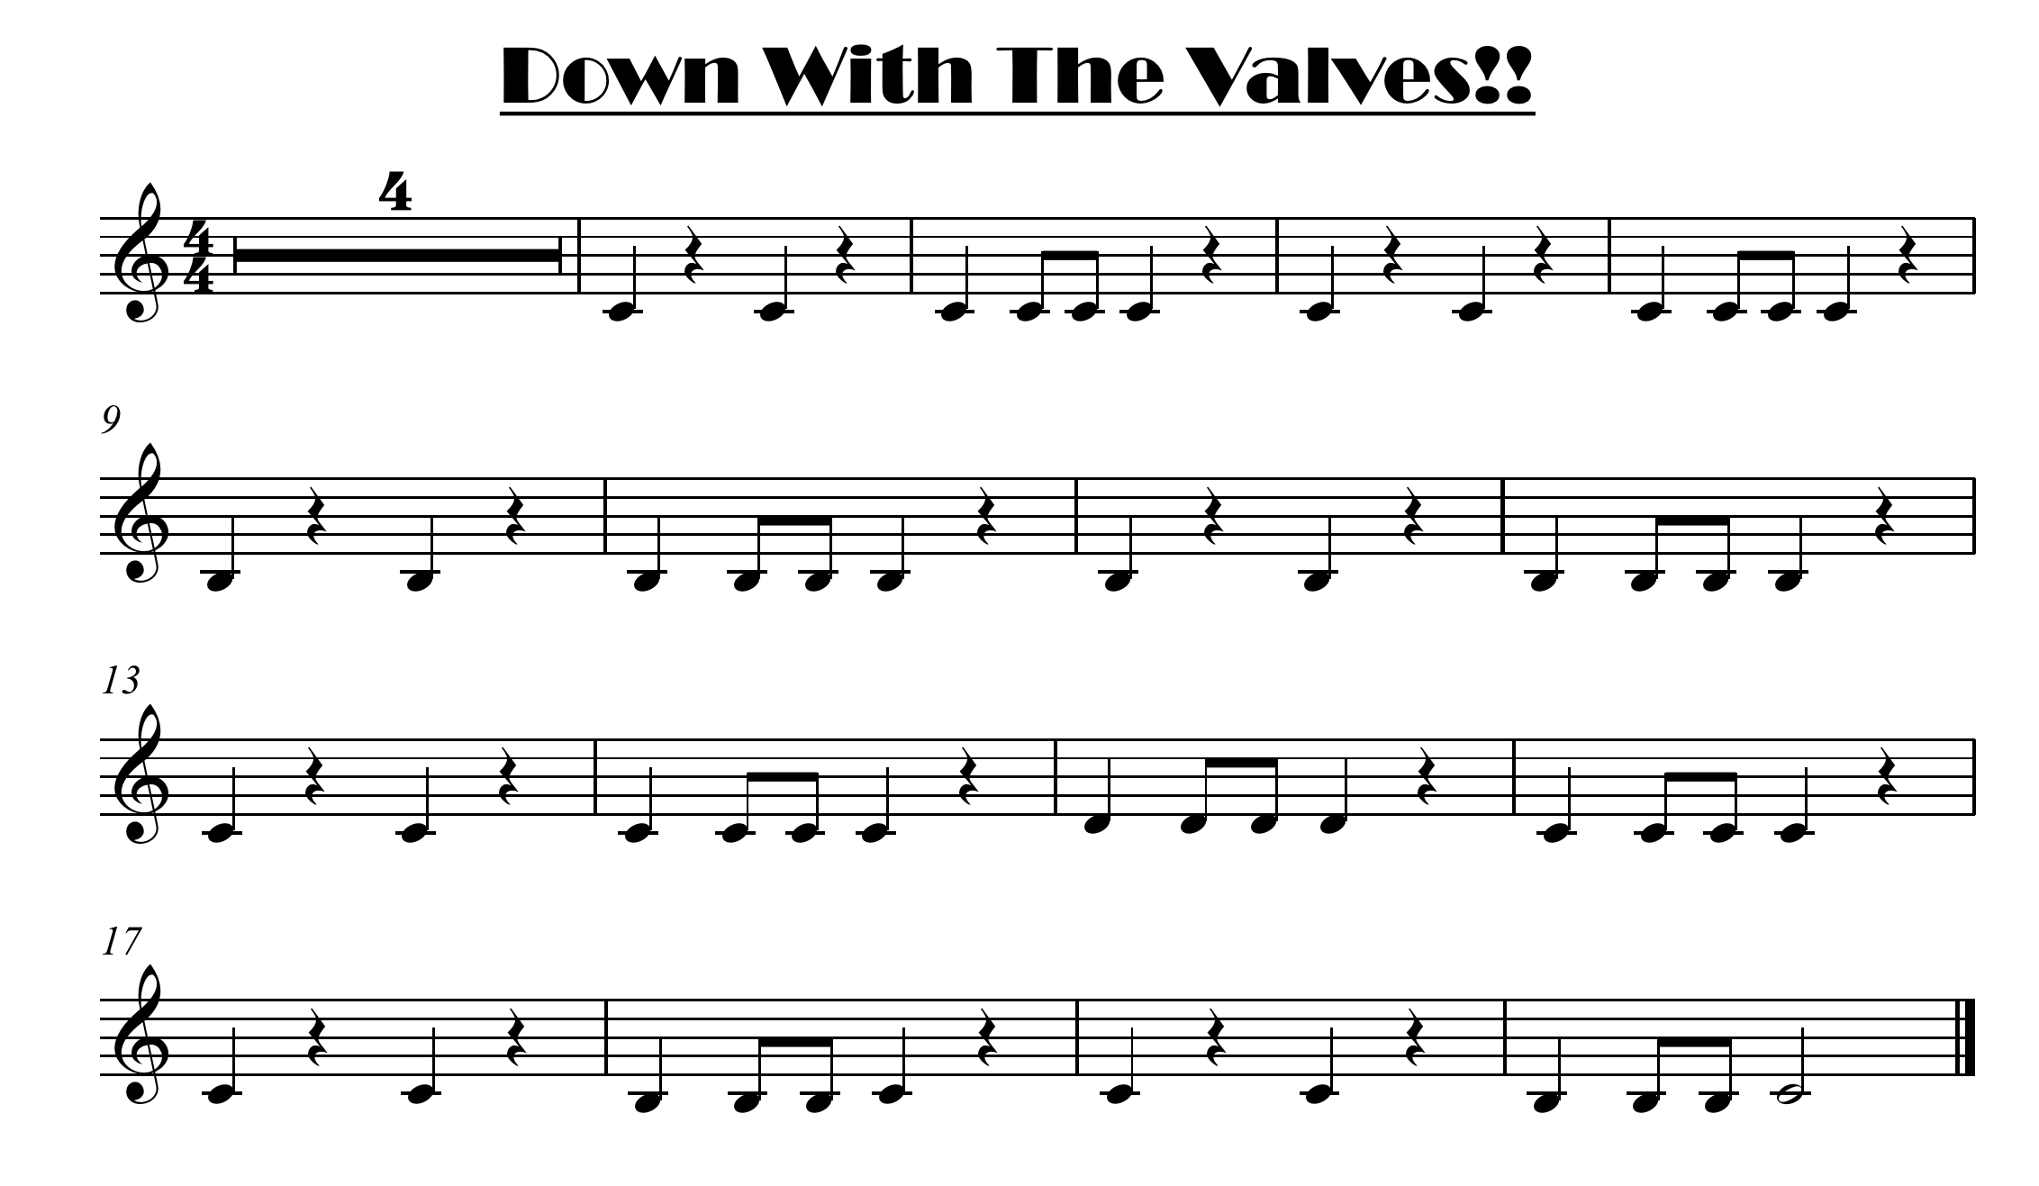
click for note names

Slide 33
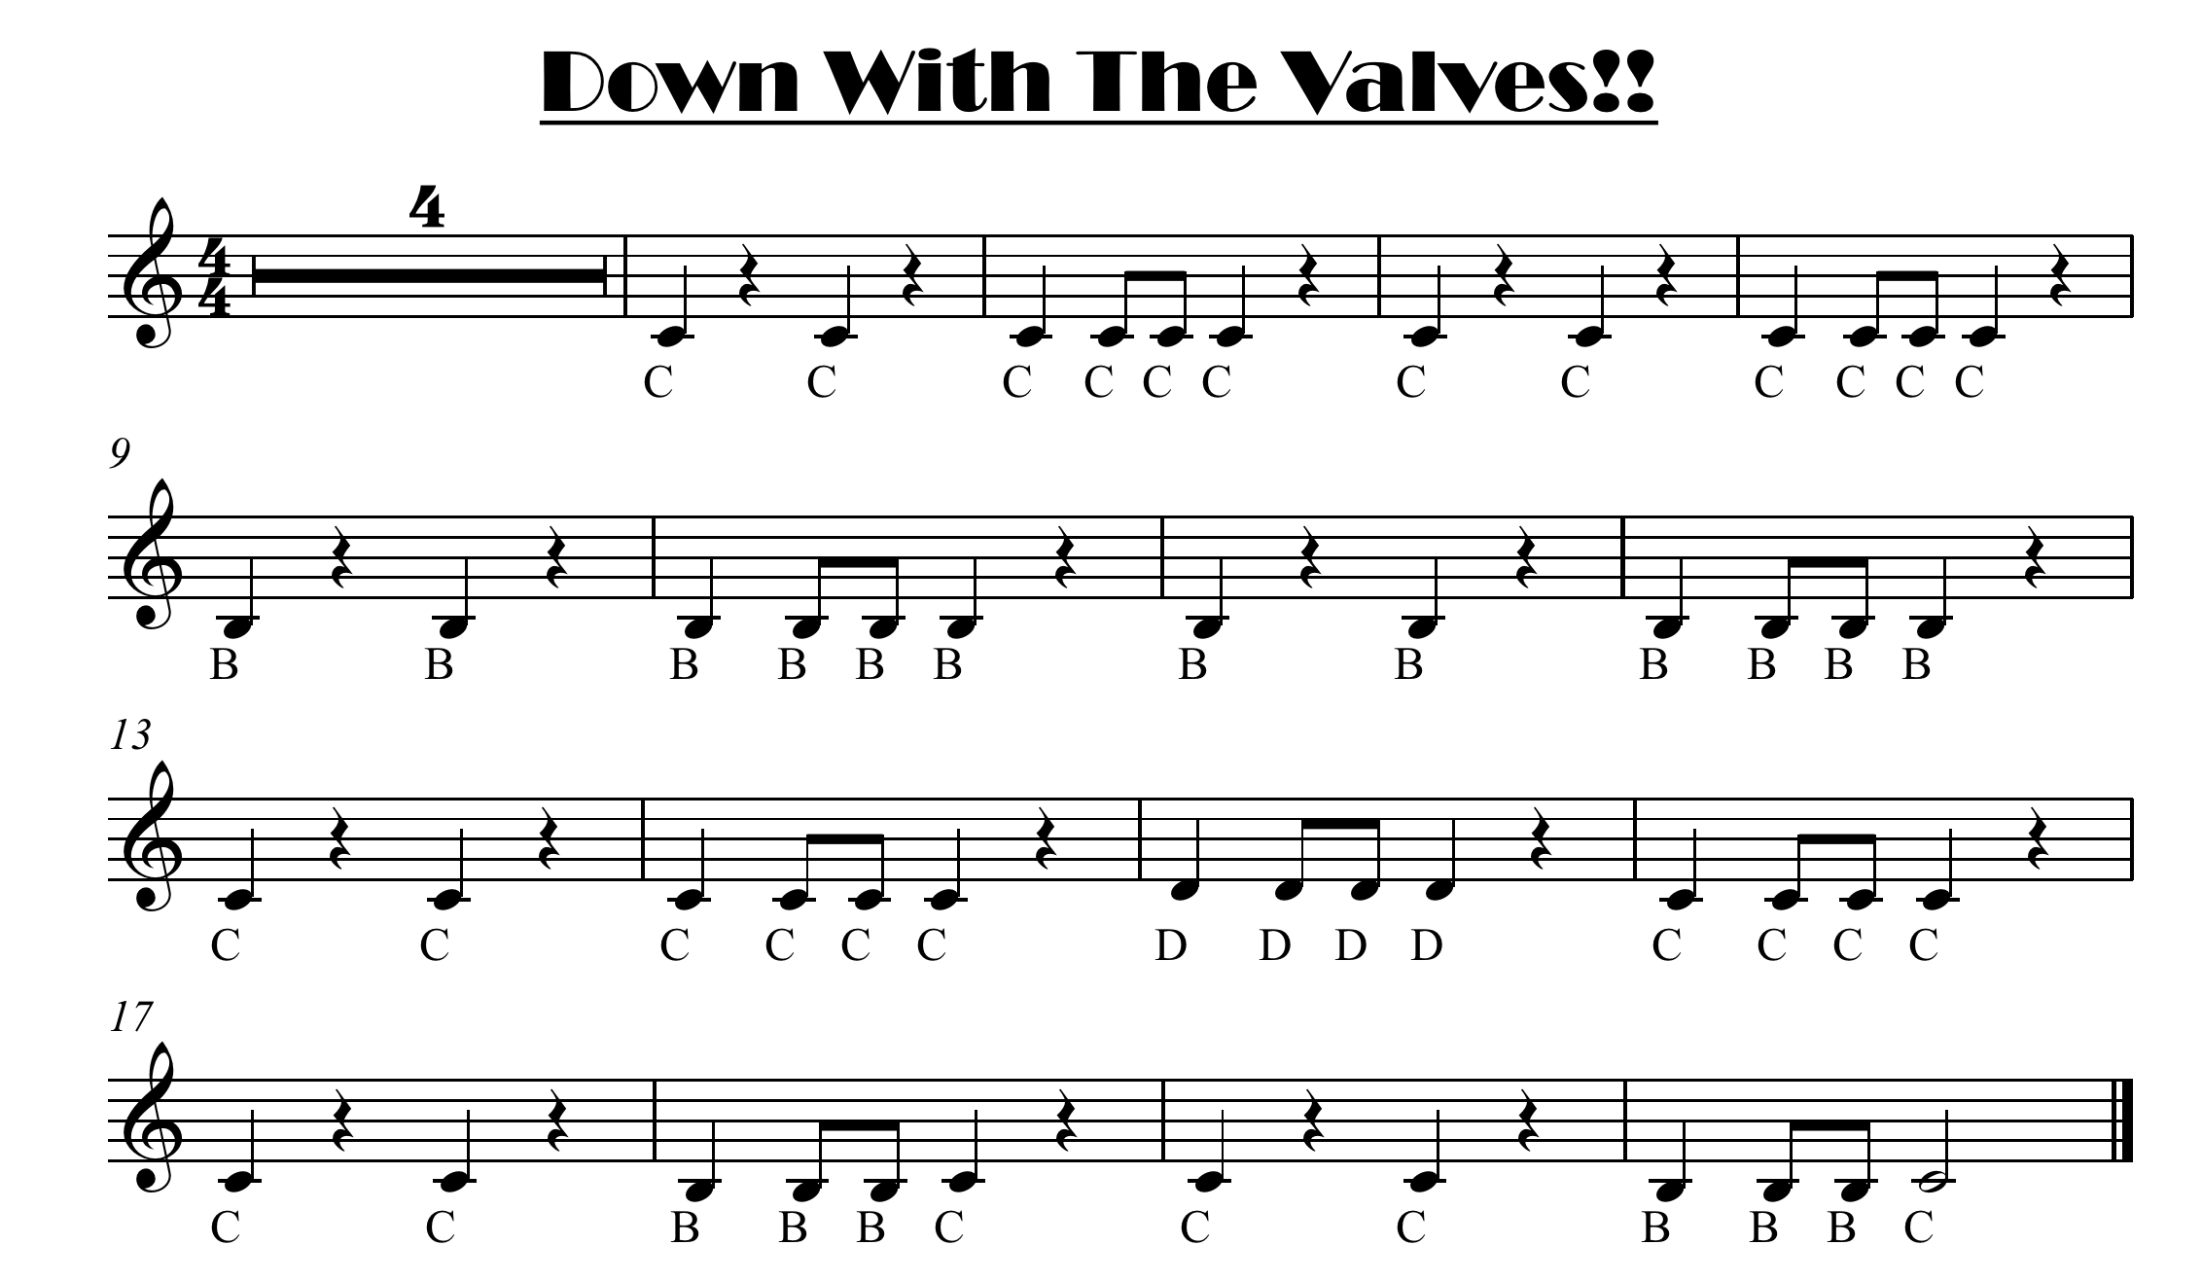

Slide 34
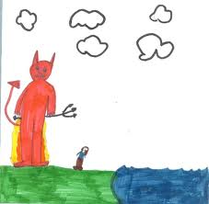
Between The Devil and The Deep Blue C

Slide 35
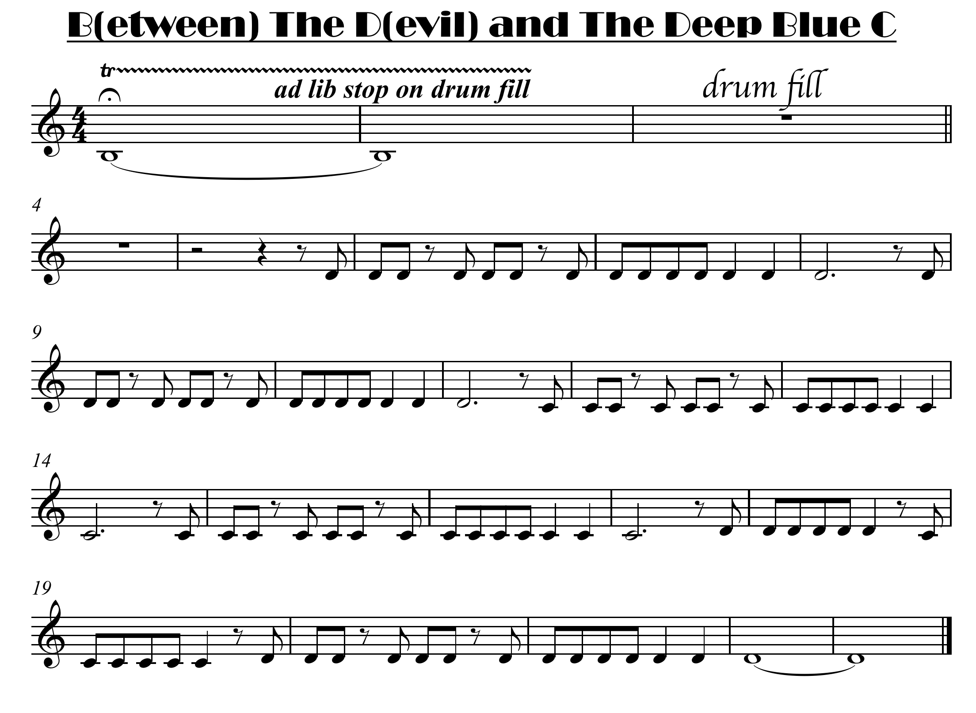
click for note names

Slide 36
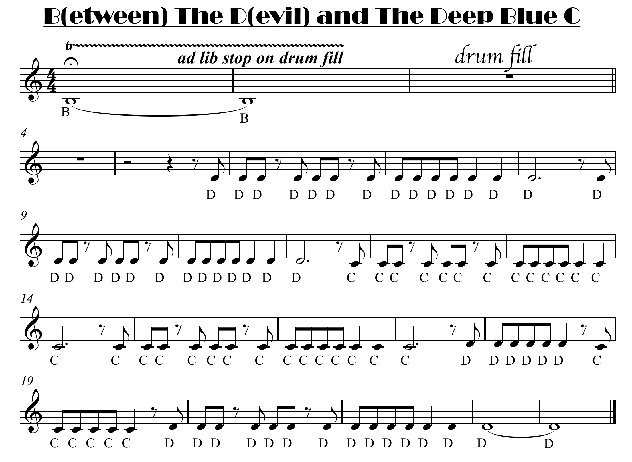

Slide 37
To complete this terms pieces you can try:-
The Four Seasons
Ate For Too Wan
Easy Bells

