Slide 1

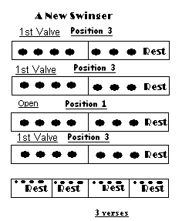
Now Try This Tune
“A New Swinger”
Introduction :- Wait for 1234
Press down 1st valve
F
F
G
F
Keep 1st Valve Down
Now change to open valves
Now 1st valve again
Have a dance but be ready to play the piece 2 more times

