Slide 1
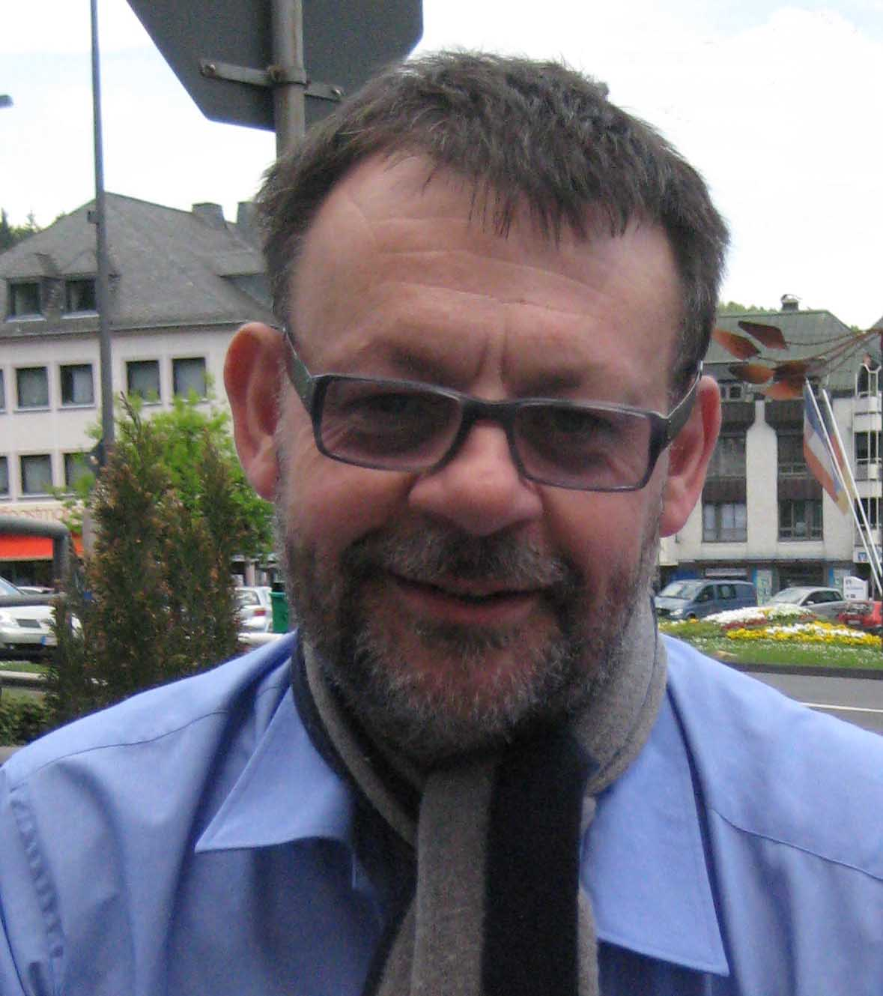
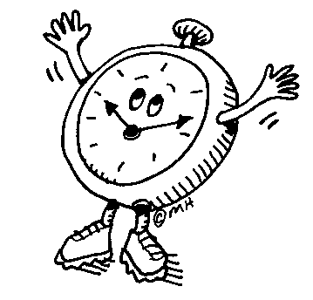


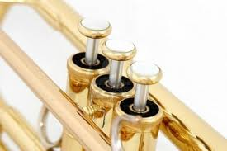
Welcome To Mr. Bates’ Name The Notes
Challenge
Can You Name The Notes and the Valves in less then 5 seconds
Which Level Can You Reach ?

Slide 2
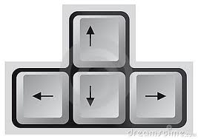
right click to start

Slide 3
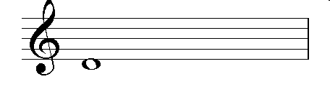
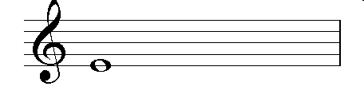
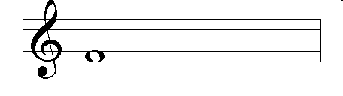
Name The Notes and valves (level 1)
D
1 and 3
1 and 2
E
1
F

Slide 4
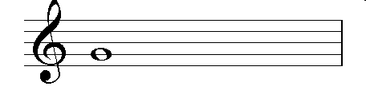
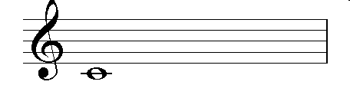
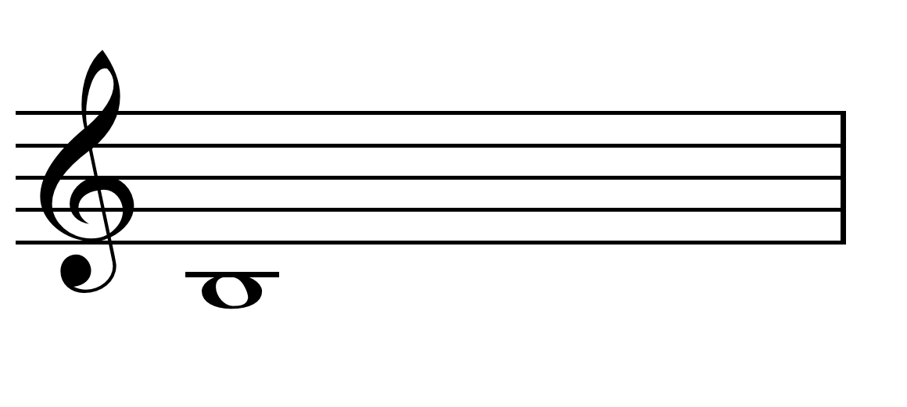
open
G
open
C
2
B

Slide 5
Level 2 : 4 seconds 2+2)
More Level 2
1 and 2
E
Open
G
G
Open
Open
C
F
1
1 and 2
E
C
Open
2
B
D
1 and 3
1
F
2
B
1 and 3
D

Slide 6
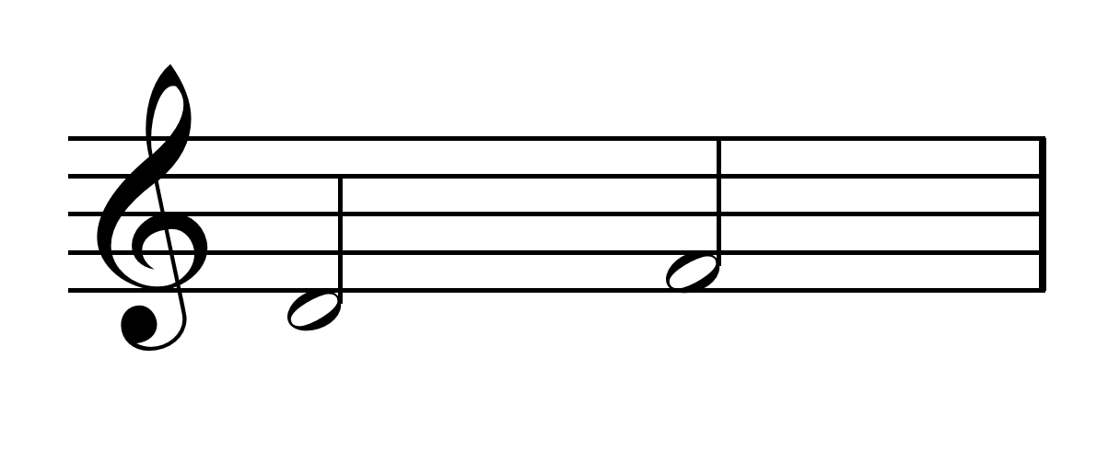
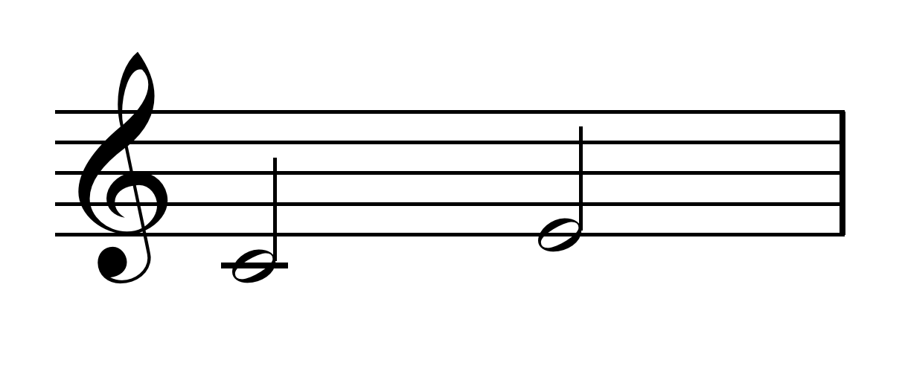
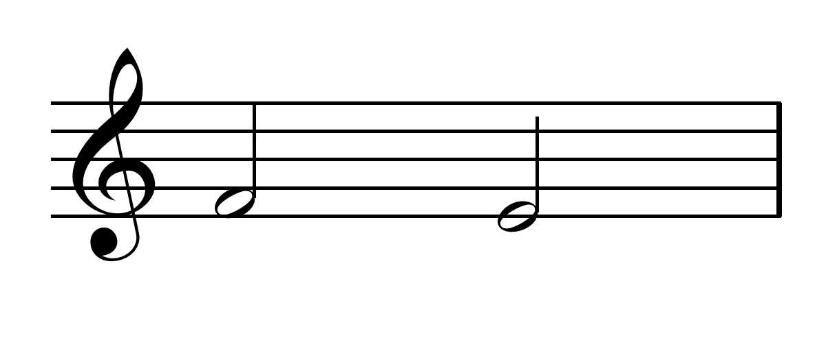
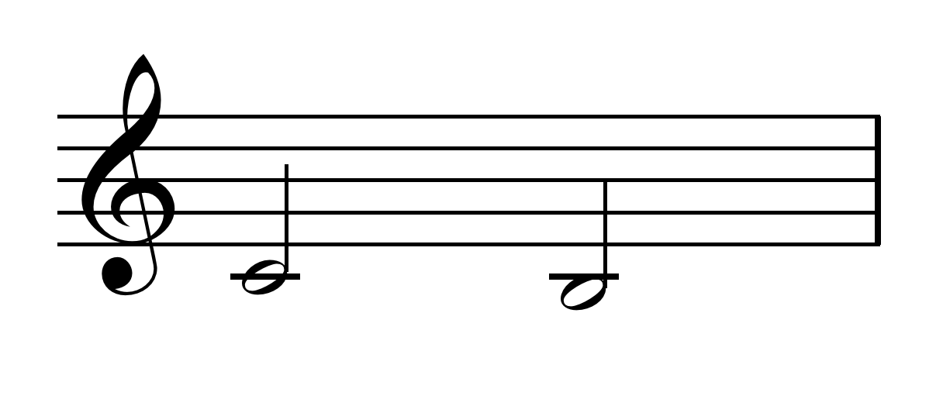
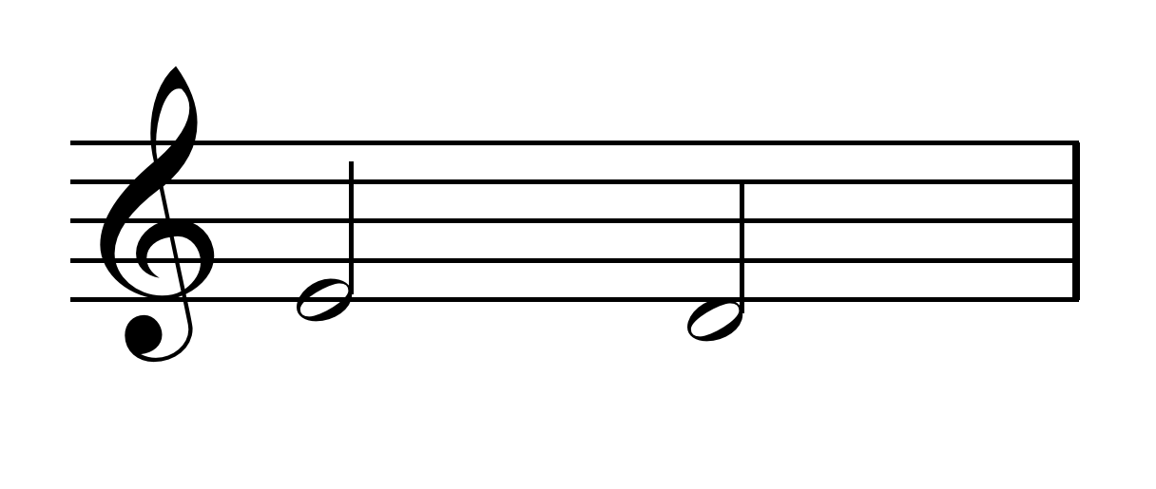

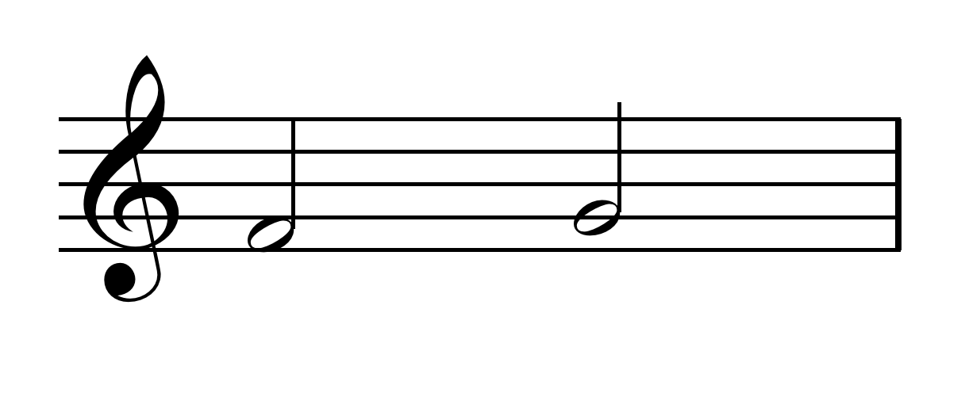
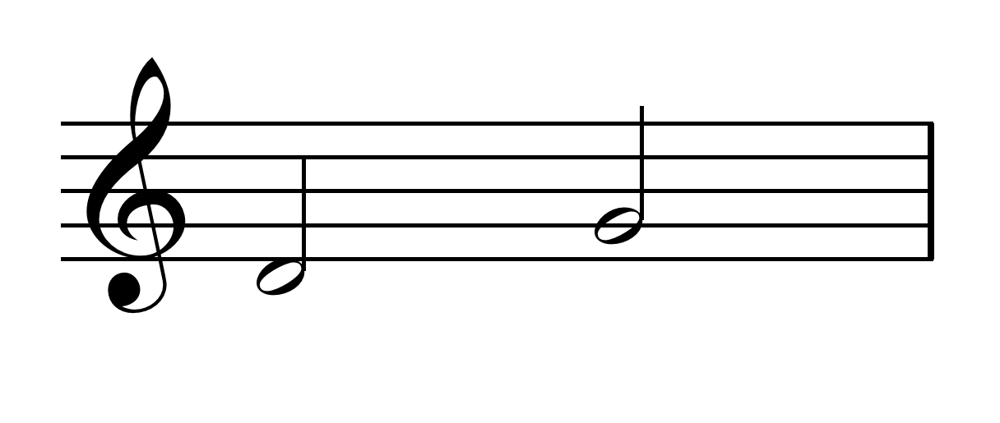
Level 3:- 4 seconds to name 2 notes and the valves
D 1/3 F 1
C 0pen E 1/2
F 1 E 1/2
C Open B 2
E 1/2 F 1
E 1/2 D 1/3
F 1 G Open
D 1/3 G Open

Slide 7
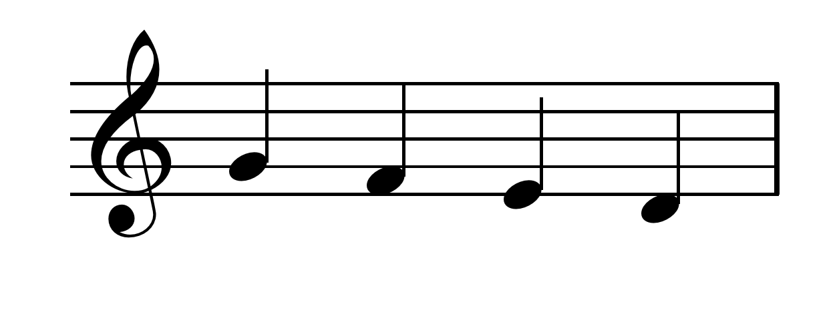
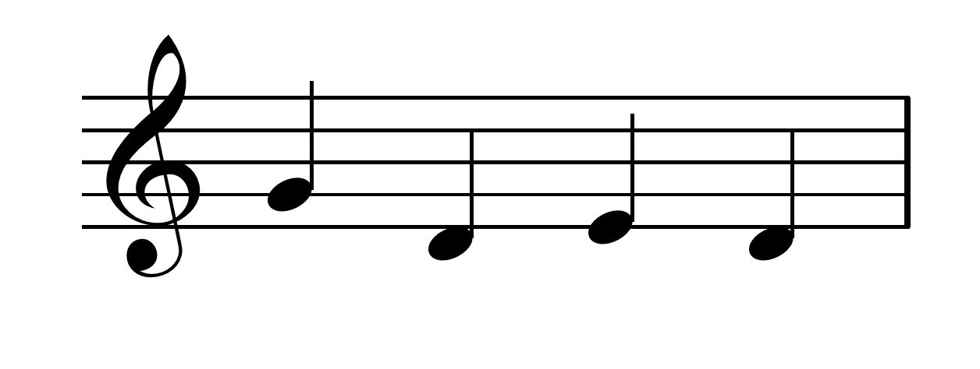
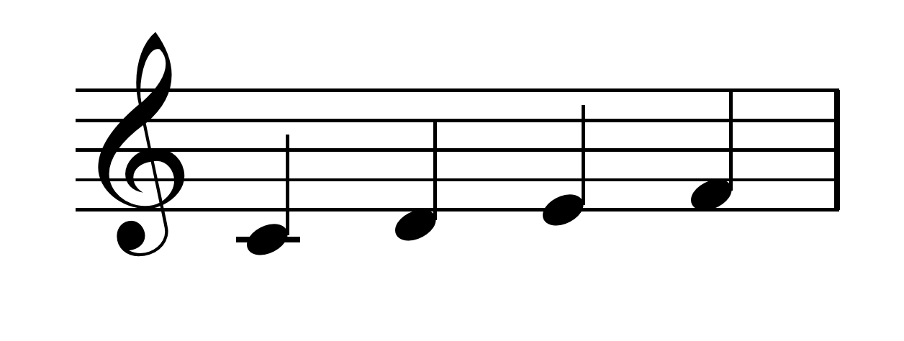
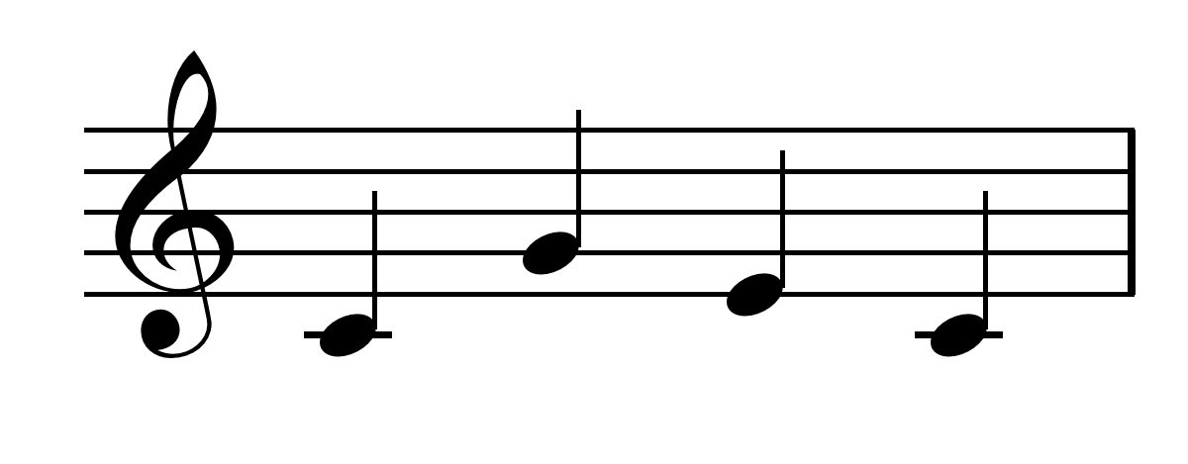
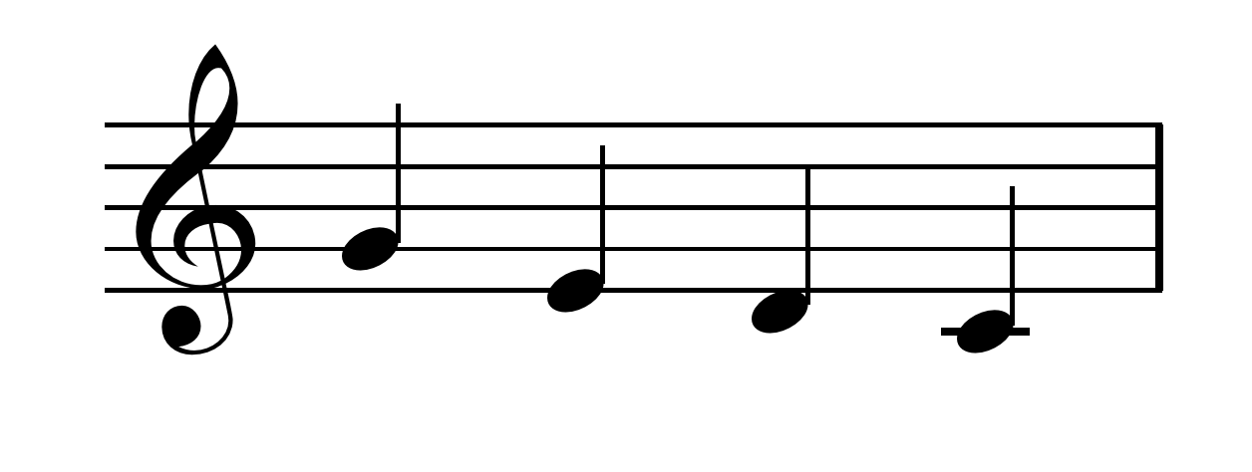
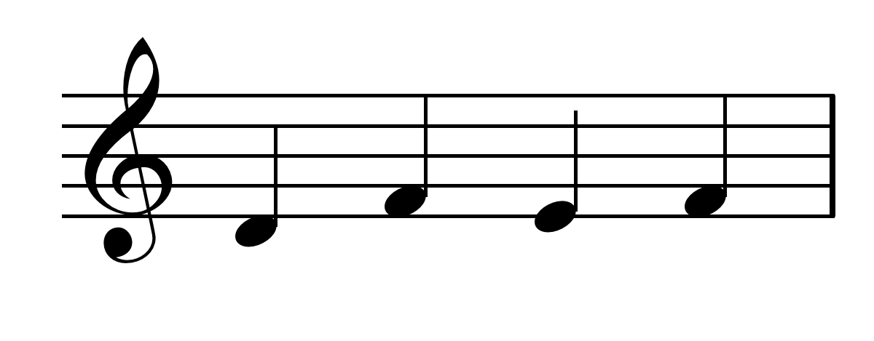
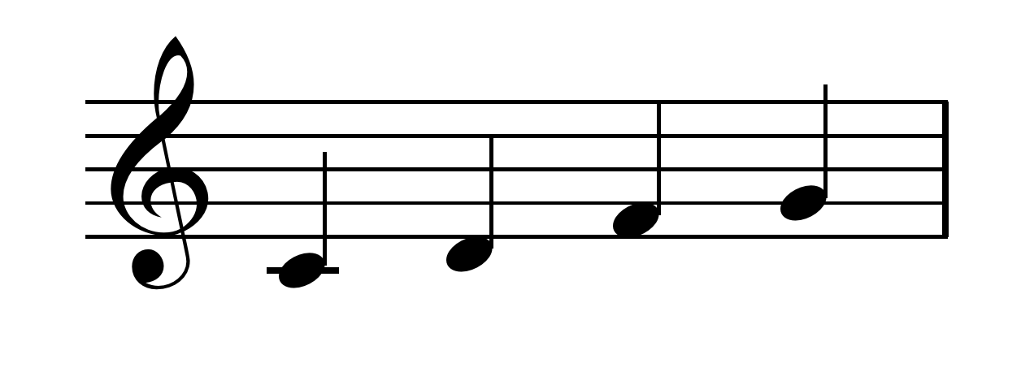
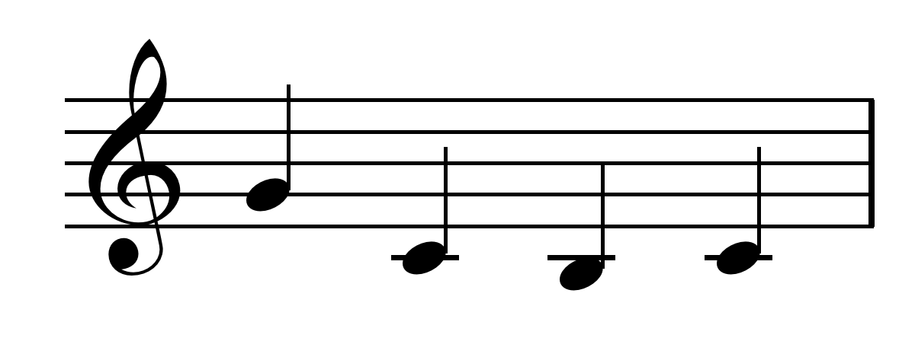
Level 4:- 5 seconds to name 4 notes and the valves
G 0 F 1 E 1/2 D 1/3
G 0 D 1/3 E 1/2 D 1/3
C 0 D 1/3 E 1/2 F 1
C 0 G 0 E 1/2 C 0
G 0 E 1/2 D 1/3 C 0
D 1/3 F 1 E 1/2 F 1
C 0 D 1/3 F 1 G 0
G 0 C 0 B 2 C 0

Slide 8
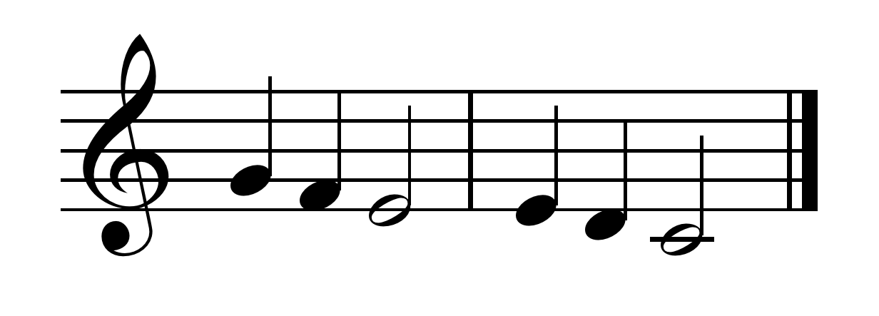
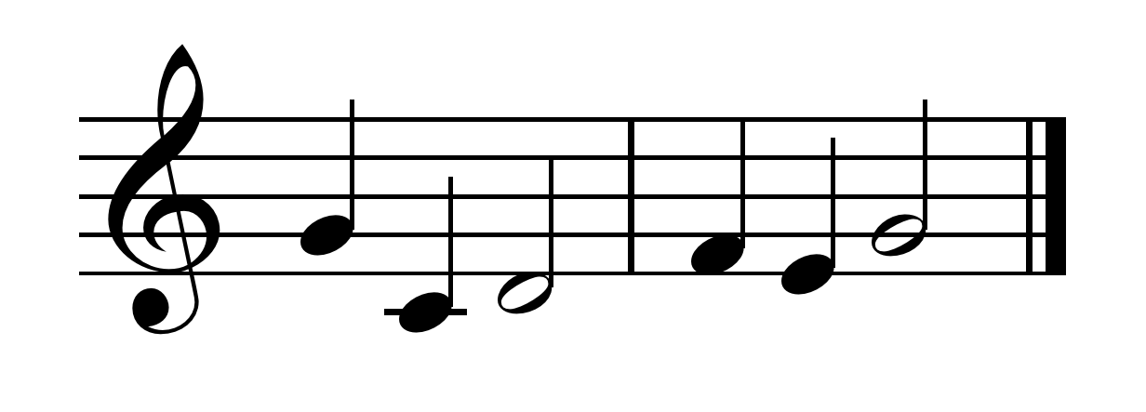
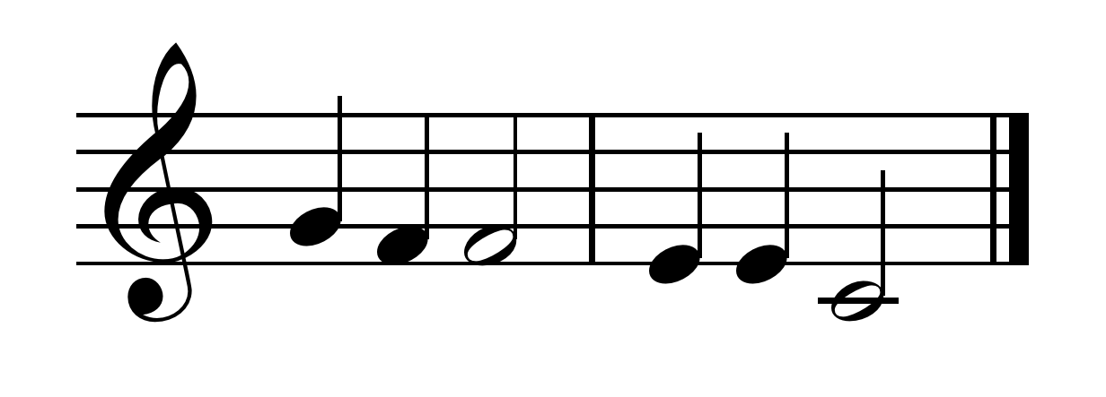
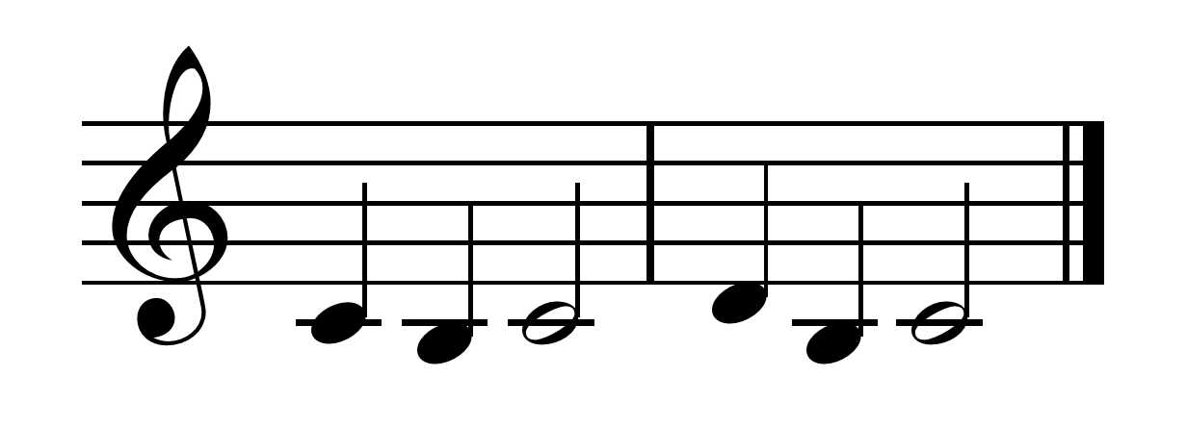
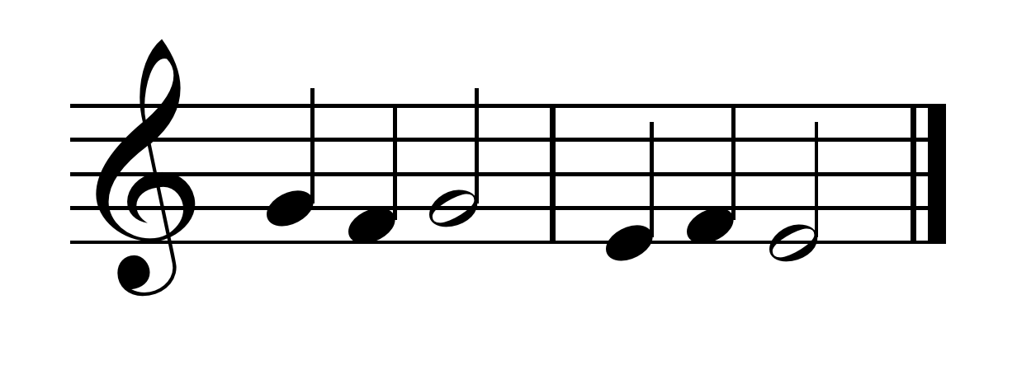
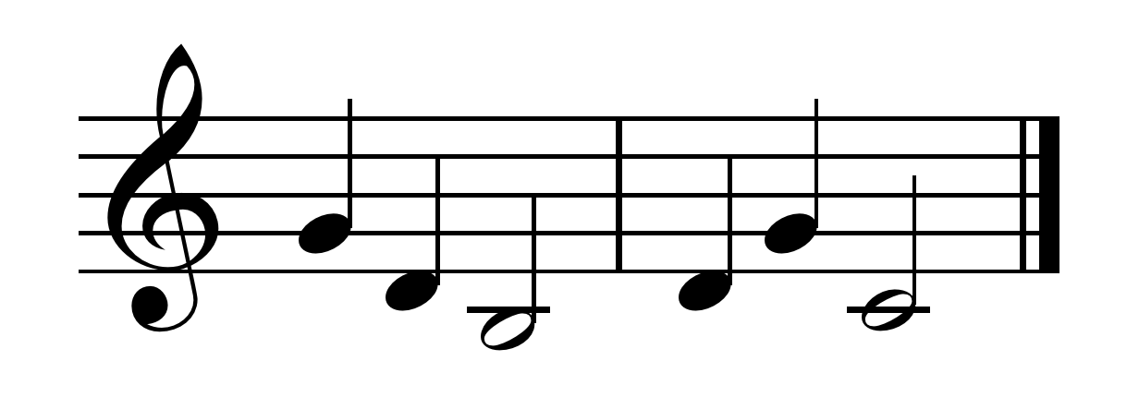
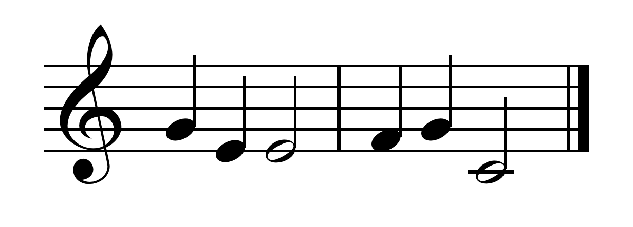
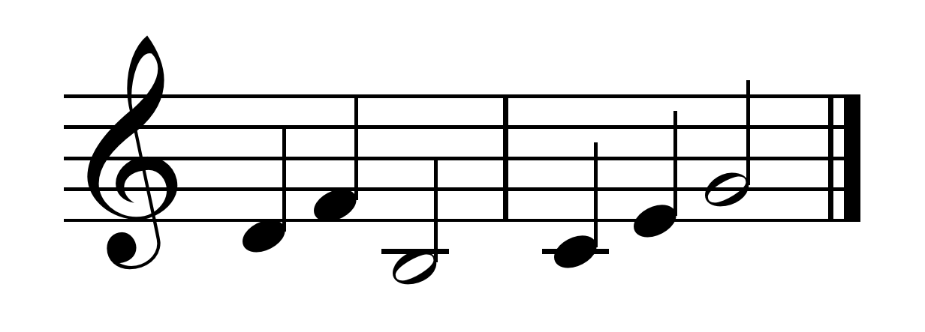
Level 5 Six Notes in 5 seconds
G F E E D C
G C D F E G
G F F E E C
C B C D B C
G F G E F E
G D B D G C
G E E F G C
D F B C E G

