Slide 1
Use these games to help learn the letter names how to read them and their fingerings
The games are based on the word game Scrabble score points as in the game
It may help to print these slides onto A4 card

Slide 2
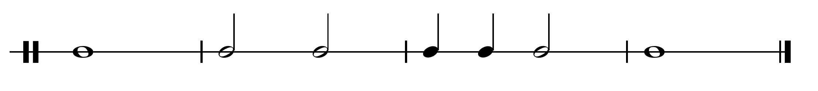
open
1 & 3
1 & 2
1
open
Game 1 (easy) do you know the fingering for the note ? double the score by playing the note correctly on your instrument. Triple score play the rhythm below on that note

Slide 3
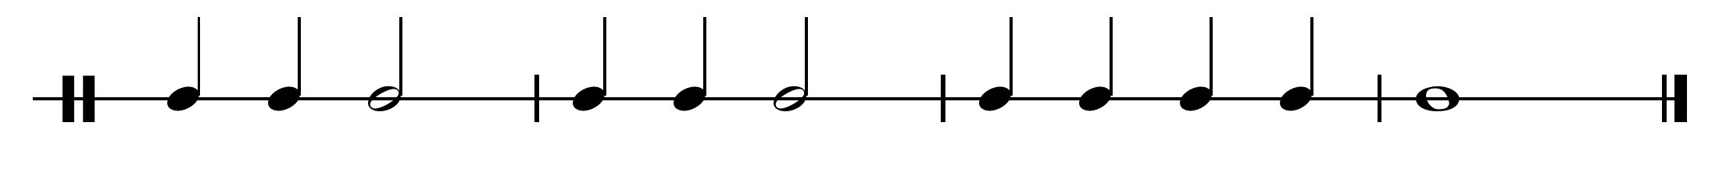
Game 2 Using the next slide Drag the music notes into the box against the correct “Scrabble” mug
Do not save when you close the presentation
On the next slide put the mugs in the correct position against the notes
To double your score play play the notes in a mixed order (not up or down). To triple your score, play the same pattern with the rhythm below

Slide 4
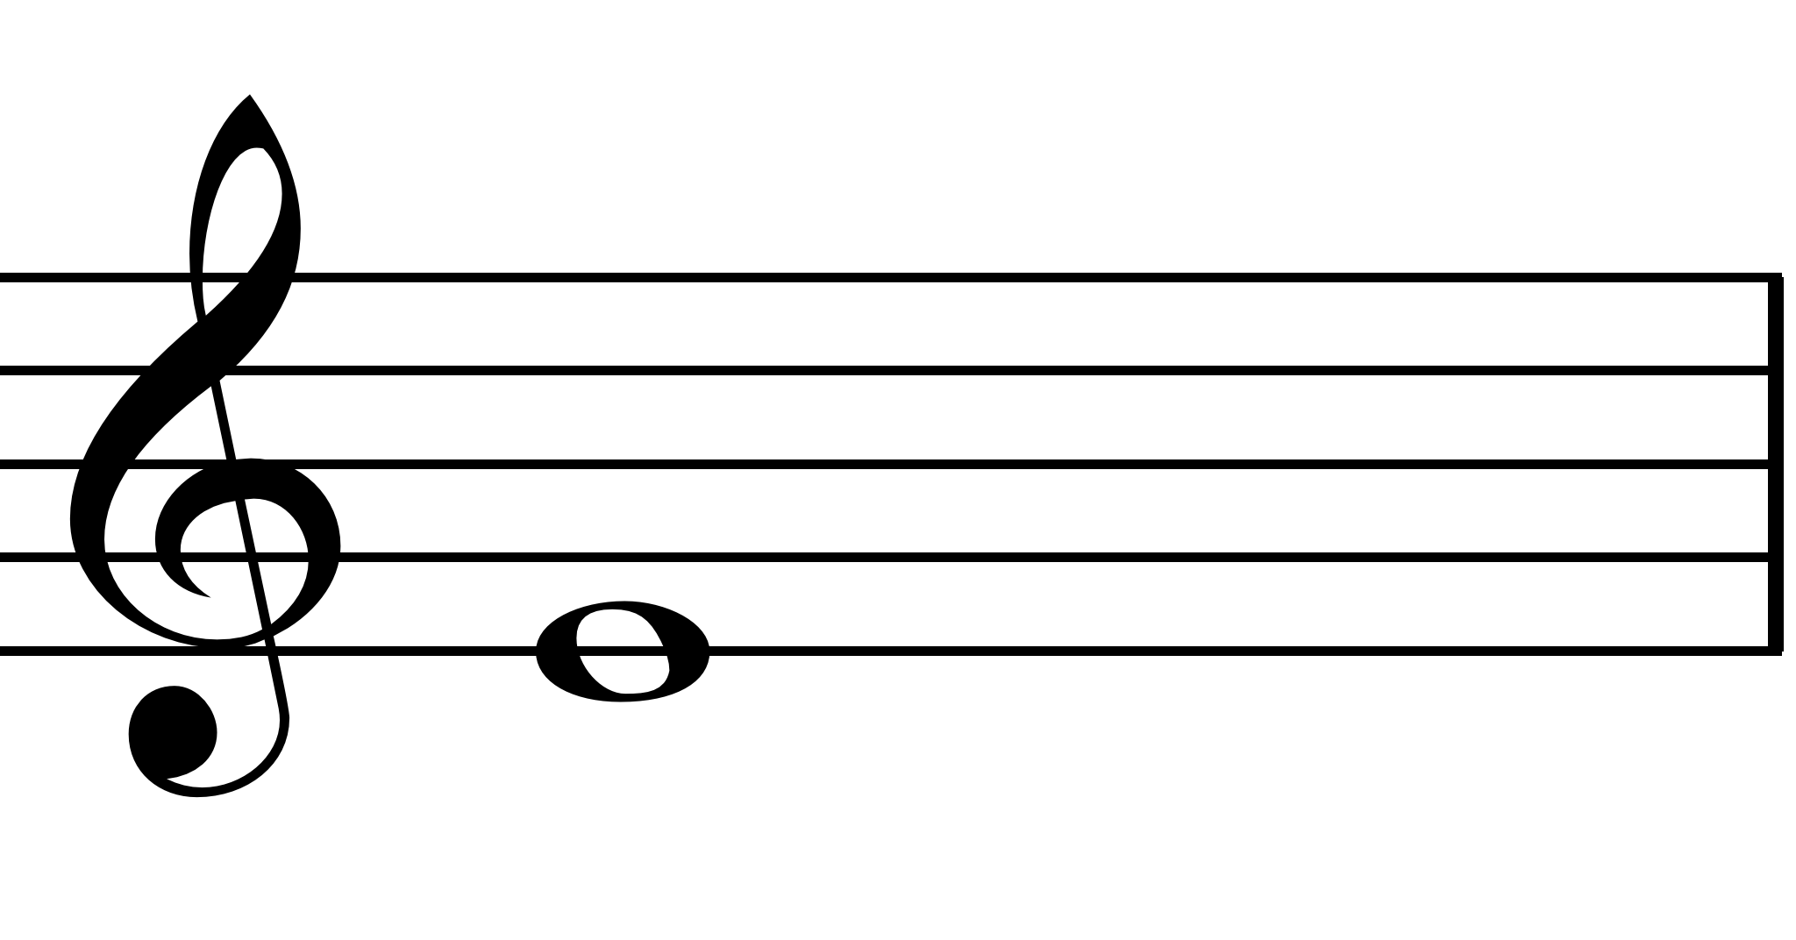
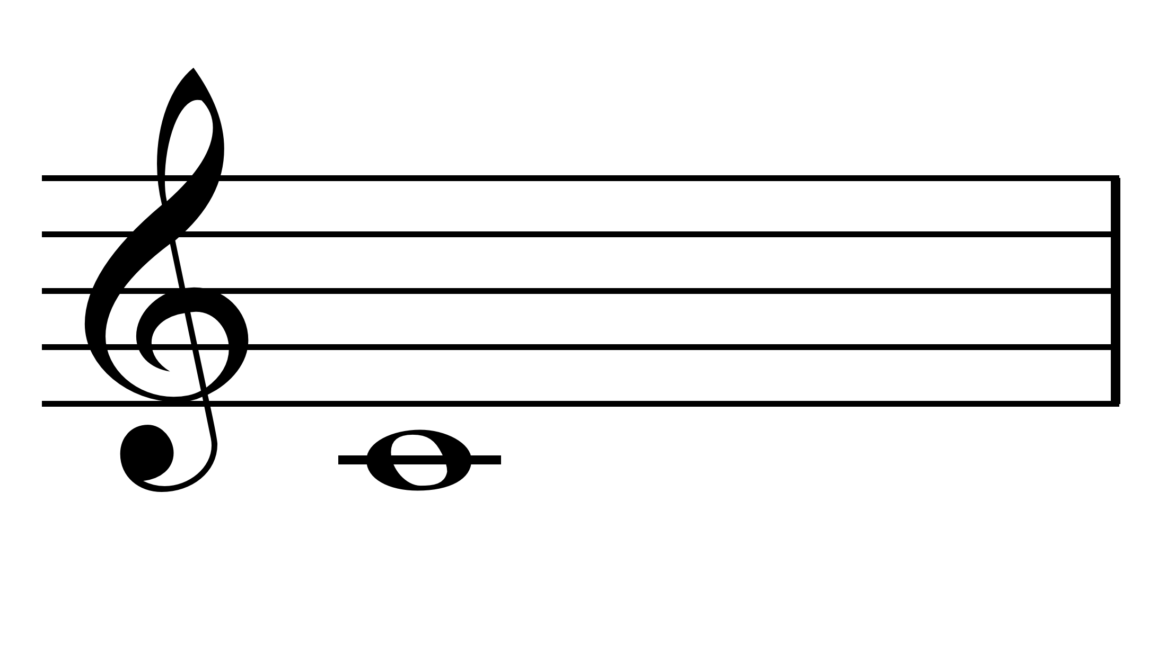
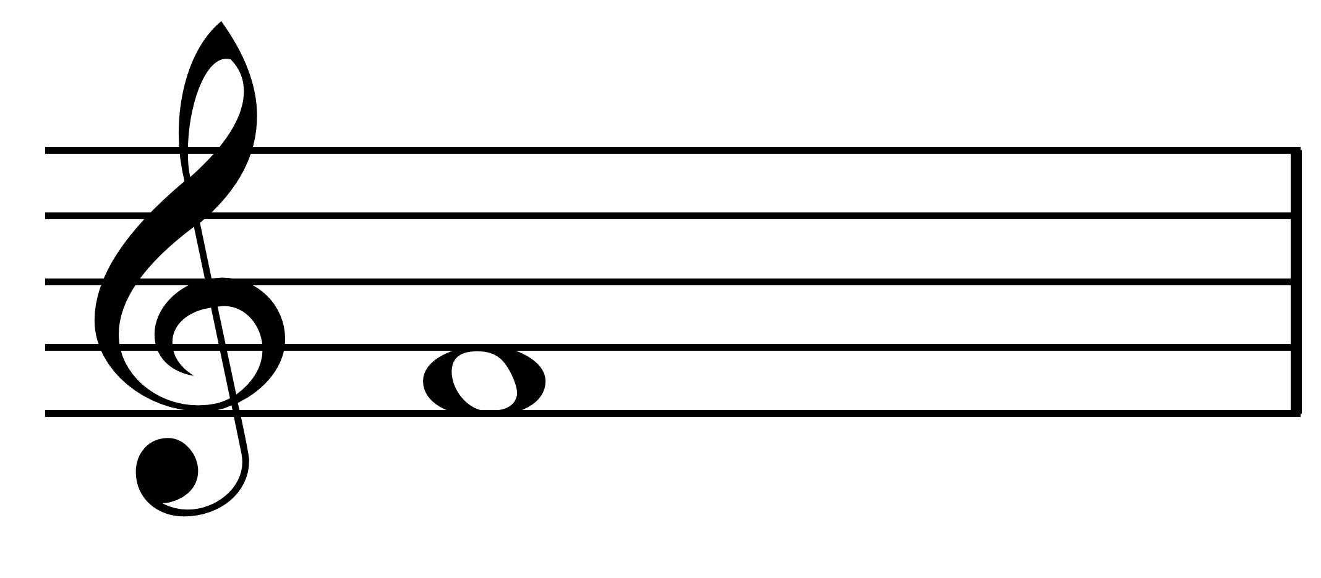
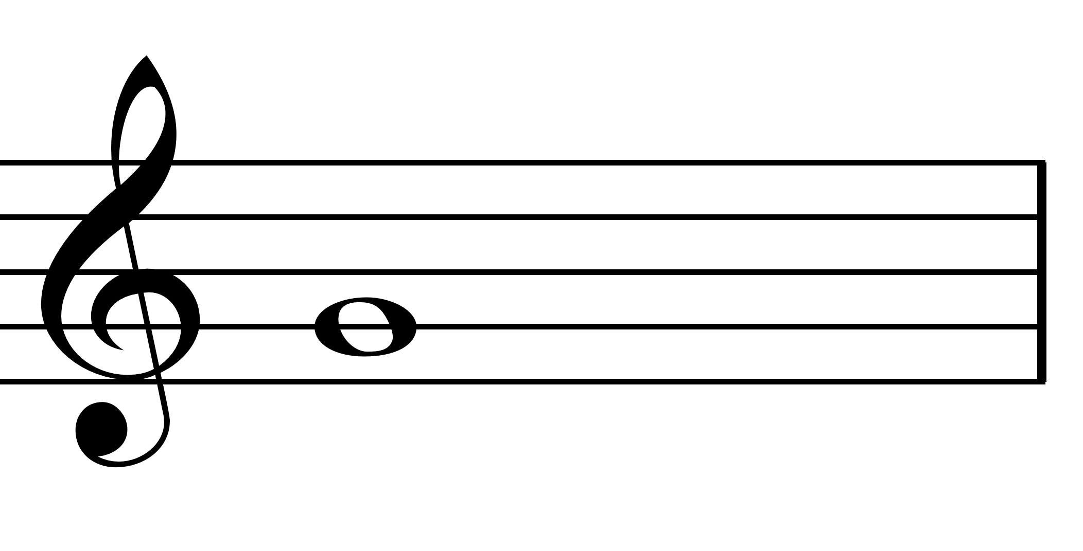
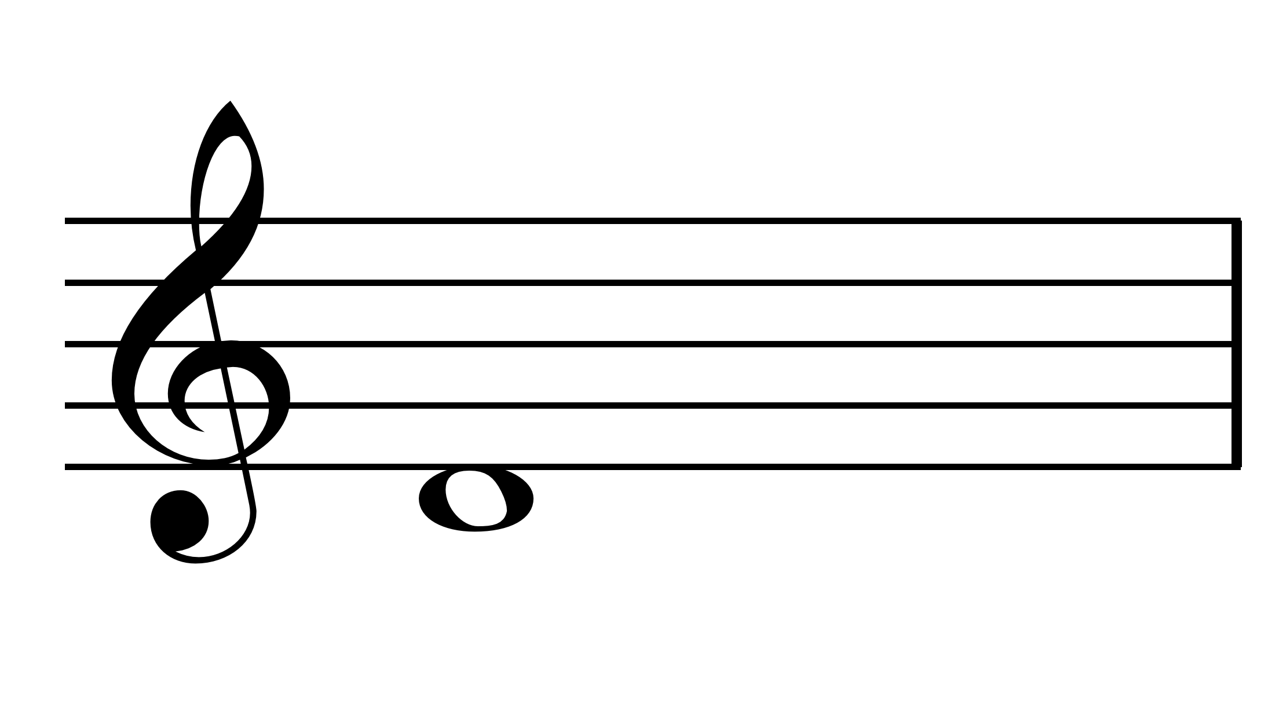

Slide 6
Game 3 now try to make as many words out of the musical letters :-
A B C D E F G as you can, use the letters as many times as you wish. What score can you reach?
Then to double your score write the word with musical notes. To treble give it a rhythm and make a 4 bar piece. (see the example on slide no.8) and try playing it. If you can do all this score a 50 point bonus

Slide 7
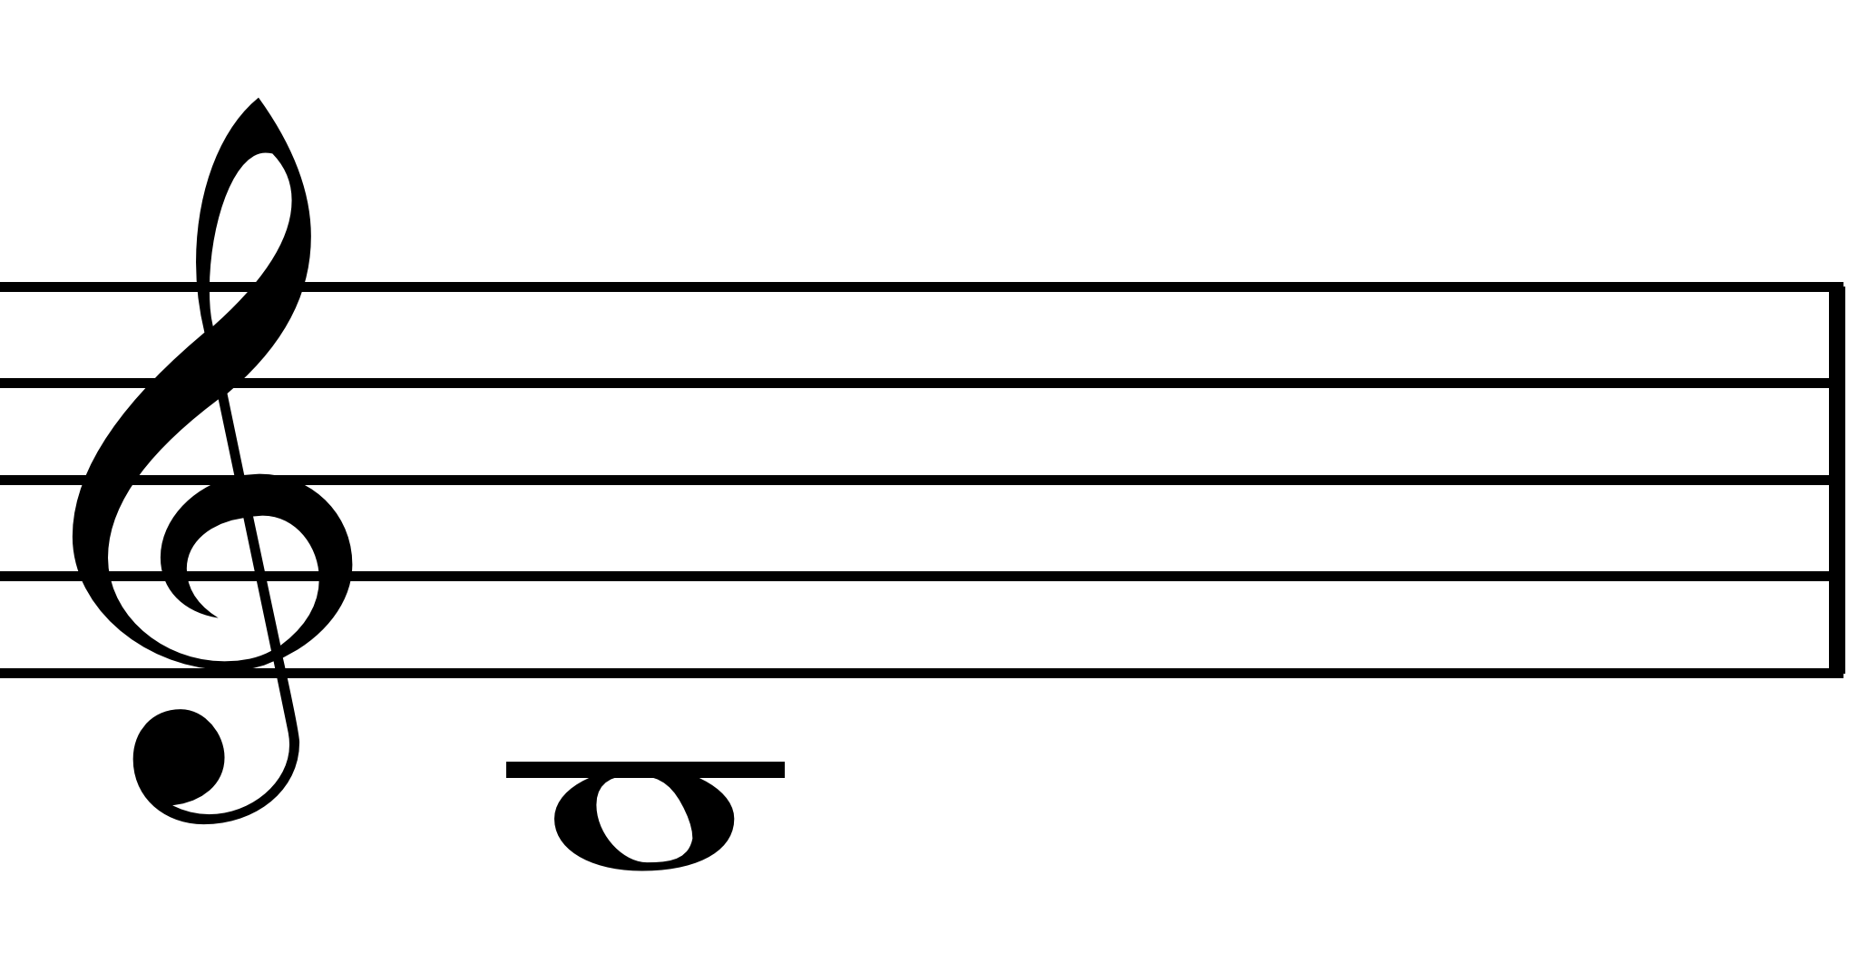
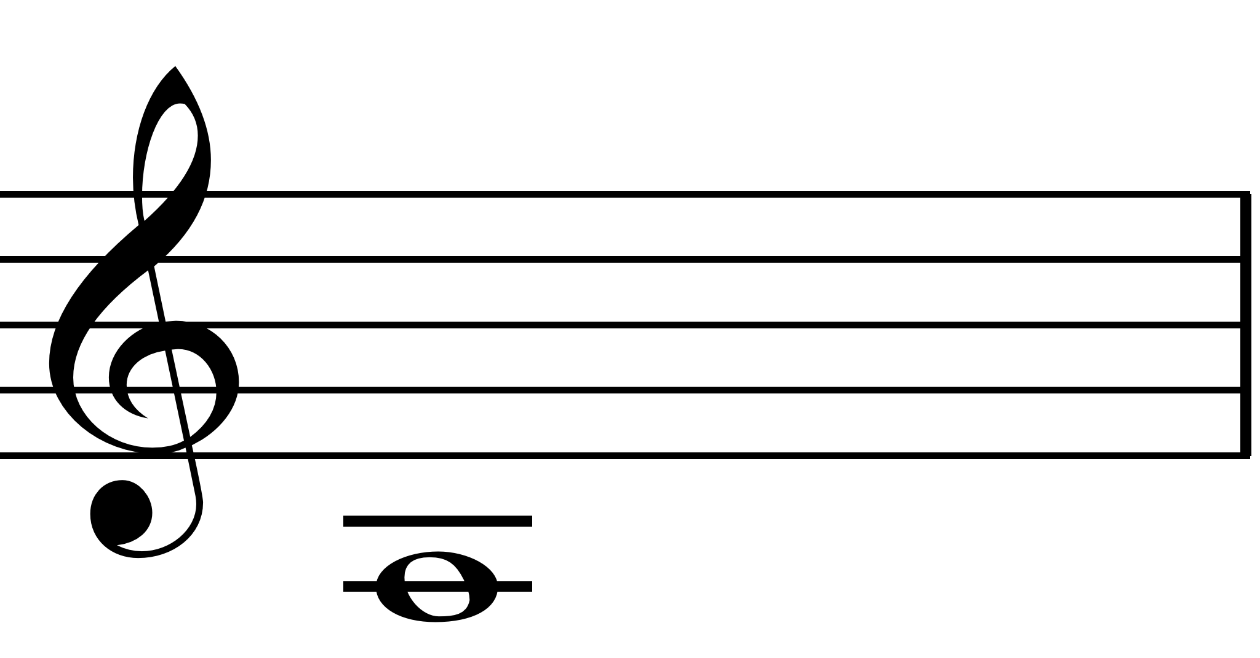
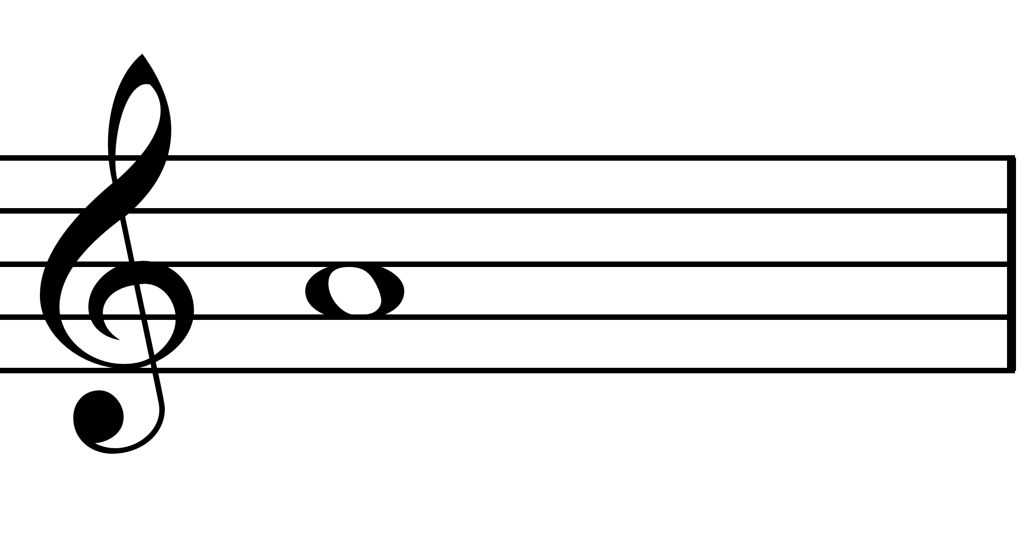
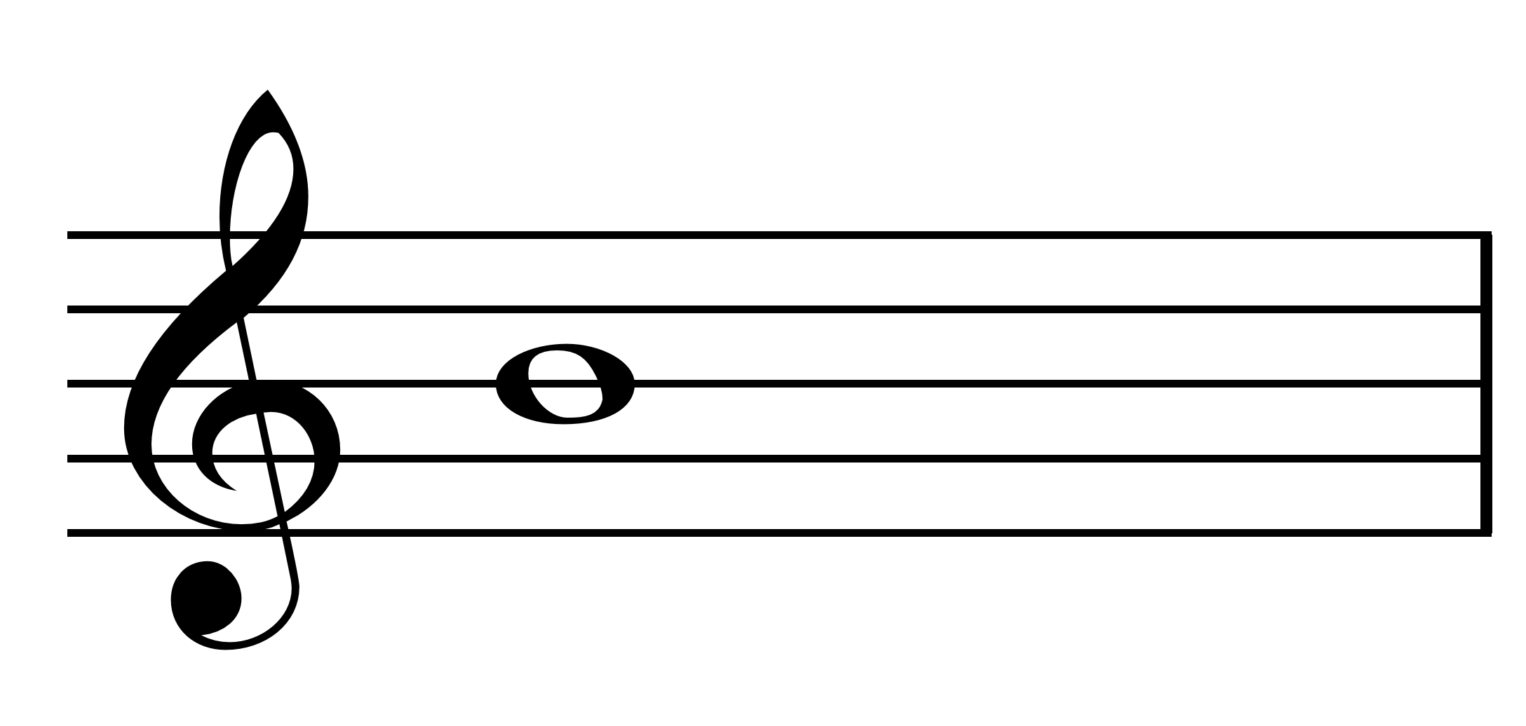
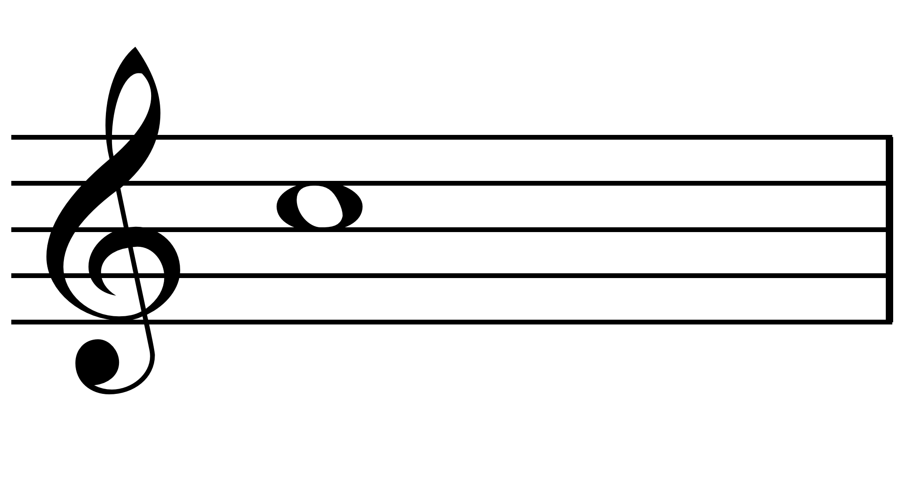
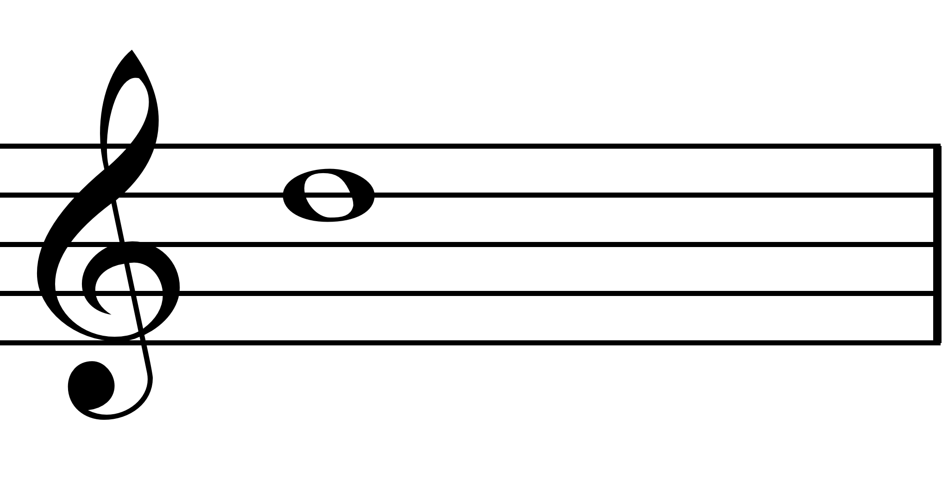
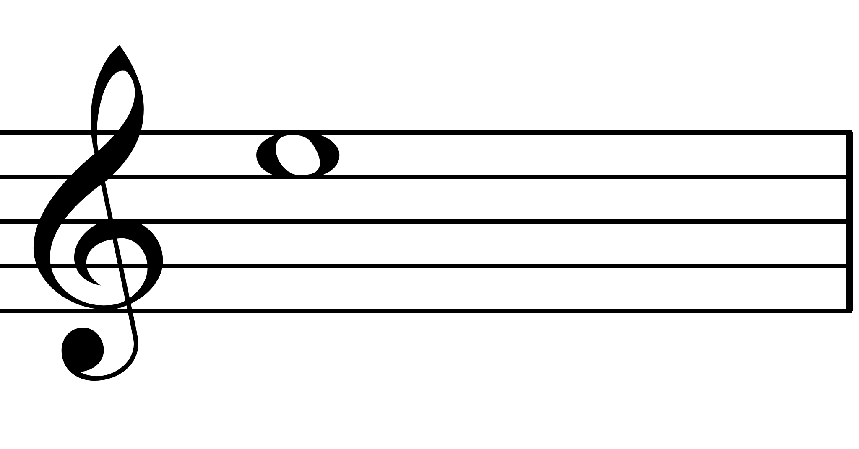
here are the musical notes for A B C D E F G some appear twice as both high and low!!

Slide 8
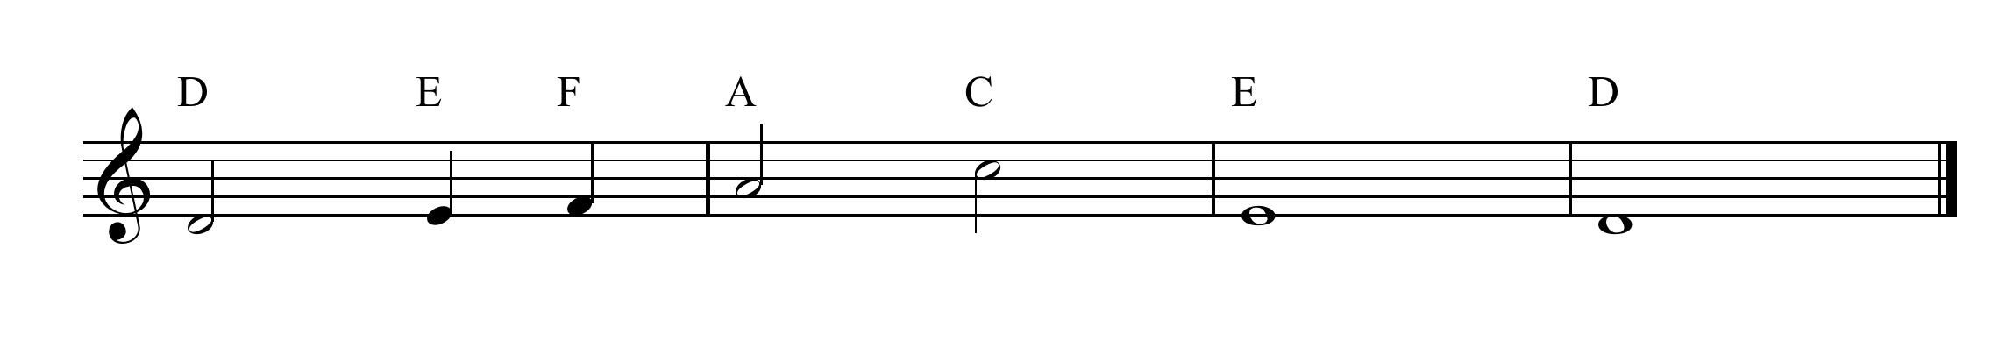

Mr. Bs’ example
92
Mr. B scores (14 x 3) +50 =
now beat that

Slide 9
here are the musical notes for A B C D E F G
score scrabble points by naming them double your points by playing them on your instrument triple points for any of the notes on the bottom 2 lines

Slide 10
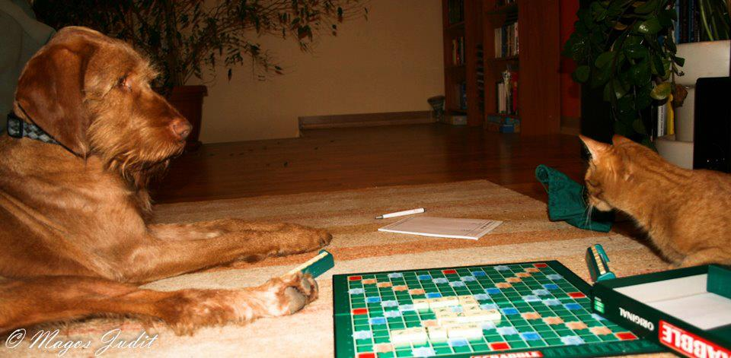
All the best play scrabble

