Slide 1


Slide 2
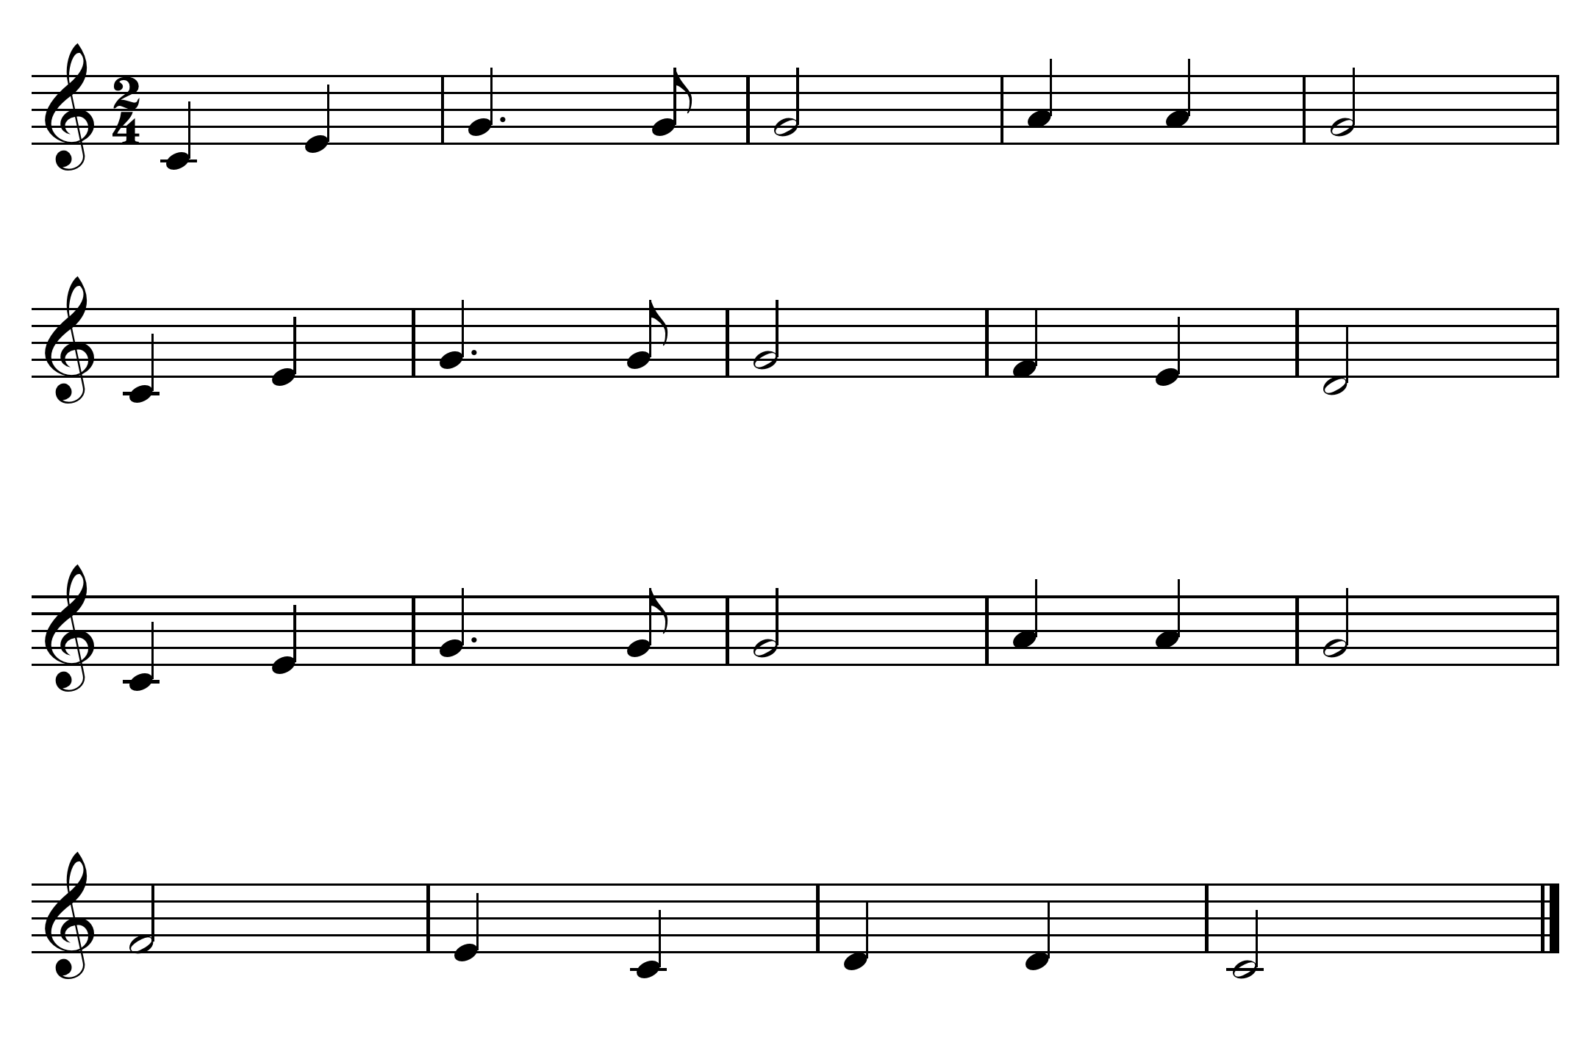
click here for note names

Slide 3
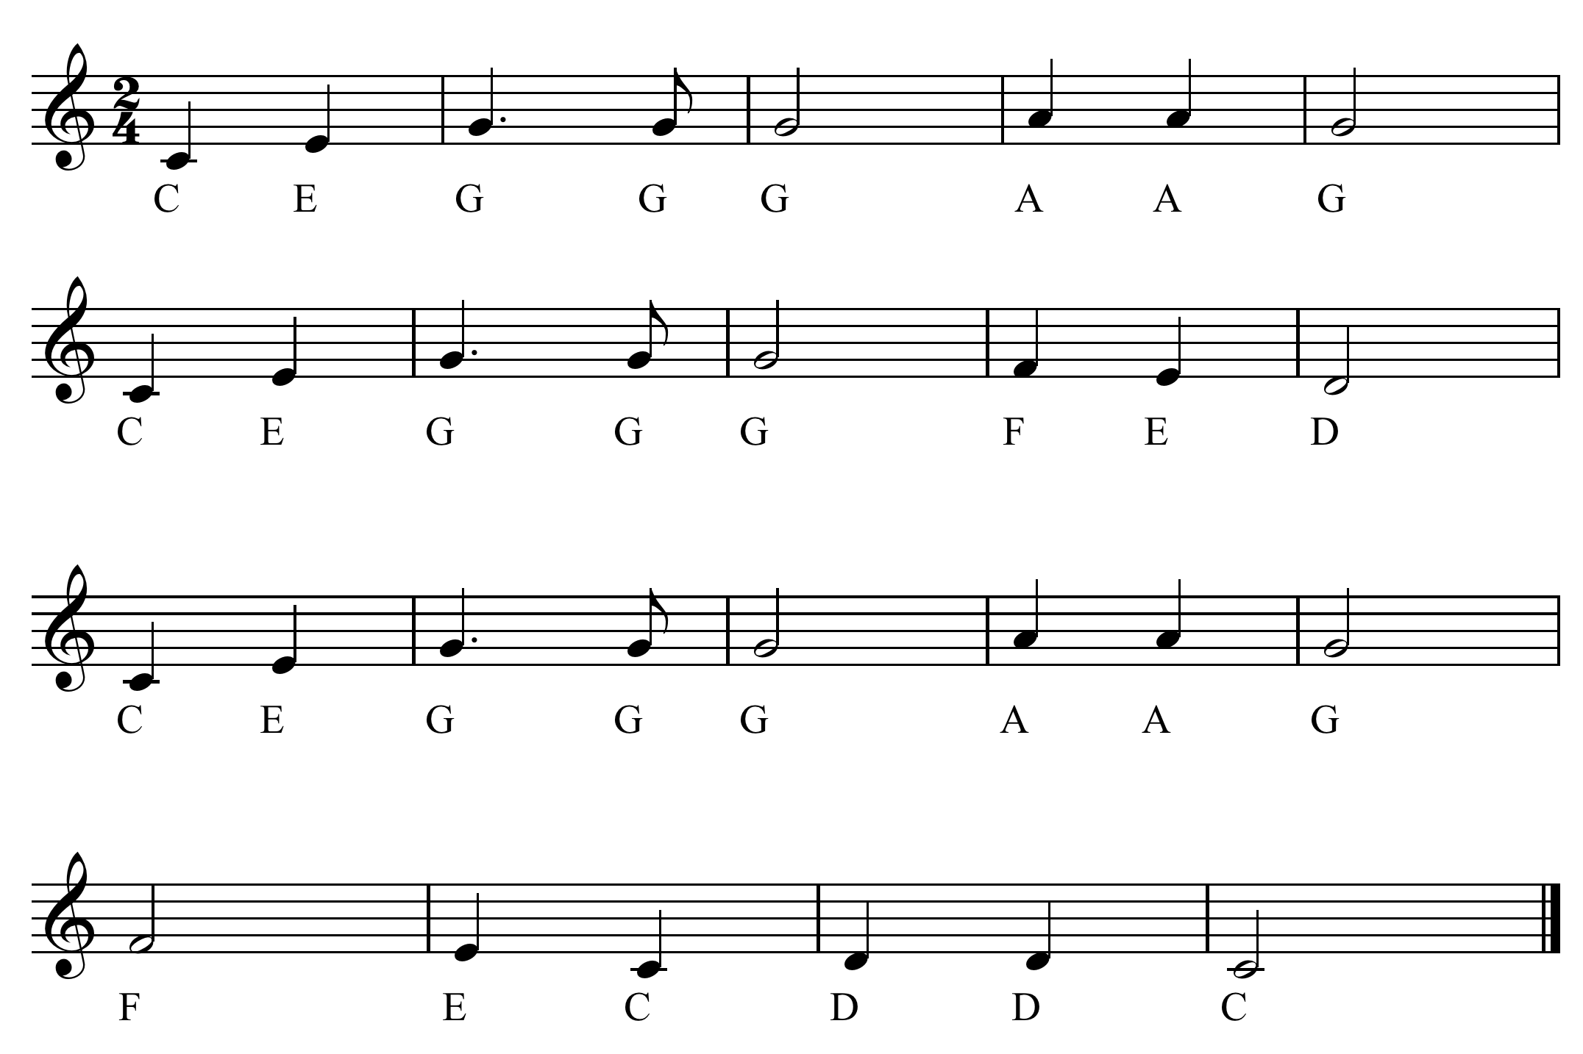

Slide 4
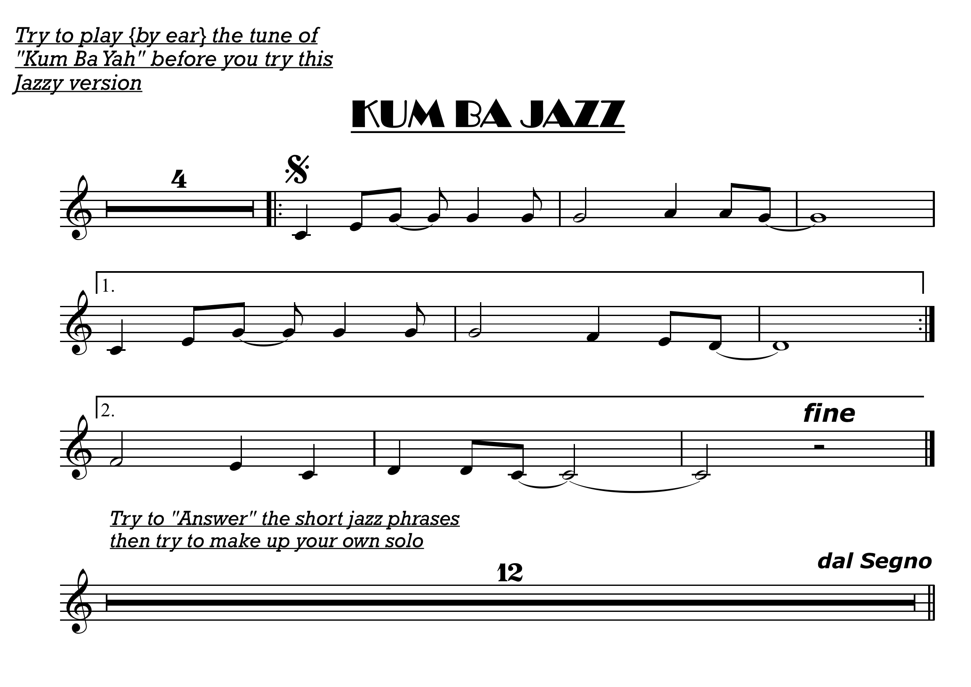
The Super 7
click here for note names

Slide 5
