Slide 1

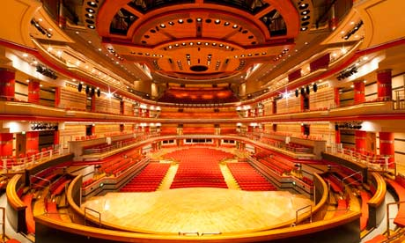
There are 3 versions of this tune:-
1 for Cornets Baritones
2 for Tenor Horns (and Alto trombones)
3 a version for Cornets and baritones to play with Tenor Horns
composed for Ladywood Showcase Symphony Hall Birmingham May 2012

Slide 2
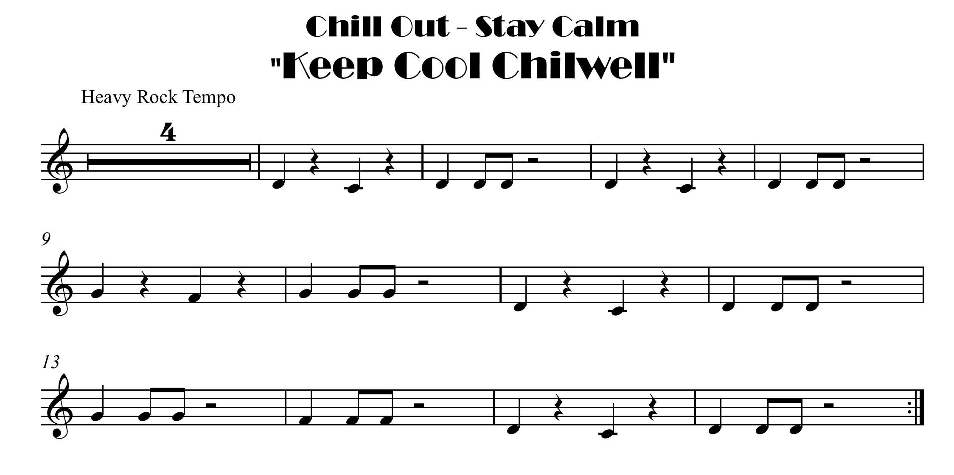


click here for note names

Slide 3
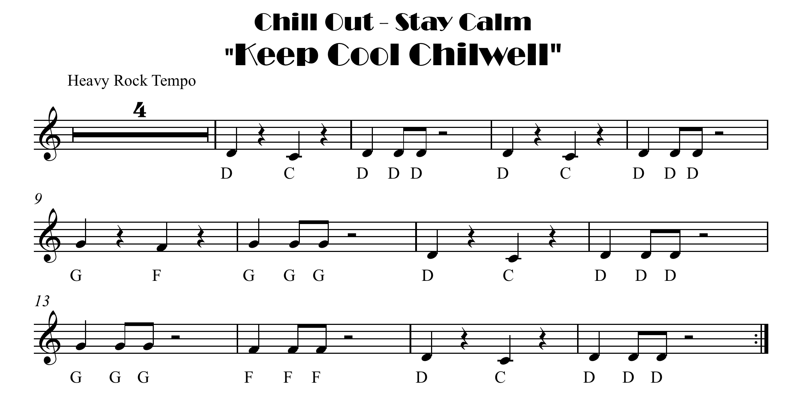

Slide 4

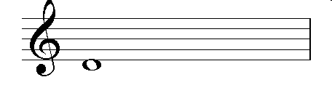

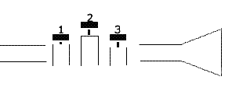
1 and 3
D is dropping off
the line

Slide 5
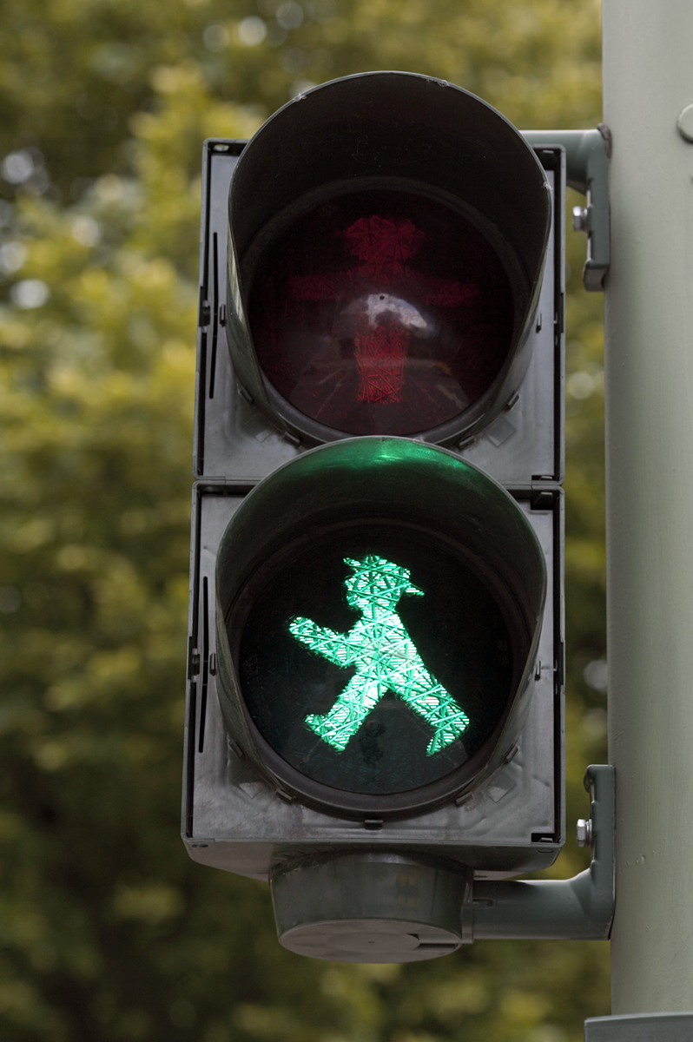
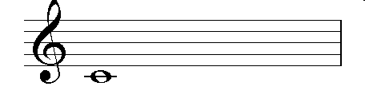
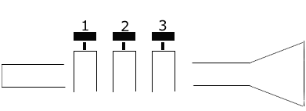
C is crossing a line
open

Slide 6
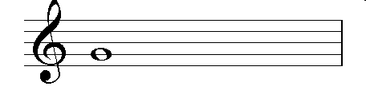
Note Names
open
G is gripping the line

Slide 7
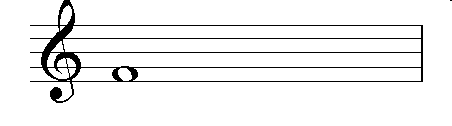
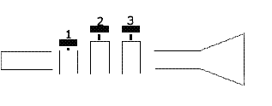
F is filling
the space
1

Slide 8

click here for note names

Slide 10
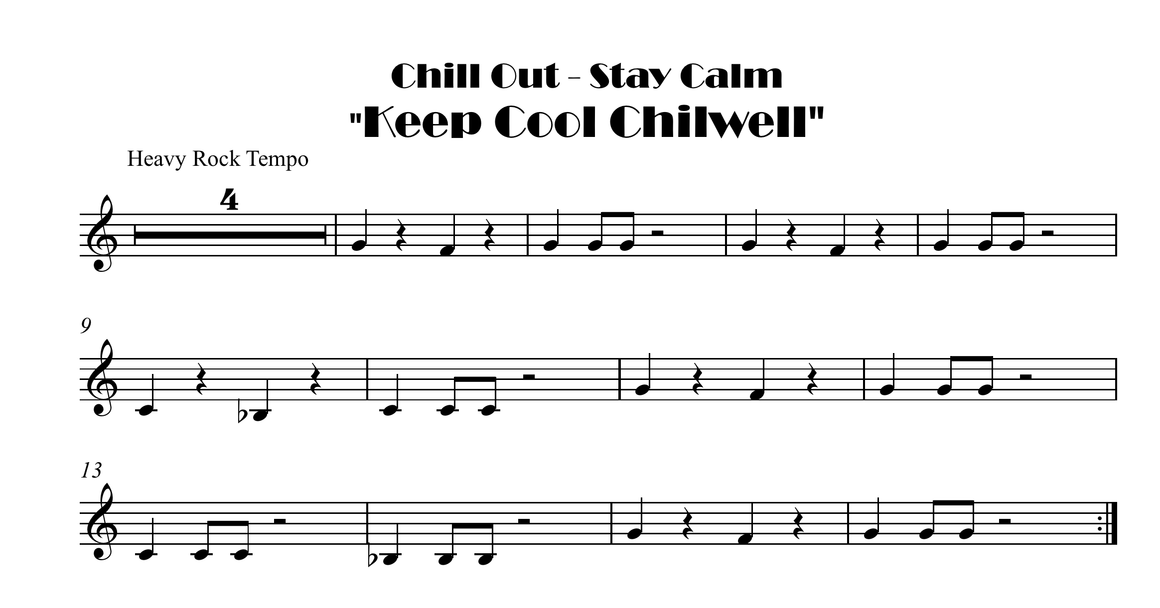
Bb with Eb
click here for note names

Slide 11
