Slide 1
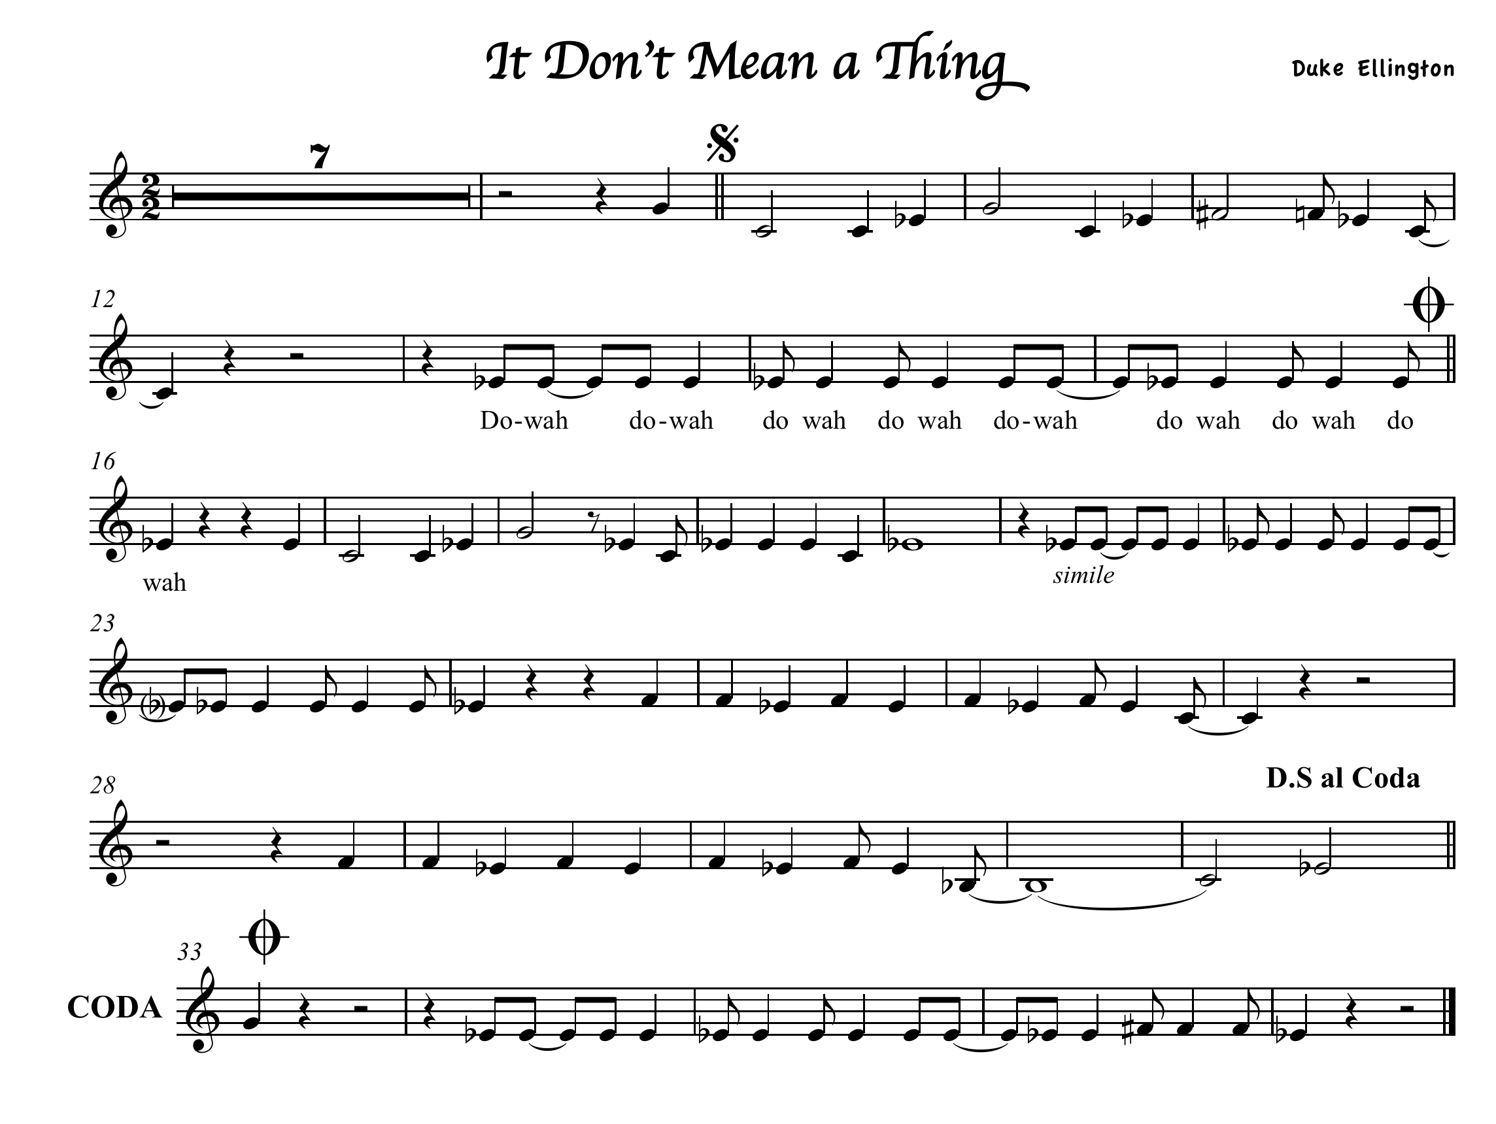


Slide 2
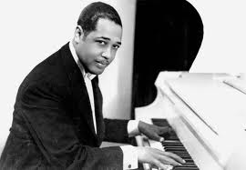
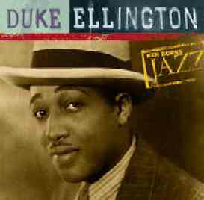
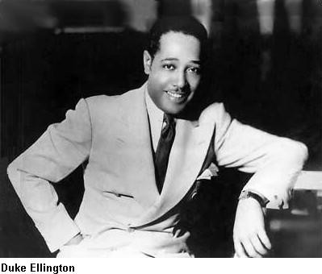
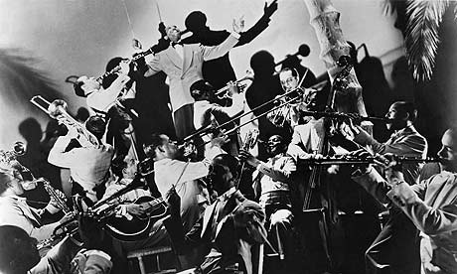

Slide 3
"It Don't Mean A Thing (If It Ain't Got That Swing)" is a 1931 composition by Duke Ellington with lyrics by Irving Mills, now accepted as a jazz standard. The music was written and arranged by Ellington in August 1931 during intermissions at Chicago's Lincoln Tavern and was first recorded by Ellington and his orchestra for Brunswick Records on February 2, 1932. Ivie Anderson sang the vocal and trombonist Joe Nanton and alto saxophonist Johnny Hodges played the instrumental solos. The title was based on the oft-stated credo of Ellington's former trumpeter Bubber Miley, who was dying of tuberculosis. The song became famous, Ellington wrote, 'as the expression of a sentiment which prevailed among jazz musicians at the time'. Probably the first song to use the phrase 'swing' in the title, it introduced the term into everyday language and preceded the swing era in music by three years. Edward Kennedy 'Duke' Ellington (April 29, 1899 - May 24, 1974) was an American composer, pianist, and jazz orchestra leader. Duke Ellington became one of the most influential artists in the history of recorded music, and is largely recognized as one of the greatest figures in the history of jazz, though his music stretched into various other genres, including blues, gospel, movie soundtracks, popular, and classical. His career spanned five decades and comprised of leading his orchestra, an inexhaustible songbook, scoring for movies and world tours. Due to his inventive use of the orchestra, or 'big band', and in part to his refined public manner and extraordinary charisma, he is generally considered to have elevated the perception of jazz to an artistic level on par with that of classical music. This channel is dedicated to the classic jazz music you've loved for years. The smokin' hot, icy cool jams that still make you tap your feet whenever you hear them . . . Cool Jazz is here!
http://www.youtube.com/watch?v=-FvsgGp8rSE

Slide 4
