Slide 1
Hot Cross Rock Buns
website edition
“Good Friday come this month, the old woman runs With one or two a penny hot cross buns”
http://news.bbc.co.uk/1/hi/magazine/8598312.stm

Slide 2
Religious connotation of the words and lyrics Hot cross buns are a fruit cake decorated with a white cross across the top of it celebrated in this nursery rhyme. Generally they are served with a butter spread. Hot cross buns were sold in the street to the cry of "Hot cross buns!" around the period in English history dating back to the nineteenth century. They are generally sold at Easter and commemorate the religious significance of the Easter Christian festival which celebrates the resurrection following crucifixion on the cross.

Slide 3
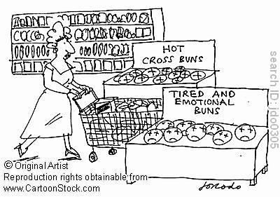

Slide 4

There are 2 versions of this tune:-
We Sing http://www.youtube.com/watch?v=Ndd-6WB5vlo
We play
4 bars in
Hot cross buns! Hot cross buns! One ha' penny, two ha' penny, Hot cross buns! Give them to your daughters, Give them to your sons One ha' penny, Two ha' penny, Hot Cross Buns![2 times]

Slide 5
Now try the brass version (which is a different tune) it uses
C and D
and the new note E

Slide 6
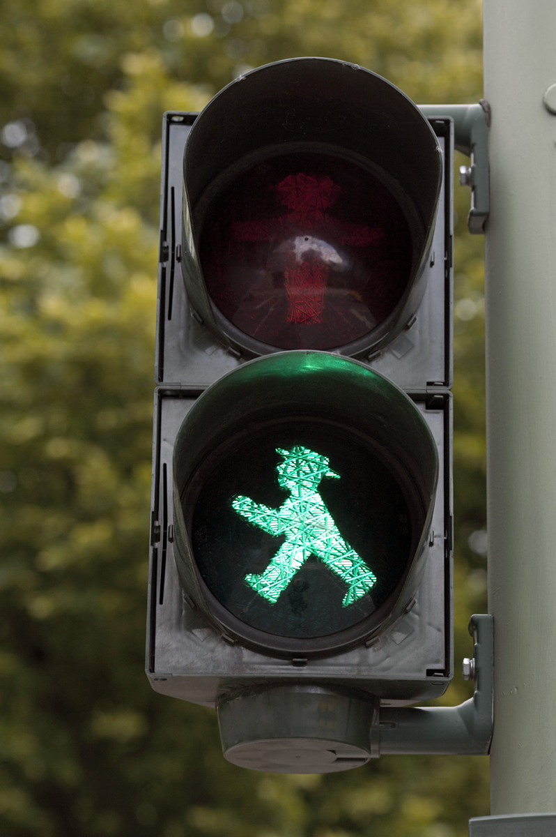
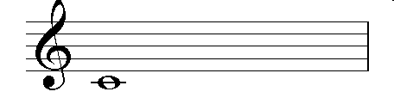
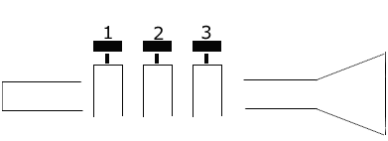
C is crossing a line
open

Slide 7

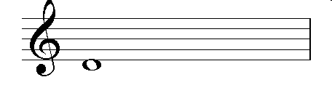

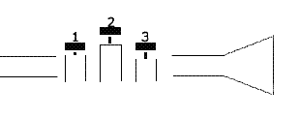
1 and 3
D is dropping off
the line

Slide 8

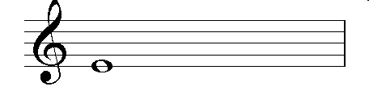
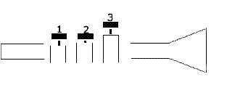
E is eating the line
1 and 2

Slide 9

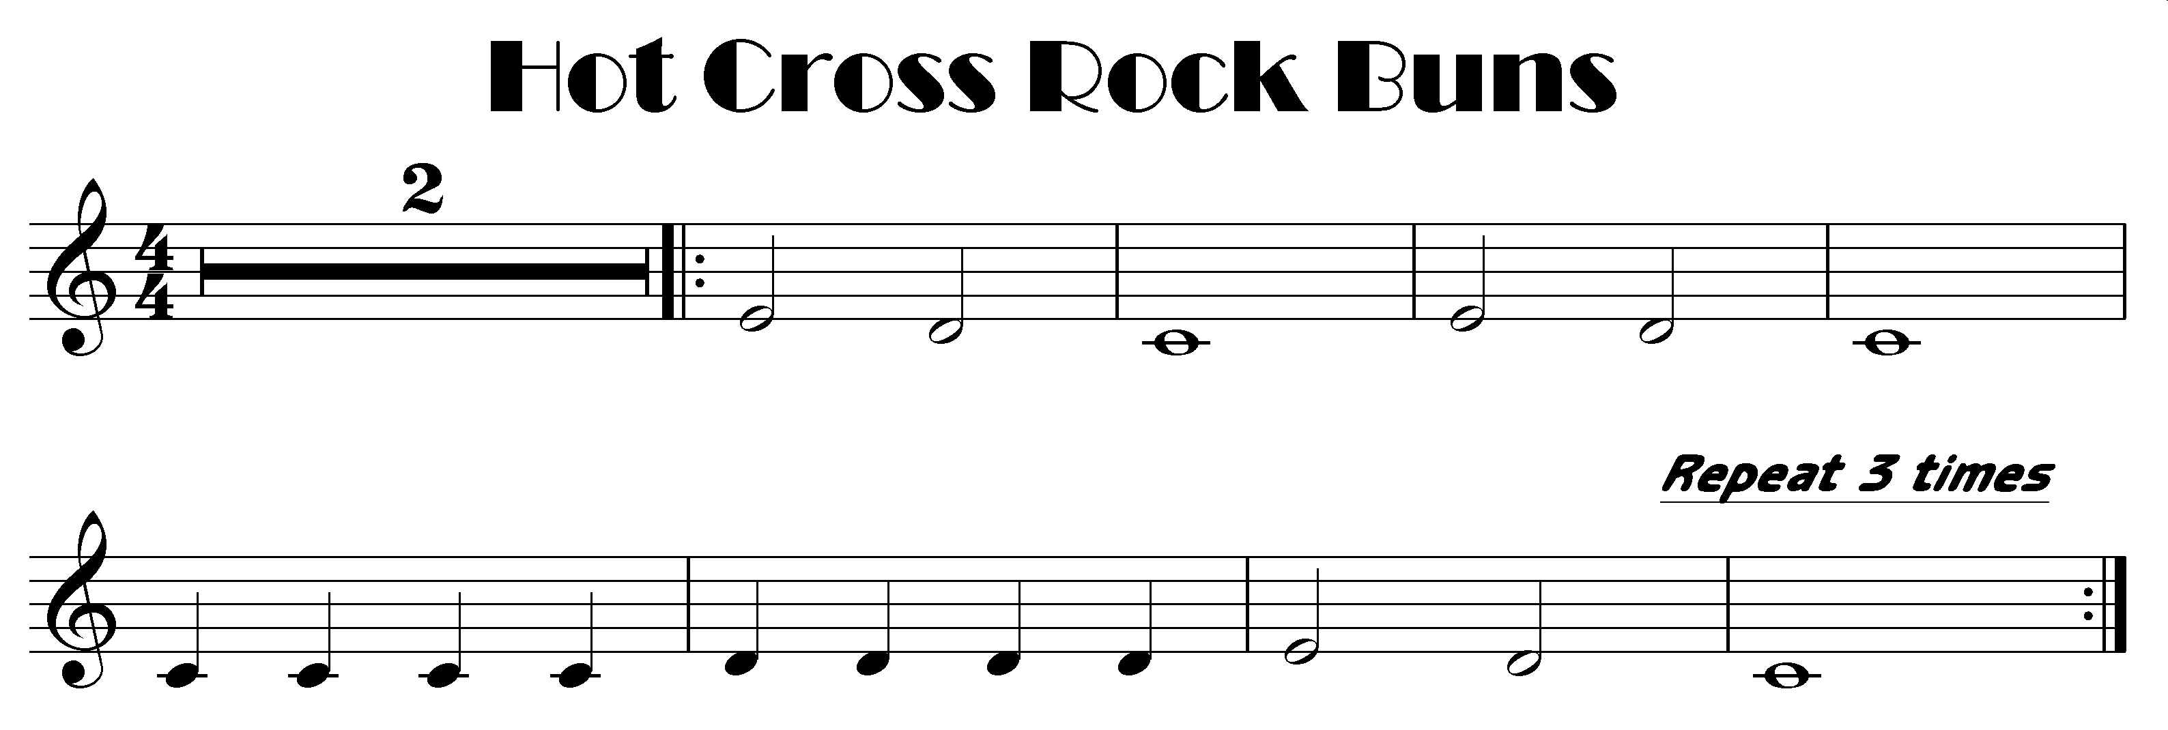

slow bit quicker quick fast
slow bit quicker quick fast

Slide 10
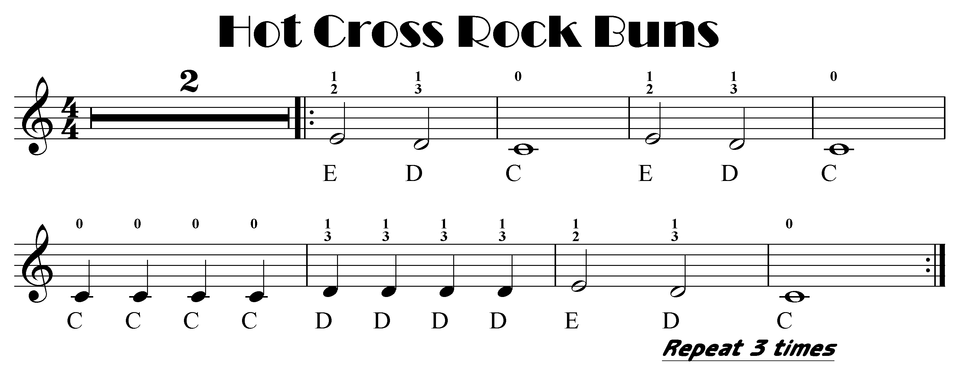
slow bit quicker quick fast
slow bit quicker quick fast

Slide 11
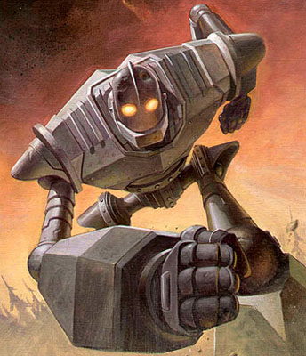
Here is my funky version using G F and E check the notes out first
Strong

Slide 12
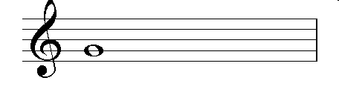
Note Names
open
G is gripping the line

Slide 13
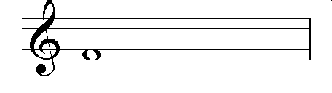
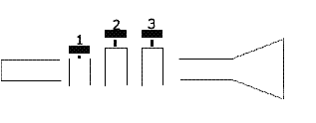
F is filling
the space
1

Slide 14
E is eating the line
1 and 2

Slide 15
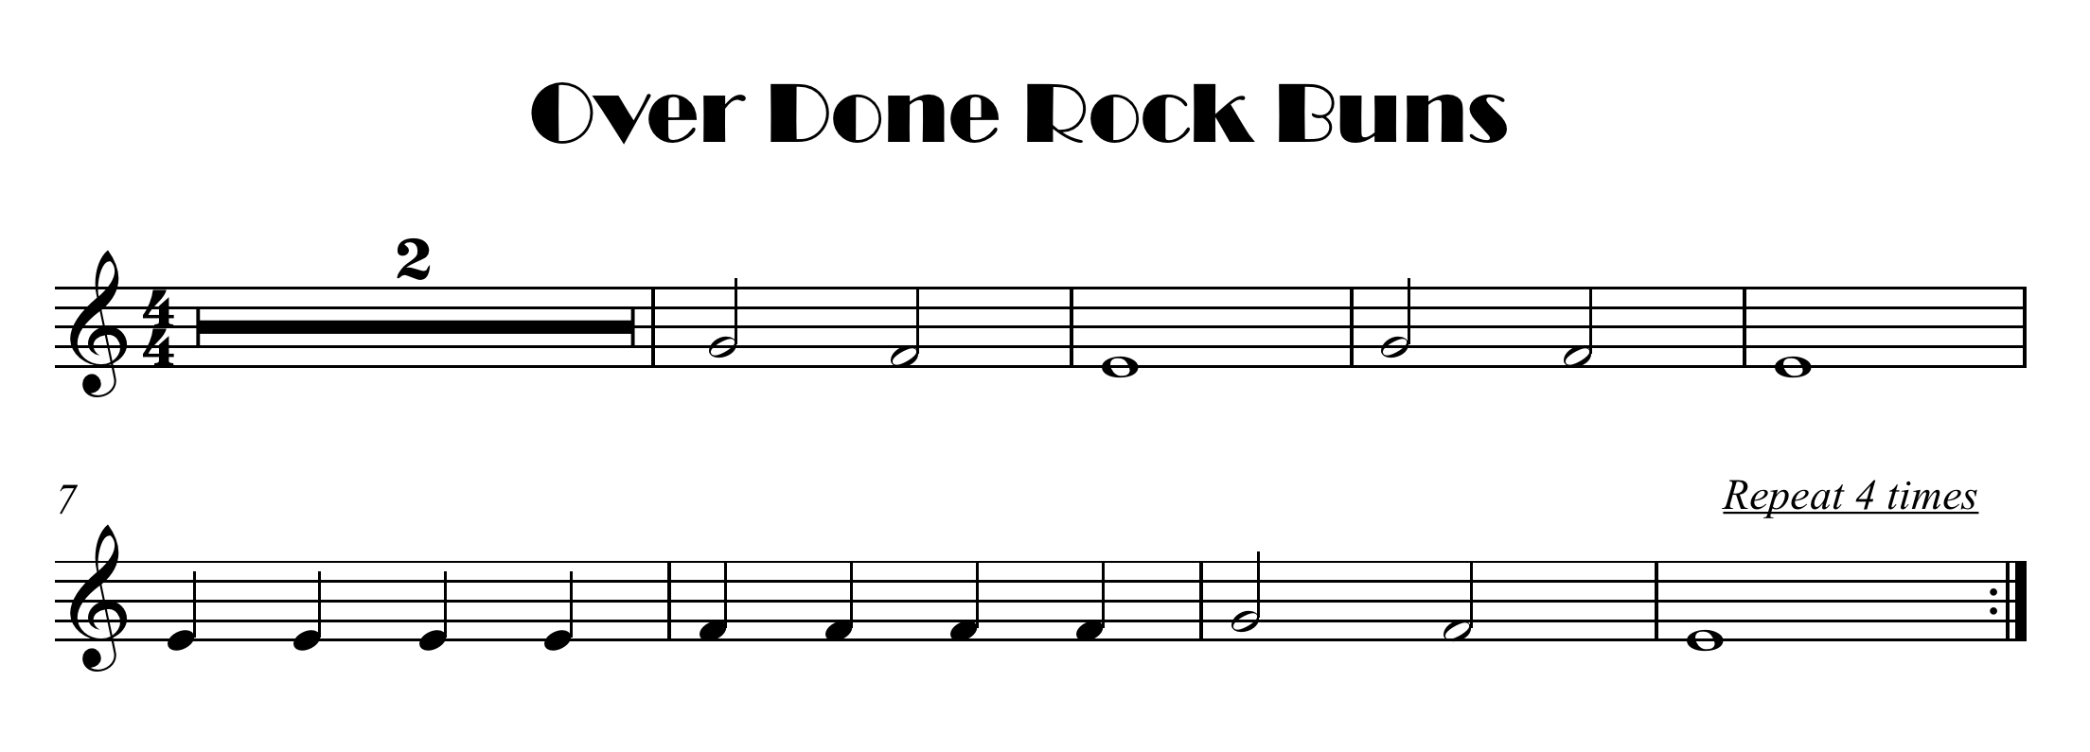
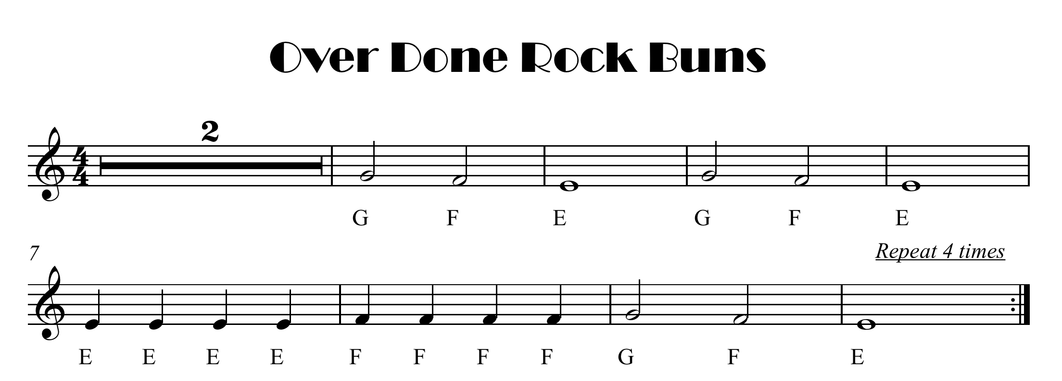
click here for note names

Slide 16
click here for note names

Slide 17
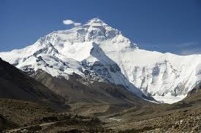
One More Note to get to the top

Slide 18
Name The Notes and valves
D
1 and 3
1 and 2
E
F
1

Slide 19
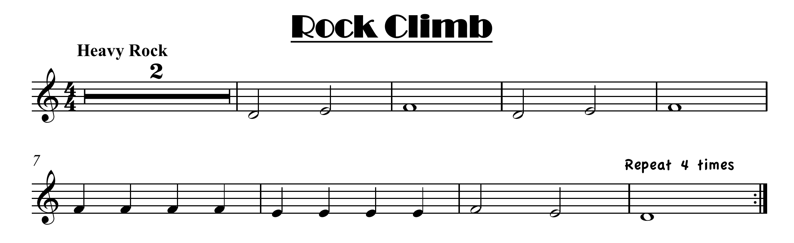
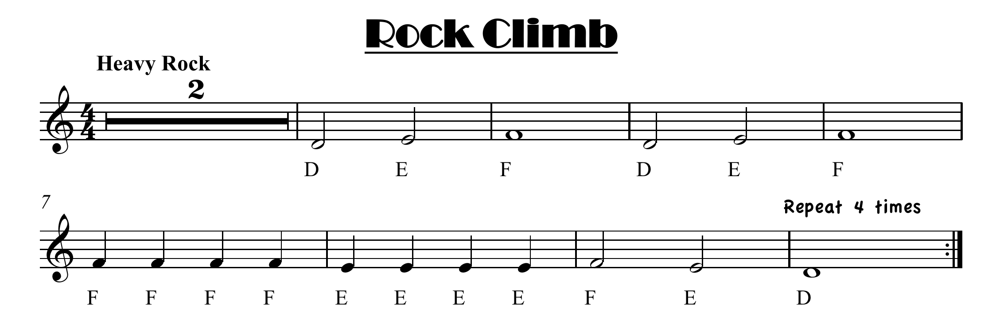
click here for note names

Slide 20
click here for note names

Slide 21
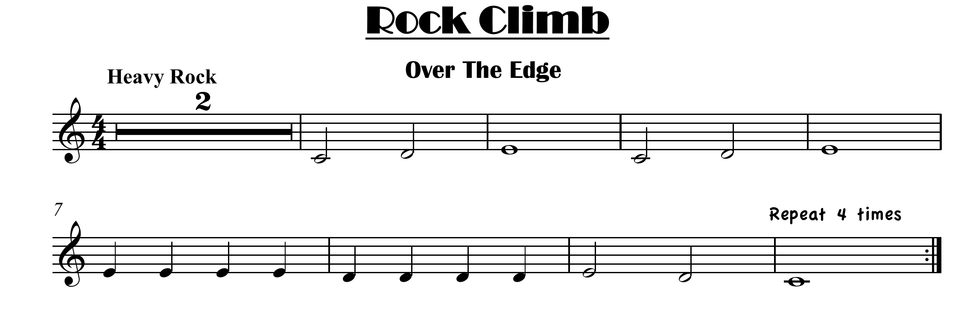
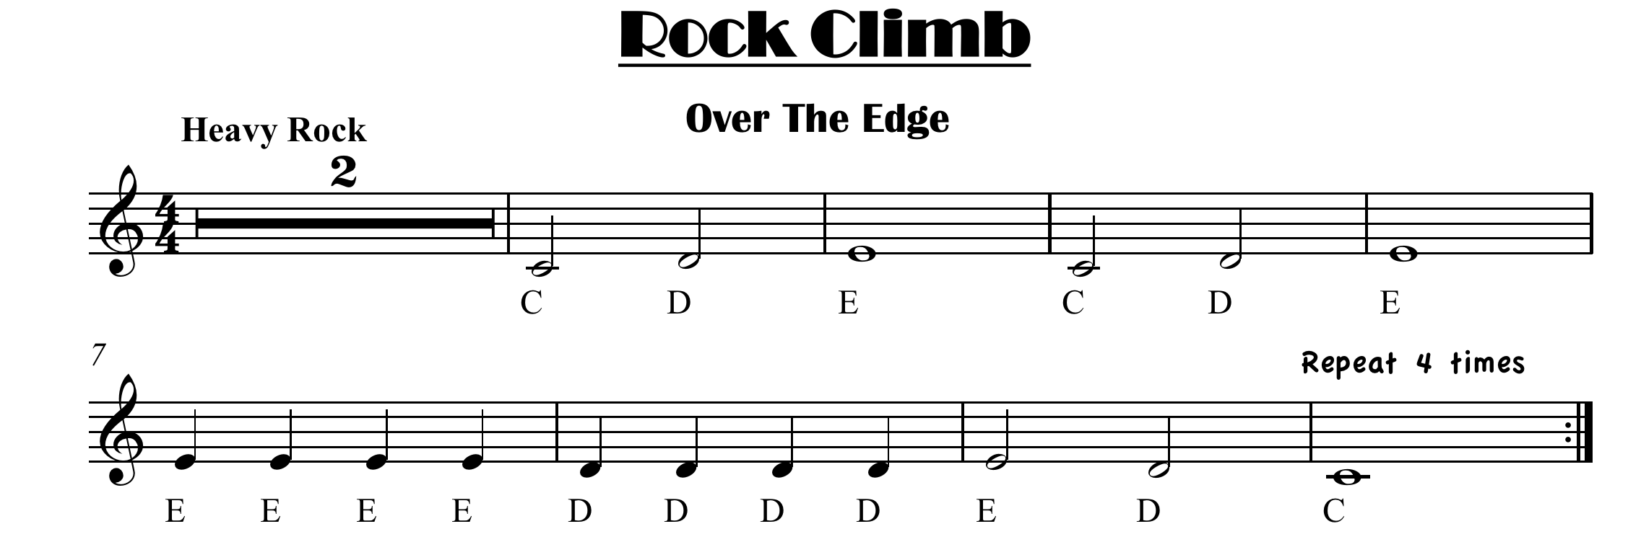
click here for note names

Slide 22
click here for note names

