Slide 1
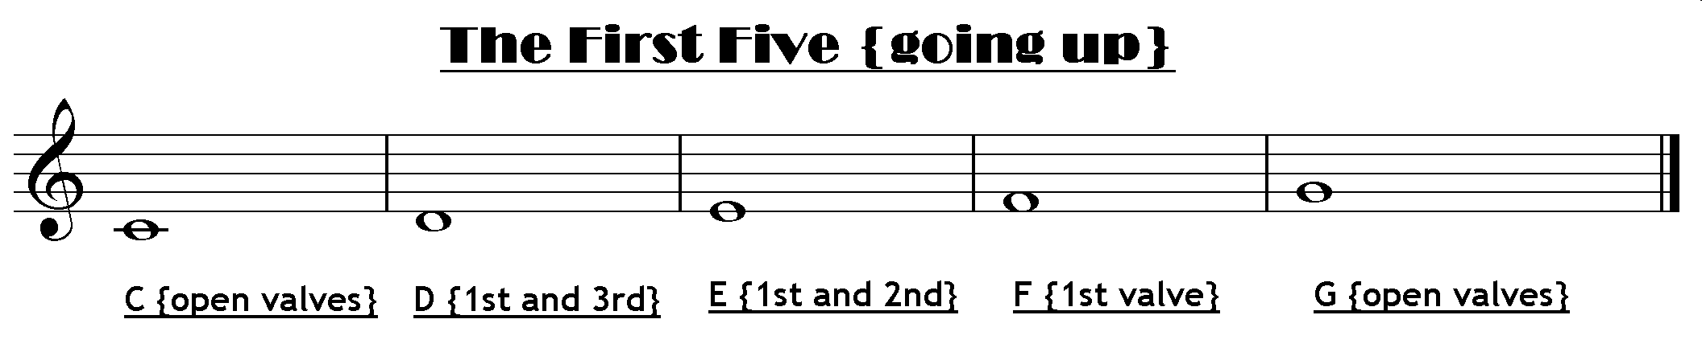
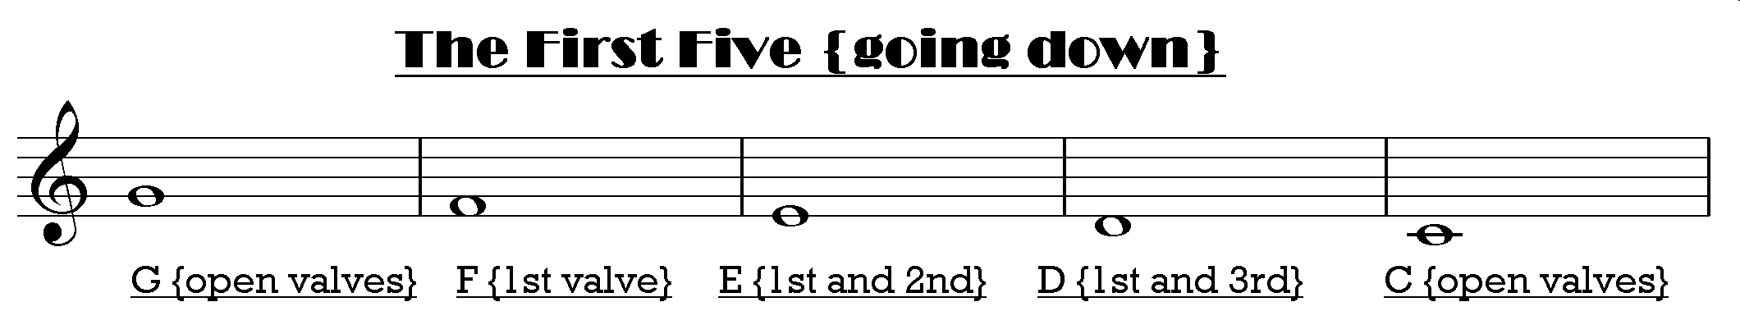
In The 5 Note Scale :-
The first and last note are always played on open valves

Slide 2
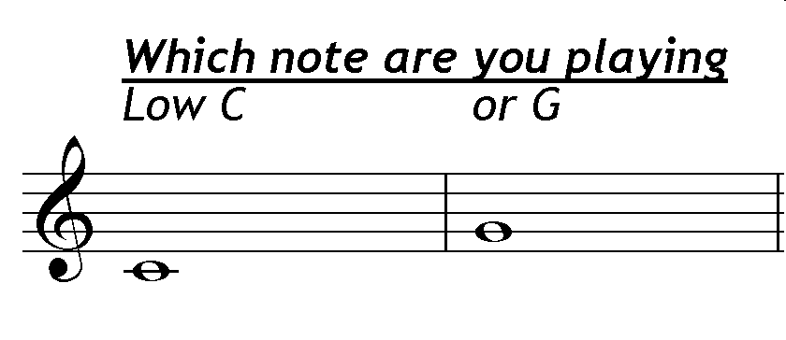

Slide 3
Here are some ideas to think about
Listen To The Sound of Each Note
Learn To Recognise The Sound of Each Note
Try To Hear The Notes In Your Head
Sing The Notes
Buzz Your Lips Tight
Try To Make The Buzz Go Higher and Lower
Do The Same On The Mouthpiece
Check Your Lip Shape
Warm Slow Air –Cold Fast Air

Slide 4
Now
Try :--

Slide 5
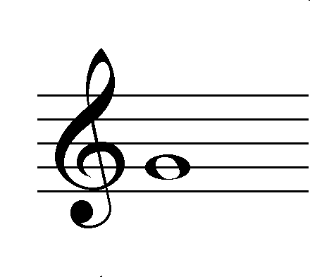
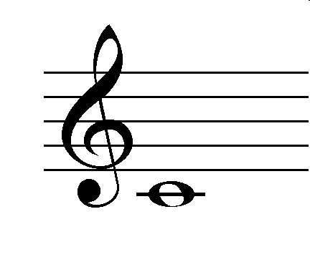

The Pitching Game
Listen:- then copy the pitch
High G
Low C

Slide 6
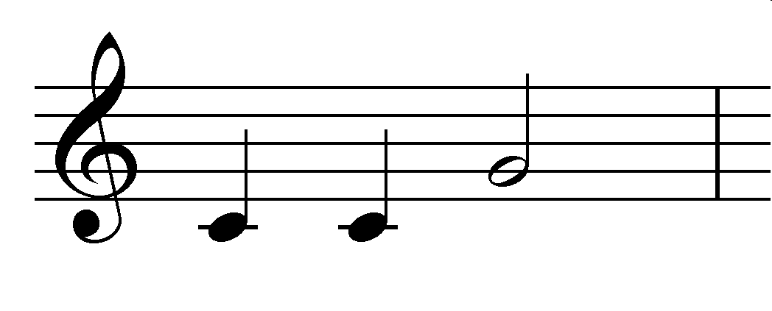
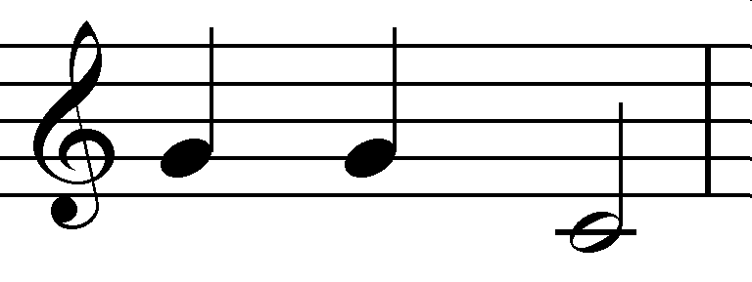
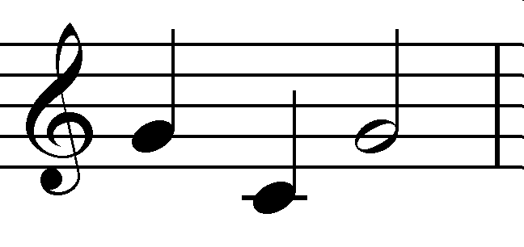
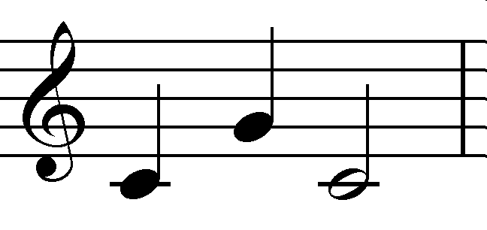
2nd Section

Slide 7
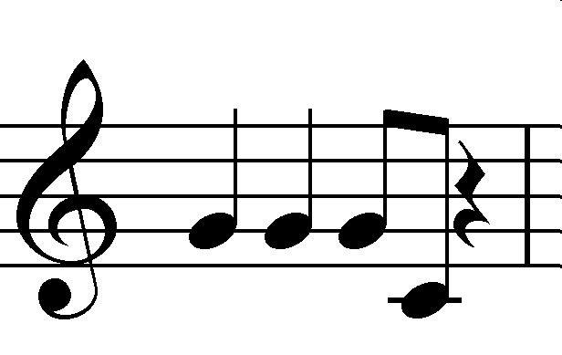
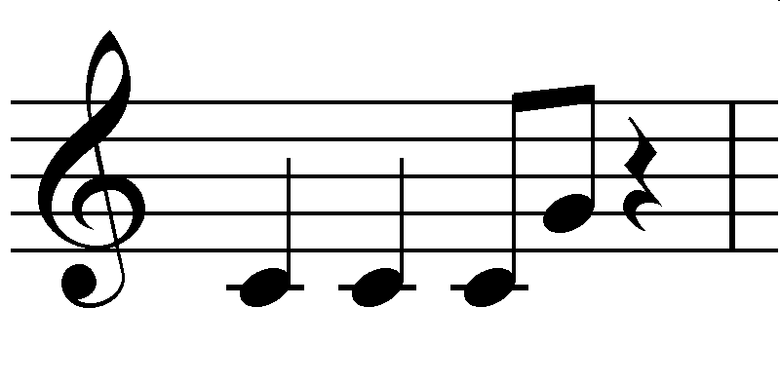
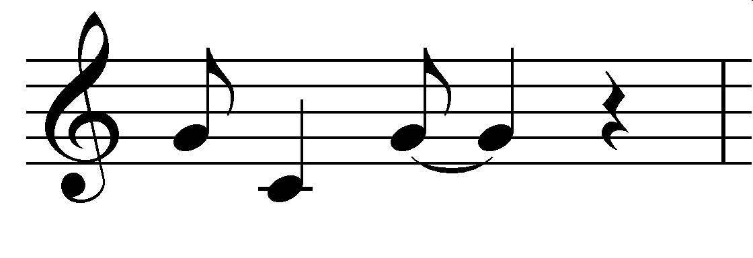
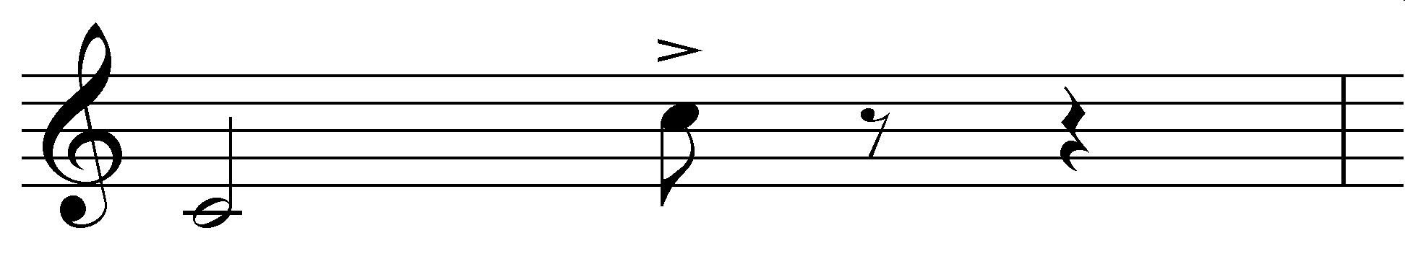
3rd Section
Well Done
Top C (Very High) Open

Slide 8
WCIT 3 more versions

Slide 9
Now Try
“Take The Lead” version

